Slide 1
Interpretivism
Structure Vs Action

Slide 2
Interactionism: Essay Titles
Assess the contributions interactionism has made to our understanding of society. (33 marks)
Assess the extent to which structure/agency debate has been resolved. (33 marks)
Evaluate whether our behaviour is due to structure or action? (33 marks)
Assess the extent to which humans are puppets of society (33 marks)

Slide 3
Starter: Post-it Note Challenge
Write down concepts / writers we associate with interactionism / interpretivism.
SCLY 1
SCLY 2
SCLY 3
SCLY 4

Slide 4
Starter 2:

Slide 5
Some clips …
https://www.youtube.com/watch?v=jFQIIM8IRZU&list=PLhMMvN4zZVbe-aUu9DlZ1ANaVMnFwrNsE
https://www.youtube.com/watch?v=6E66iDghFkg
https://www.youtube.com/watch?v=yJrnwOPC2f8
https://www.youtube.com/watch?v=Ql0XPwtfFGY

Slide 6
In a nutshell…
Interpretivists believe sociology should not model itself on the natural sciences.
The positivist approach is unsuited to human beings.
The subject matter of sociology is meaningful social actions (interactionism).
It is important to interpret these actions and make sense of them.
Interpretivists say sociology is about internal meanings NOT cause and effect – as cause and effect does not always apply to humans.

Slide 7
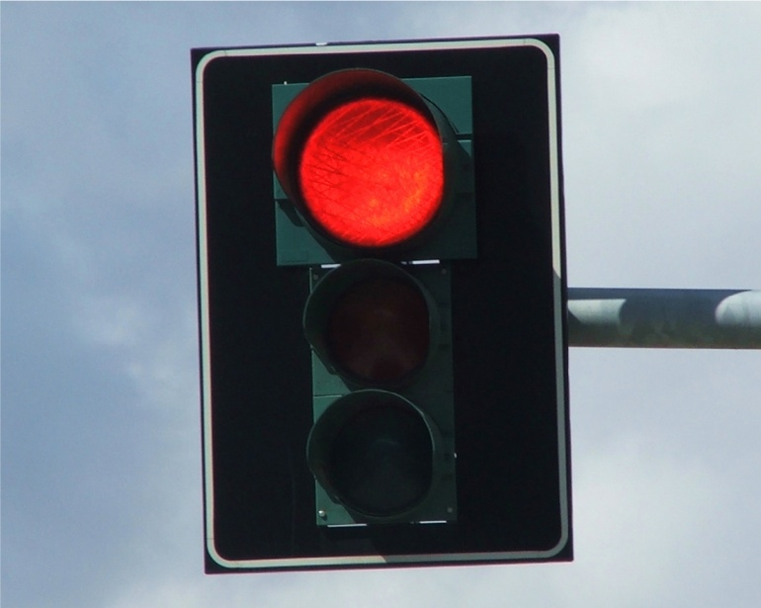
Example: A car approaches a red light and the driver thinks…
Cause
“Oh, red light…That means I have to slow down and stop”
Effect

Slide 8
Is it always that simple?
“I’m late for work…I’ll jump it”
These examples demonstrate that how people act is often determined by the meaning they give to the situation, and how they choose to respond to it.
“I WANT TO RUN THAT OLD LADY DOWN!!!!”
“I’m following that car, I can’t lose it”

Slide 9
If a motorist does stop, it is not because of an external force determining their behaviour, it is because they have chosen to stop.
Interpretivists do not see individuals as puppets on a string, that are manipulated by external ‘social facts’.
We are autonomous, and we construct our world by the meanings we choose to give things.

Slide 10
G.H. Mead (Social Action Theorist)
He argues that people have free will and choice.
They are not like ‘rocks’ in the natural sciences.
Rocks are unconscious, and dependent on external factors/stimuli for change.
Humans are conscious beings who interpret the meaning of a stimulus, then choose how they act upon it.
An apple does not choose when it falls from the tree.
But a human could choose whether or not to eat the apple and explain why they made that choice.

Slide 11

Doorbell
Cause = Press button
Effect = Ringing sound
Human
Cause = doorbell rings
Effect = ?

Slide 12
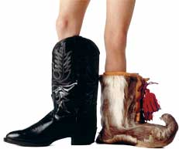
“Wow, I feel like I understand your plight so much better now…”
Verstehen

Slide 13
Verstehen: ‘to understand’
To discover the meanings people give to their actions, we need to see the world from their viewpoint.
Interpretivists abandon detachment and objectivity favoured by positivists.
Weber argued that we must put ourselves in the place of the actor in order to achieve verstehen – empathetic understandings.

Slide 14
So, which methods help us achieve Verstehen and why?
Task: List the methods Interpretivists favour
Task: Now create a detailed paragraph that explains why they favour these methods (in your own words).

Slide 15
Social Action Perspectives
Also known as Interpretivism
Micro Sociology

Slide 16
Overview – 4 variations
Social Action
Symbolic Interactionism
Phenomenology
Ethnomethodology

Slide 17
Social Action - Weber
People hold meanings about the world and consciously act on the basis of those meanings
Weber saw behaviour in terms of the meanings people attach to actions
Verstehen – the aim of sociological investigation should be the creation of an understanding of the meanings, motives and values involved in social actions.
Getting behind people’s actions, finding out why they do what they do.
Protestant Ethic and the Spirit of Capitalism – Weber took the position of a Calvinist believer
What meanings did Calvinists hold about the world?
What actions did they take based on these meanings?

Slide 18
Symbolic Interactionism
Focuses on small-scale interactions rather than on the social structure
How meanings are constructed through social interaction
People have a degree of control and influence over social behaviour

Slide 19
Symbolic Interactionism - Mead
People define and interpret the world through the meanings they attach to it
‘Reality’ (what is real) is therefore a subjective reality (a matter of opinion or interpretation)
The meanings people hold are constructed from and communicated in the form of symbols
Social life is a constant stream of symbolic communication with meanings being constantly negotiated and re-negotiated
People can do this by being able to ‘take the role of the other’

Slide 20
Symbolic Interactionism - Goffman
Dramaturgical analogy – life is like a stage….
As in the theatre, roles are not fixed. People can interpret their roles in many different ways
People are aware they are doing this and life is a process of ‘self-presentation’
We use props, stages etc. to control how we appear to others. This is made possible by our ability to see ourselves as other see us.
Asylums – participant observation – ‘Institutionalized’, ‘disculturalisation’, ‘notion of self’

Slide 21
Symbolic Interactionism - Becker
Labelling theory
Self-fulfilling prophecy
Master status
You know this one :-)

Slide 22
Phenomenology
– Husserl and Schutz
Phenomenology – internal workings of the human mind and the way humans make sense of and classify the world around them.
We have a series of typifications (categories) we use to organise the world as we see it
We have a store of common-sense knowledge which helps in everyday interactions. We assume everyone has these. Phenomenologists believe sociology should be concerned with things on the surface – not things that are hidden

Slide 23
Phenomenologists DON’T look for the causes of phenomena, they look at how we CATEGORISE phenomena
For example, Atkinson (a phenomenologist) looked at suicide. His research was concerned with how coroners reached their verdicts of suicide and what they used to make these decisions (notes, mode of death, location, life history)
The categories and verdicts are therefore social constructions based on common sense typifications of how we see the world.

Slide 24
Ethnomethodology - Garfinkel
The study of the methods used by people to construct, account for and give meaning to their social world. (Atkinson and the methods coroners use in suicide)
Unwritten rules govern everyday situations
Deny there is a real thing called society with a structure, instead we actively construct our social world every time we interact with others
Conversation analysis (Saks), naturalistic (disruptive) experiments (Garfinkel)

Slide 25
Links to issues
Suicide – Douglas and coroners interpretations
Labelling – education, crime, media
Choice of research methods
The issue of value-free sociology
The social construction of crime statistics
Weber – Protestant Ethic and Spirit of Capitalism

Slide 26
Evaluation
Where do meanings and labels come from? The similarity of meanings and labels suggest they come from a social structure.
If individuals have such influence, why do people act in such similar ways? Social structure again?
Social behaviour is not randomly created, it is influenced by the social and historical context
Research methods used do not meet scientific criteria

Slide 27
Tip: Structure and Agency
This is a commonly referred to debate in sociology.
It means structural theories VS social action theories.
Obviously they look at society in different ways (octopus picture)
Are the actions of individuals the prime social phenomena or are social structures the most important aspect of social activity?

Slide 28
Structure VS Agency
Many people think the structure/agency debate is pointless, because most sociologists deal in both aspects.
However, the major perspectives do fit into two the two main camps.
The biggest attempt to dissolve the debate was developed by Giddens (late-modernist) His theory is called structuration, and it stresses that the inter-dependence of structure and agency.
By this, he means that structures (class, family, law, religion) are created by the patterned activities of individuals, who call upon structures to perform those actions.

Slide 29
Weber Soc Action (The ‘founder’)
Mead Symbolic Interactionism
Becker Symbolic Interactionism (labelling)
Goffman Symbolic Interactionism (dramaturgy)
Husserl Phenomenology
Schutz Phenomenology
Garfinkel Ethnomethodology
Giddens Structuration (attempt to resolve the debate)

Slide 30
Symbolic Interactionism
How meanings are constructed through social interaction. How we shape the world through interaction. People have a degree of control and influence over social behaviour
Phenomenology
Phenomenology – internal workings of the human mind and the way humans make sense of and classify the world around them.
Ethnomethodology
The study of the methods used by people to construct, account for and give meaning to their social world

Slide 31
Who would you give flowers to?
Who would you give red roses to?
If your gave your Grandma red roses would it mean the same as if you gave your girlfriend red roses?
Would your Grandma/Girlfriend thank you in the same way?
Meanings are a product of social interaction
Meanings are handled through a process where people try to make sense of situations.

Slide 33
Who would you give flowers to?
Who would you give red roses to?
If your gave your Grandma red roses would it mean the same as if you gave your girlfriend red roses?
Would your Grandma/Girlfriends thank you in the same way?
Meanings are a product of social interaction
Meanings are handled through a process where people try to make sense of situations.

Slide 34
Who’s ever been in a play?
What are you required to do?
What roles do you play?
How do you modify your performance?

Slide 35
Social Action Theory
Says we ‘act’, we do not ‘react’
We make our own choices and take our own action.
We are not controlled by a social structure (unlike structural theories)
Social action theorists see peoples actions as key to studying society
Microsociology – small scale
Society is constructed from peoples meanings, interpretations, behaviours and negotiations.

Slide 36
SOCIAL ORDER is SOCIALLY CONSTRUCTED
People want to believe there is order in society so they behave towards others in a way that convinces them that there is order.
E.g., following social norms such as being polite and not stealing from one another.
Even if we break a law, the law has been socially constructed by people and their interpretations.
The same act can get one person arrested and imprisoned, but just a fine for someone else.

Slide 37
Social action theorists are INTERPRETVISTS because they say sociology cannot be objective – it is always biased
People will always interpret things differently
It is subjective – human behaviour cannot be predicted.

Slide 38
So, Durkheim's suicide typology would be rejected…
According to SA theorists, social facts cannot exist
+ Integration
- Regulation
+Regulation
- Integration

Slide 39
Criticisms
It is too subjective – everything is a matter of interpretation
It is relativist – all points of view are stripped of value
It ignores the wider social context (structures) that individuals act (or react) in (e.g., poverty)
It doesn’t explain social norms. It argues that we just have them because we desire order.

Slide 40
Structuration
Where Structuralism and Social Action theory meet!
Giddens is a structuration theorist
People are subject to restrictions and pressures generated by social structures and systems (e.g. laws)
But, individuals respond to these in different ways (the SA bit)
Individuals have an awareness of the social rules and structures and have some level of choice about how to react to them.
Social structures and systems can be changed by the actions of individuals say structuration theorists

Slide 41
Mindmap task: Match up the theorist to the key term and elaborate on what is means
STRUCTURATION MEAD
DRAMATURGICAL MODEL GARFINKEL
SYMBOLLIC INTERACTIONISM GIDDENS
ETHNOMETHODOLOGY GOFFMAN
THE SELF (‘I’, ‘ME’) BLUMER

Slide 42
Who’s ever been in a play?
What are you required to do?
What roles do you play?
How do you modify your performance?

Slide 43
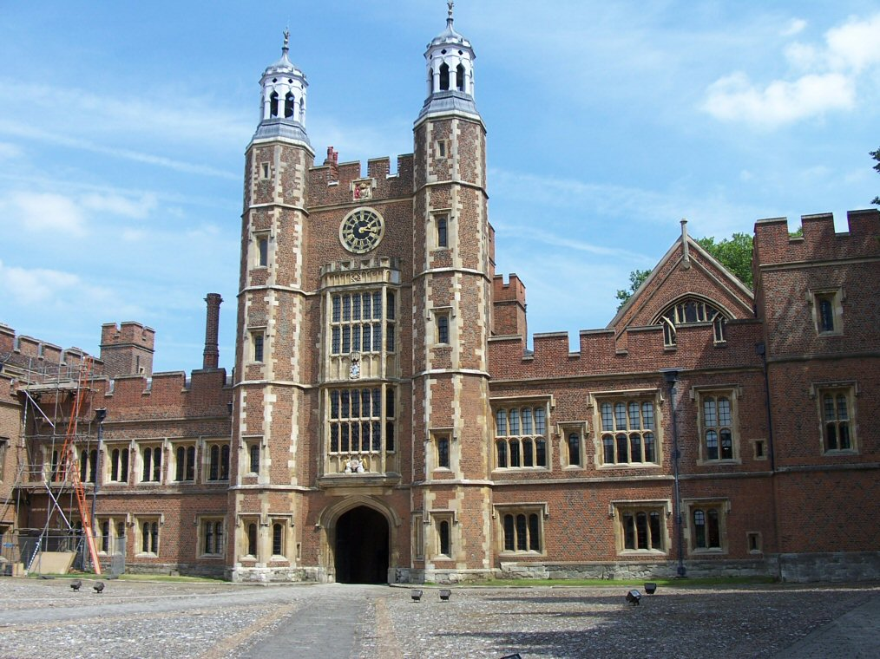
Starter
Discuss what factors may influence why you send your child to a particular school.

Slide 44
Catchment area
Siblings attended
Good exam results
Most local, could walk
Good reputation
Subject specialism
Single sexed school
Passed grammar exam

Slide 45
In pairs
Take the list we have just discussed, and explain which ones would be linked to structural factors and which ones are to do with individual choice.

Slide 46
Structure and agency
To summarise:
Structural approaches emphasise how people are influenced by major structural forces.
Social action studies may describe how individuals operate in society as relatively free agents, creating identities for themselves.

Slide 47
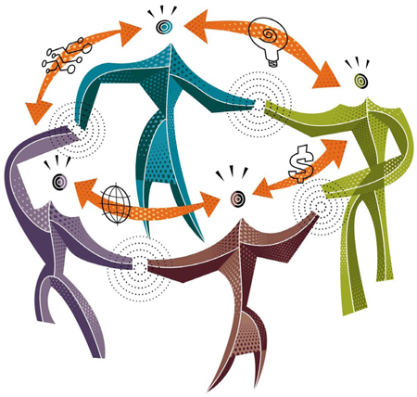
Social action theory
Social action theorists believe that the best approach to the understanding of society is by studying small groups.
Weber

Slide 48
AO2 to Structuralism
One of the criticisms made of some structuralist research, such as work by Functionalists and Marxists, has been that all-embracing theories may be thought of first and then evidence selected to back them up.
Instead SA theorists recommended doing close and detailed observation of some aspect of social life first and then deriving a grounded theory from their findings.

Slide 49
Bottom Up
A good example of grounded theory is the work of David Gillborn. He carried out observations over 2 years in a comprehensive school.
This approach can be described as bottom-up, because the sociologist studies a specific set of behaviours, experiences or attitudes but then identifies their wider relevance by relating them to some aspect of the social structure.
Notes:
Gillborn’s ethnographic study (detailed research of a small group or institution using a variety of methods) was used to suggest one of the reasons for the relative under-performance in school examinations of Afro-Caribbean students. The negative expectations some teachers had of this group and the tendency of some black students to respond defensively to confrontations inevitably connected with ethnic divisions, tensions and stereotypes in society outside the school.
Despite the structural implications of Gillborn’s findings, he chose to conduct his research by closely observing and informally interviewing students and teachers in order to fully empathise with their points of view and experiences through deep immersion. Max Weber described this approach as verstehen (to understand). Gillborn noted how students interacted with each other and with the teachers and how they negotiated roles, not necessarily by talking about them but by modifying their behaviour towards each other in order to achieve a particular goal. For example Paul Dixon was so determined to avoid trouble that he learnt to stay away as far as possible from teachers whom he felt had negative expectations of him and stopped socialising in school with students who frequently got into trouble.

Slide 50
Weber and Social Action
Weber argues that we should avoid generalising theories because people are not determined by general laws.
Social science should proceed by understanding human action.
Weber’s work has been influential in the development of the sociology of everyday life.
Weber’s approach lead to a view called methodological individualism which focuses on how people actively engage in social interaction. Structures do not determine our behaviour.
Weber is critical of Marx, and believes that it is individuals that shape the development of society.

Slide 51
Weber: Different types of social action
Type | Explanation
Traditional Action | Action is carried out because of custom or habit, such as buying gifts at Christmas
Affective Action | Action that is influenced by an emotional state, such as crying at a funeral
Rational value-orientated action | Action that is led by an overriding ideal or value. If a person is committed to a particular religious belief, it is rational within that belief system to prey.
Rational goal-orientated action | This is a highly rational form of action where people calculate the likely results of behaviour in relation to a goal. A student may consider various costs and benefits of different courses of action before selecting a particular behaviour. They may put more effort into an essay for one teacher because they write the student reports.

Slide 52
Criticisms of Weber:
Schutz (1972) argues that the action theory is too individualistic and cannot explain the shared nature of meanings.
Weber’s typology of action is difficult to apply and some actions belong to more than one type of action identified by Weber.
We can never truly understand an individual’s actions so Weber’s idea of verstehen cannot be applied.
Lee and Newby (1983) describe Weber as a methodological individualist who ignores the structure of society.

Slide 53
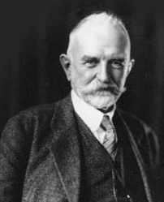
Symbolic Interactionism – Meads Theory
Mead is usually seen as the founder of symbolic interactionism.

Slide 54
Symbolic Interactionism
Symbolic interactionists emphasise the ways in which society is actively shaped by individuals and the meanings they attach to ‘everyday things’.
Symbolic interactionism is usually regarded as a social action theory.
Notes:
Mead argued that humans interact through the use of symbols such as
Symbols can be:
Visual signs (red traffic light = stop)
Visual gestures (waving = hello)
Expressions (frown = angry)
Verbal (scream = fear)
Sounds (siren = emergency)
Shared understanding of these symbols and how to respond to them form the basis of communication.
Whilst we are each conscious individuals, the way in which we choose to behave is influenced by the social context of that behaviour.

Slide 55
The ‘I’ and the ‘me’
G. H. Mead in 1934 described our awareness of how others see us.
The ‘I’ is the spontaneous side of our personality which would like to act freely, but we are aware of the way ‘generalised others’ of our society view us and expect us to behave.
This more inhibiting self concept seen through the eyes of others is termed the ‘me’.

Slide 56

‘The looking glass self’
Cooley (1922) aptly called the me side of our self the ‘looking glass self’, referring to how, after a while, we begin to view ourselves as if others’ eyes are a mirror.
You sure are babe
I’m hot!

Slide 57
How does it link to symbolic interactionism
Symbolic interactionism: A sociological perspective on self and society based on the ideas of George Mead (1934). The central theme of symbolic interactionism is that human life is based on the use of symbols. Through language and communication, symbols provide the means by which reality is constructed.
Mead’s work: Human behaviour is social because people interact in terms of symbols. Symbols stand for other objects and imply certain behaviour. For example; The ‘ no entry’ symbol implies to the majority of people that they cannot enter. Therefore Mead’s work is credible that we follow symbols, however as the majority follow this rule, does this show there must be some sort of collective norms and values? Can we really say that reality being so complex comes down to simply the use of symbols? However, Mead’s work is accurate that we do associates symbols with meanings.

Slide 58
Herbert Blumer
Blumer, 1962 has developed Mead’s approach.
Blumer emphasizes that people do not react automatically to external stimuli but interpret their meaning before reacting (for example, interpreting the meaning of a red light before deciding how to react to it)
Meanings develop during interaction and are not fixed.
Rules and Structures restrict social action and shape the interpretation of meaning to some extent, but they are never absolutely fixed.

Slide 59
http://www.youtube.com/watch?v=Ql0XPwtfFGY&feature=related

Slide 60
How useful is Mead’s theory to an understanding of society?
Although Meads theory is over 70 years old, humans do relate the meanings of symbols to what they do, i.e at a red traffic light, the majority of people would stop. Therefore, Mead is correct to an extent.
However, Mead states that we as individuals shape society, but for the majority to abide by the symbols, rules and regulations there must be some sort of collective conscience, norms and values.
In order to have shared meanings, it must feed of some sort of structural factors .

Slide 61
Labelling Theory
Perhaps the most well known application of symbolic interactionism is labelling theory. Developed initially by H Becker it has been used widely in Education and Deviance.
We all label people and objects
Those with power are able to label someone, and make others accept that label
Labelling of humans can lead to a self-fulfilling prophecy
If the label is especially damaging, it can become a master status
Notes:
Look at the work of Goffman and the dramaturgical analogy

Slide 62
Dramaturgy
http://www.youtube.com/watch?v=UdNQ4SuinEI&feature=related

Slide 63
Evaluation of symbolic interactionism
It over-emphasises the significance of the individual. There tends to be little conception of social structures.
It cannot explain power relationships in society in the way that Marxists or feminists have. It does not explain why some individuals / social groups are more powerful than others.
It concentrates too much on small-scale, trivial aspects of social life, therefore ignoring the much bigger picture of life at a society-wide level of analysis.
The dramaturgical analogy is weak because at times we are actors and audience members.

Slide 64
Evaluation
It believes that nearly everything is socially constructed – so logically one could argue that sociology is itself a social construct, and therefore useless?
It fails to explain social order and social change.
Ethnomethodologists believe it fails to explain how actors create meanings
Reynolds (1975) found evidence that interactionists ignore power and class as being important concepts of interactionism.

Slide 65
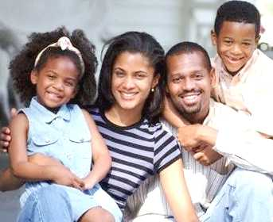
Ethnomethodology
Ethnomethodology, another type of social action approach, can certainly be described as micro sociology as it examines how people speak to each other and interact in everyday conversations and in relationships within their own homes.
Notes:
Look at sheet

Slide 66
Phenomenology
Phenomenology is another branch of social action theory with a slightly different emphasis. It examines the social construction of particular phenomena and the results of this subjective way of seeing and talking about them (a discourse) on people’s attitudes and behaviour.
Notes:
Look at the sheet
Complete the vocab check sheet and bottom up sheet

Slide 67
The difference between structural theories and social action theory
Social Action Theory
Analysis starts at the level of the individual
Socially negotiable symbols and social roles.
People interact on the basis of their perception of themselves and other people.
Individuals perceptions of themselves as social beings.
Structural Theories
Analysis starts at level of society
Consists of various subcultures that operate to maintain society.
Culture consists of dominant values.
Individual behaviour is heavily influenced by dominant values.

Slide 68

Structuralist approach
The macro or structuralist approach to society is adopted by Marxists, functionalists and feminists. They believe that by studying the major groupings or strata in society we can explain the experiences of individuals.
They believe in a process of reification: which is where society is seen as a thing that exists and acts independently of individual action.
Durkheim
Marx

Slide 69
Structure
Theory | Structure
Durkheim | Social facts are external, objective and restraining
Parsons | A social system made up of institutions that fulfil basic needs. Society is a functional unit.
Merton | The goals and means of society
Marx | Capitalists society consists of a base that determines the superstructure. A structure of inequality and power relations between the bourgeoisie and the proletariat.
Althusser | Society is a social formation of economic, political and ideological levels. ISA reproduces and legitimises inequality.
Frankfurt School | A culture industry produces and satisfies false needs.
Walby | Structures of patriarchy oppress women.

Slide 70
Structure, Agency or both?
The structure/agency debate is an important discussion in sociological theory.
It involves two main questions:
  To what extent are people constrained and determined by social structures?
  To what extent do people have agency? To what extent are they free to act as they choose?
Agency: ability to act independently of structure
Social Structure: pre-existing social arrangements that shape behaviour.

Slide 71
Four positions
Position 1: Structure determines action | Position 2: No such thing as society beyond action
Social systems of functional institutions (Parsons) Economic, political and Ideological levels (Althusser) Structures of patriarchy (Walaby) Criticism: underplays the importance of agency | Act on the basis of meanings (Symbolic Interactionism) Methods create a sense of order (Ethnomethodology) Dramaturgical analogy (Goffman) Criticism: rejects the concept of structure
Position 3: Structure and action are not separate | Position 4: Structure and agency are linked
Structuration: Giddens Criticism: loses sight of structure | Life world and system (Habermas) Recognises how systems and action intersect

Slide 72
Structuration and Life world and system
Using pages 382 and 383, create a theory card for:
  Giddens and Structuration theory
  Habermas and Life world and system
http://www.theorycards.org.uk/card01.htm

Slide 73
Criticisms of Structuration Theory:
Archer (1995) claims that Giddens underestimates the capacity of structures to resist change. For example, slaves may want to abolish slavery but lack the power to do so.
According to Craib (1992), the structuration Theory isn’t a theory but a description of things we find in society such as actions, rules and resources.
Giddens fails to explain how his theory applies to large-scale structures such as the economy and the state.

Slide 74
Check understanding
Rank the following concepts in order of your level of understanding (i.e. A= good)
Social Action theory
Ethnography
Interactionist
Labelling
Social constructionist
Interpretive
Self
Verstehen
Structuration

Slide 75
Exam Practice
Assess the extent to which structure/agency debate has been resolved.
(33 marks)
Notes:
Set this as an essay – or complete in class

Slide 76
Home Learning
Each person will be given an area of Theory and Methods to research.
We are creating our own student guide.
You must produce revision material for the topic you have been given =2 sides of info.
It needs to be succinct (no long text – bullet if necessary) Use other sources – not just our textbook. (LIBRARY)
If you don’t do this, you’re letting the class down ☹ You have two weeks.

