Slide 1
A2 Sociology Today’s objectives
Reflect on suicide essay feedback.
Evaluate individual student progress.
Create a ‘killer’ conclusion.
Understand expectations of synoptic.
Explain the link between theory and method
Evaluate the usefulness of functionalism

Slide 2
Essay Feedback
Assess the usefulness of different sociological approaches to suicide. (21 marks)

Slide 3
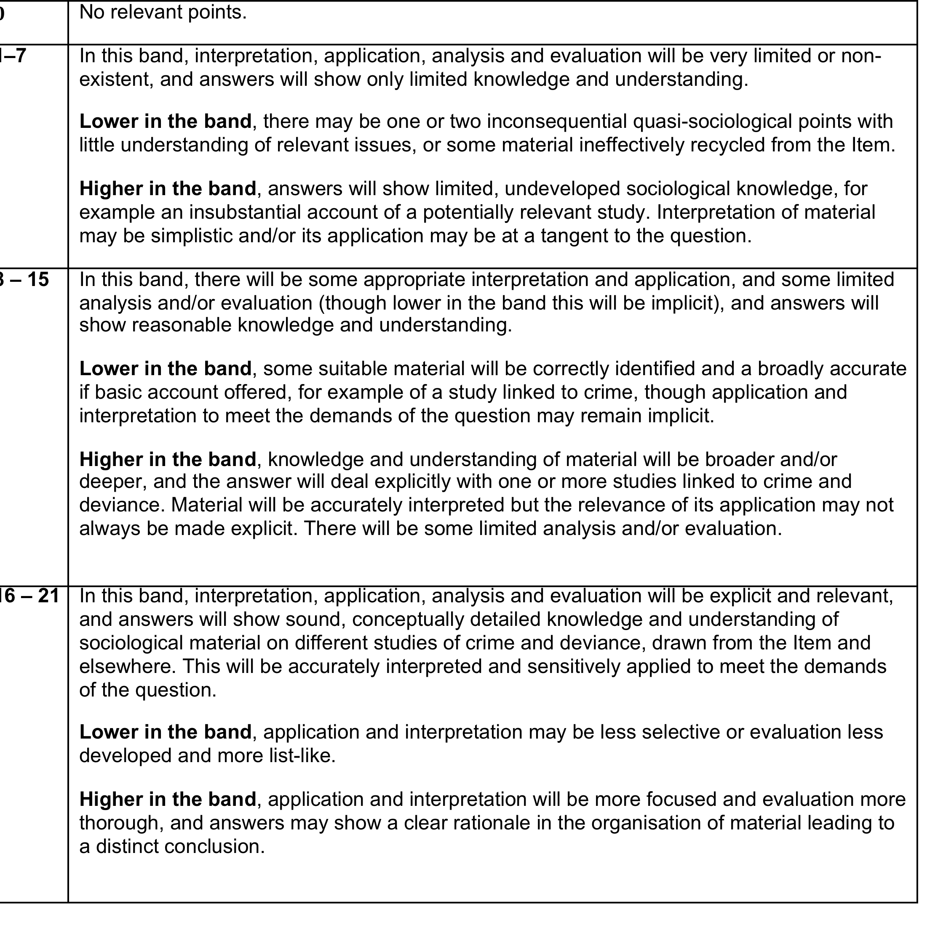

Slide 4
Student Progress Activity
Complete your Essay Tracker (Blue sheet).
Post-it Note Activity
Look back over your essays – what are the consistent targets or suggestion.
What have you improved?
What needs development?

Slide 5
Killer Conclusion
Useful because
Not useful because
Reliability
Validity
Meaning
Cause and effect
Correlation
Combination
Assess the usefulness of different sociological approaches to suicide. (21 marks)

Slide 6
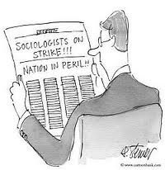
Synoptic
Define me!

Slide 7
Synoptic
Greek words σύν (syn "together") and ὄψις (opsis "view"), and describes observations that give a broad view of a subject. (OED)
Synoptic assessment
Encourages students to combine elements of their learning from different parts of a programme and to show their accumulated knowledge and understanding of a topic or subject area.

Slide 8
What the exam board say
Synoptic assessment in GCE Sociology is
assessed in the A2 units by requiring candidates
to demonstrate that they have developed
holistic understanding of the subject. In order
to demonstrate the level of expertise required,
candidates are expected to be able to interrelate areas of content and address the requirements at A2 using appropriate concepts, knowledge and skills developed throughout the course.
GCE Sociology, as a subject, is inherently synoptic.
There is a natural progression from AS to A2 and, at A2, the sociological concepts, theories and methods of enquiry studied in the AS course are revisited and applied to new contexts, requiring a higher degree of selectivity in their application, analysis, interpretation and evaluation.
In both A2 units there are questions that are
particularly synoptic, requiring candidates to
draw together and synthesise the knowledge,
understanding and skills learnt in different aspects
of the course. Furthermore, in Unit 4 there are
questions that require candidates to create
hypotheses/solutions, etc to problems that go
beyond the strict limits of the knowledge, skills and understanding studied within the unit.
These questions provide greater stretch and
challenge for all candidates and will enable the
performance of the most able candidates to be
identified through the award of an A*

Slide 9

SCLY 4 Theory & Method Section.
The challenge:
One 33 mark essay.
40 minutes of your life.
Be synoptic.

Slide 10
Theory & Methods – The synoptic bit.
In pairs – look at the overview diagram and consider the key questions opposite.
What are the key theories in Sociology?
Who are the key writers?
What is the link between theory and method?
Why is Feminism and Post-modernism not on this diagram?

Slide 11
The Specification SCLY 4 – Synoptic Bit
9 subtopics.
Types of Question
Assess the usefulness …
Assess the view …
To what extent do sociological arguments support this view …
Assess the contribution …
Assess the value …
Evaluate …

Slide 12
The 33 mark – Mark scheme
A01
Knowledge and Understanding (15m)
A02 (a) Interpretation and Application (9m)
A02 (b)
Analysis and Evaluation (9m)

Slide 13
Assess the usefulness of functionalist theories to our understanding of society.
33 marks.

Slide 14
Synoptic Activity
In groups, summarise and critique functionalist ideas and writers from:
Unit 1 – Family
Unit 2 – Education
Unit 3 – Religion
Unit 4 – Crime and Deviance

Slide 15
Did you get any of the following…
Consensus theory Structural theory
System value consensus Organic analogy
Positivism Macro theory Parsons
Shared norms and values
Durkheim Institutions Social solidarity
Expressive roles Instrumental roles
Collective conscience

Slide 16

Functionalism
How might this image describe Functionalism?

Slide 17
General Summary and Critique of Functionalism.
Can you use these ideas and merge your content from the synoptic activity?
What might the structure of the essay be?
What is the killer conclusion?

Slide 18
Plenary: Plan the essay.
5 – 6 Paragraphs.

Slide 19
To finish…
If you were asked to summarise Functionalism with a basic or sketch or drawing what would you draw?
Be prepared to explain your masterpiece.

Slide 20
Functionalism is a Modern theory
Modern does note necessarily mean ‘brand new’.
The modern period evolved as a result of the Enlightenment of the mid 17th century until the middle of the 20th century.
This was a period of IMMENSE scientific discovery that prompted industrialisation, capitalism and rationalisation.
Rationalisation refers to how scientific, empirical facts came to replace many religious or supernatural explanations.

Slide 21

Example…

Slide 22
Why is Functionalism modernist?
It has a rational outlook on social issues.
There are identifiable causes of social issues like poverty and suicide.
Its approach to studying society is scientific (Positivism) and large scale (Macro theory)
Society can only evolve and improve over time – it will update constantly and become more efficient.
Durkheim was an early sociologist whose ideas became known as Functionalist, but Parsons is credited with developing Functionalism and making it popular in the 40’s, 50’s and early 60’s.

Slide 23
The Organic Analogy
Body | Society
A self-regulating system of inter-related and inter-dependant parts | Made up of inter-related organisations and institutions that link together
The system has needs: Nutrition; exercise etc – without which the body will die. | Society needs to socialise its members if society is to continue harmoniously.
The circulatory system carries blood and oxygen, essential for survival | The economy helps maintain the social system by meeting the need for food and shelter (to keep society’s members going)

Slide 24
The Warning Function...
Cohen argues that, like a body, if society is ‘unwell’ there will be certain symptoms.
Eg, if you has a kidney problem, your skin might turn yellow. With society, something like a rise in a particular offence or protesting might be a symptom that society is ‘ill.’
The sub-systems and institutions then need to pull together (like the immune system) and change/adapt in order to get better
Can you think of any examples of the warning function?

Slide 25
Value Consensus
....Is the glue that holds society together
A shared, common culture or value system provides norms and values for communities, and lays down rules about how they should behave.
In order to have social order (harmony), the majority must agree on these norms and values (which will inevitably alter over time)
In order to feel attached to society and its norms and values, citizens must feel integrated...

Slide 26
Integration
For Parsons, the system has two mechanisms for ensuring that individuals conform to shared norms and meet the systems needs (contribute)
Socialisation: Performed by the many agents
Social Control: Rewards for conformity and punishments for deviance keep us in line and remind us of what is acceptable.
Punishments could be formal (prison, fines) or informal (social stigma, labelling)

Slide 27
OBVIOUSLY, Functionalists think Primary and Secondary Socialisation is very important

Slide 28
Parsons takes a building block approach...
THE SOCIAL SYSTEM
THE SOCIAL SYSTEM
Society’s needs
Food, energy/power, production
Shops, banks, farms, services, Army/defence
Sub-systems
The Police, schools, the family, Church
Institutions
Parent, teacher, Police officer
Status-roles
Authority, equal treatment etc
Norms dependant on status/role
Actions of an individual
Contribute to the social system

Slide 29
Parsons identified 2 types of society…
Task: On the worksheet, look at Parsons’ differences between Traditional and Modern societies.
In pairs, see if you can complete the next column - the norms of late-modern or postmodern societies.

Slide 30
Functionalism and Society
Part 2

Slide 31
Parsons and the GAIL model
He said that society had four needs that had to be met in order for the most basic society to survive and evolve.
He believed society had 2 Instrumental needs (essential) and 2 expressive needs (emotional)
This model is referred to as the GAIL model

Slide 32
Task:
Each person will be given one of the ‘problems’ that Parsons believes society must address.
Read it through, and see if you can identify whether this would be an INSTRUMENTAL or EXPRESSIVE problem for society.
Then try and think of any examples of this problem (in our society)
Then, as a group discuss which sub-systems or agents of socialisation seek to eradicate or handle this problem.

Slide 33
The GAIL scheme outlines four core functions that are required for any society to be able to persist over time

Slide 34
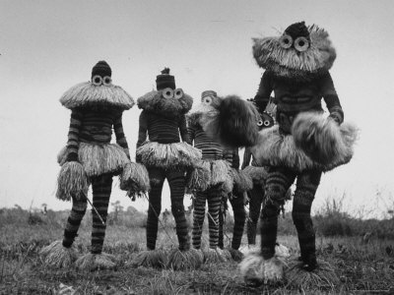
So, Parsons believed that in order for a society to survive the GAIL model needs to be effectively addressed. This is true of even small, less ‘advanced’ or ‘civilised’ societies.

Slide 35
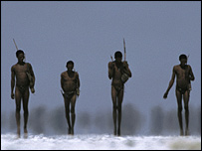
They need to have a set of goals and a system to make decisions about such things as when to migrate to better hunting grounds.
(G)oal attainment

Slide 36
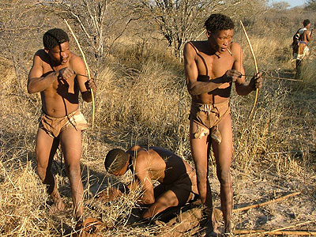
For example a tribal system of hunter-gatherers needs to gather food from the external world by hunting animals and gathering other goods.
(A)adaptation

Slide 37
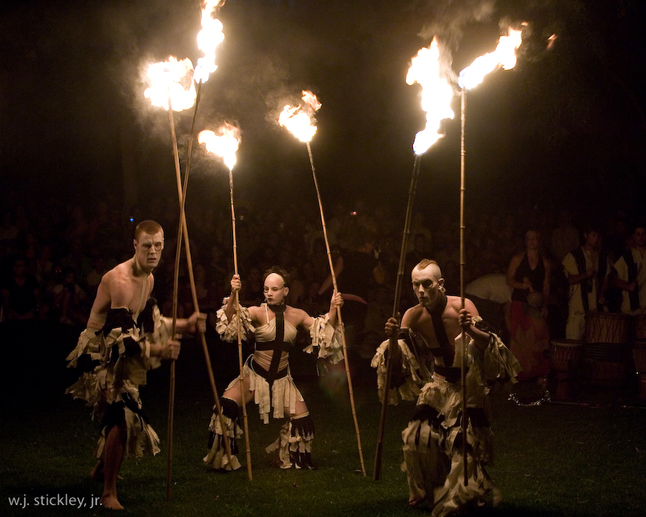
The tribe also needs to have a common belief system that enforces actions and decisions as the community sees fit.
(I)ntegration

Slide 38

Finally there needs to be some kind of educational system to pass on hunting and gathering skills and the common belief system. If these prerequisites are met, the tribe can sustain its existence.
(L)atency

Slide 39
So, each of the 4 points of GAIL are core functions, that are served by key institutions/agents of socialisation

Slide 40
Social Change
Parsons believed that society was constantly evolving. His theories are evolutionary.
Societies constantly adapt and reshape.
Parsons believes that society is constantly moving away from the idea that the kinship system (family) performs multiple roles.
The development of specialist institutions that peform duties once done by the kin is called STRUCTURAL DIFFERENTIATION.

Slide 41
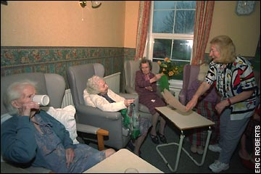
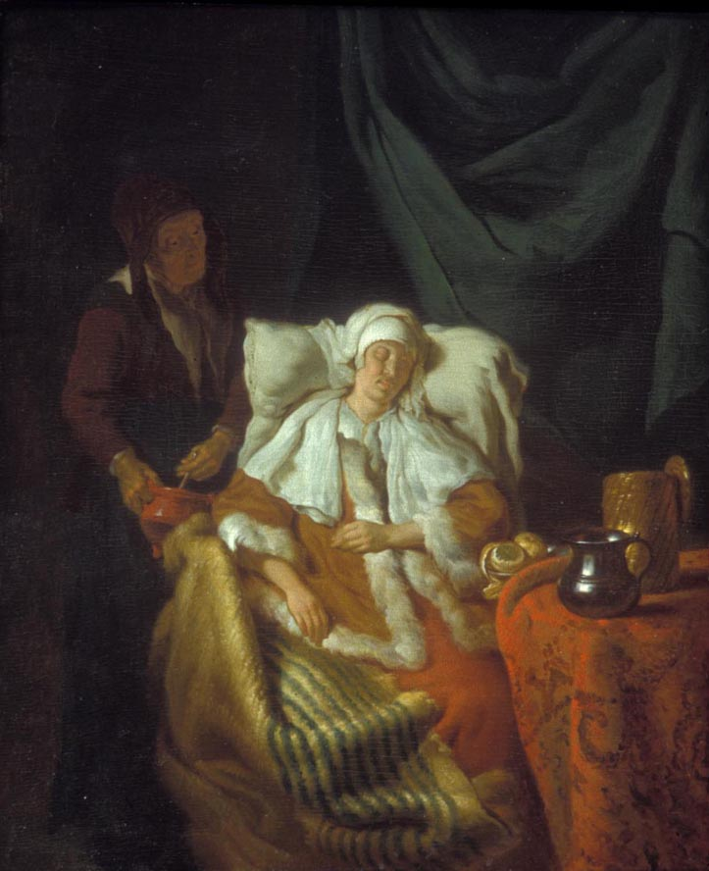


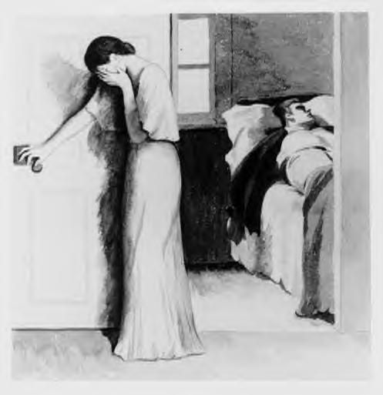
TRADITIONAL MODERN

Slide 42
Society NEEDS the four functions in order to be maintained and survive.
These needs shape the structure of institutions like the law system, economy, government, education system and family
These institutions require people to contribute, its requires them to act in order to meet the demands of society.

Slide 43
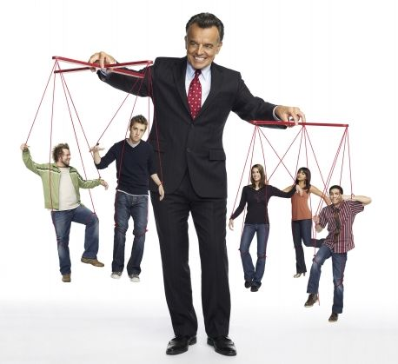
SOCIETY
The strings are the institutions
ACTORS (CITIZENS)

Slide 44
So...
Functionalism is a STRUCTURAL THEORY, because society shapes people and their behaviour.
People are meeting the demands of society.
Social institutions and effective socialisation are a big part of this.

Slide 45
Home Learning – For next Fri
Make a revision page (using the photocopies and your own research) about the Functionalist perspective. Word-process, use images and please bring it to next lesson. It will be used.
Complete the table explaining the GAIL schema/system

Slide 46
GOAL ATTAINMENT
Society needs to set out goals, prioritise, plan and allocate resources to achieve goals.
It needs to handle threats from other societies/nations.
-Expressive or instrumental need?
-Examples
-Who/what in society meets these needs?

Slide 47
ADAPTATION
The social system meets the material needs of its members.
Providing the necessary means of survival for people to live.
-Expressive or instrumental need?
-Examples of members needs
-Who/what in society meets these needs?

Slide 48
INTEGRATION
The different parts of the system must be integrated together in order to pursue shared goals.
People need to understand what the goals or ethos of a society are so that there can be value consensus and social solidarity.
-Expressive or instrumental need?
-Examples
-Who/what in society meets these needs?

Slide 49
LATENCY
Latency refers to processes that maintain society over time.
These sub-systems deal with pattern maintenance (socialisation into norms, values and roles) and tension management (providing a place to ‘let off steam’)
-Expressive or instrumental need?
-Examples
-Who/what in society meets these needs?

