Slide 1
A2 Theory - Essay Titles (33 marks)
Assess the view that Marxist theories are no longer relevant to our understanding of society.
Evaluate the usefulness of Marxist approaches in Sociology.
Assess the view that Marxist explanations of the nature of contemporary society are no longer valid. ( 33 marks)
Assess the contribution of Marxism to our understanding of society. June 2013

Slide 2
Marxism Quotes
From each according to his ability, to each according to his needs.
The history of all hitherto existing society is the history of class struggles.
A spectre is haunting Europe; the spectre of Communism.
The theory of Communism may be summed up in the single sentence: Abolition of private property.
In place of the bourgeois society, with its classes and class antagonisms, shall we have an association, in which the free development of each is the condition for the free development of all.
The bourgeoisie has torn away from the family its sentimental veil, and has reduced the family relation to a mere money relation.”
The proletarians have nothing to lose but their chains. They have a world to win. WORKING MEN OF ALL COUNTRIES, UNITE!
“The oppressed are allowed once every few years to decide which particular representatives of the oppressing class are to represent and repress them.”
Religion is the sigh of the oppressed creature, the heart of a heartless world, and the soul of soulless conditions. It is the opium of the people.
The philosophers have only interpreted the world, in various ways. The point, however, is to change it.
There is no royal road to science, and only those who do not dread the fatiguing climb of its steep paths have a chance of gaining its luminous summits.
Capitalism: Teach a man to fish, but the fish he catches aren't his. They belong to the person paying him to fish, and if he's lucky, he might get paid enough to buy a few fish for himself.”

Slide 3
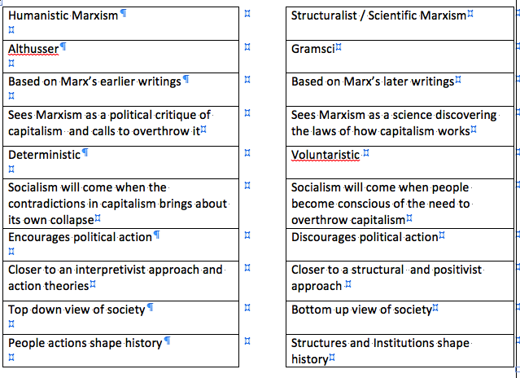
Comparisons

