Slide 1
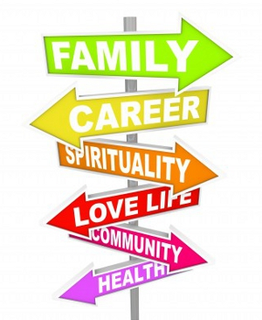
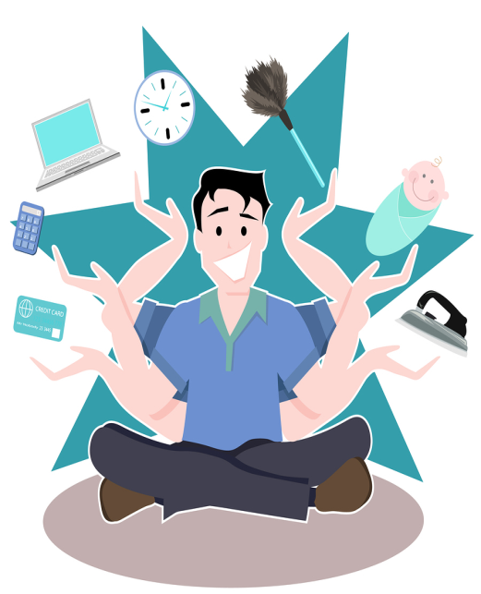
Personal life
The notion of a personal life, as now understood, is in part a creation of modern Western society.
People in the west, especially, place a high value on privacy, individualism and their pursuit of self-definition.
In modern times, many people have come to think of their personal lives as separate from their work. Work and recreation are distinct; one is either on the job or not, and the transition is abrupt. The common phrase "Work hard, play hard" illustrates this mind-set.
There is a growing trend, however, toward living more holistically and minimising such rigid distinctions between work and play, in order to achieve an "appropriate" work–life balance.
The concept of personal life also tends to be associated with the way individuals dress, the food they eat, their schooling and further education as well as their hobbies, leisure activities, and cultural interests. Increasingly, in the developed world, a person's daily life is also influenced by their leisure use of consumer electronics such as televisions, computers and the Internet.
Other factors affecting personal life are an individual's health, personal relationships, pets as well as his home and personal possessions

Slide 2
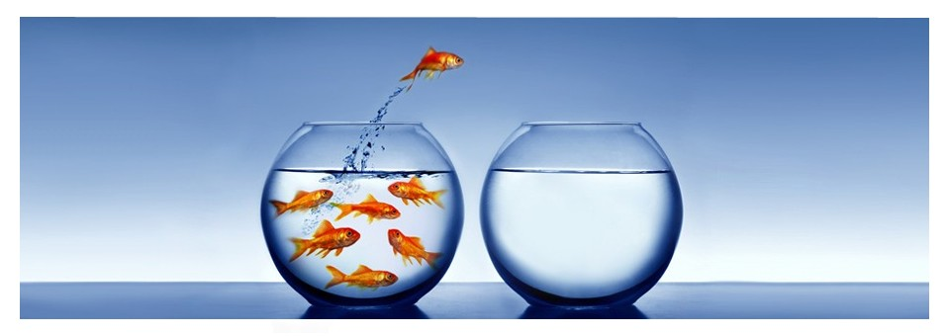
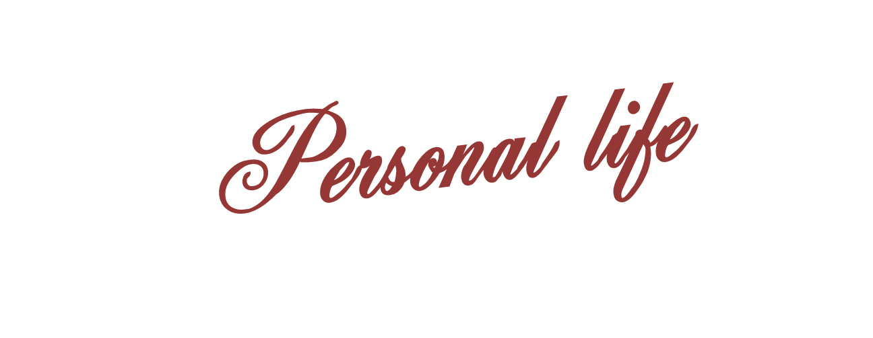
and the family
In order to understand families we must look at the view of the individuals and the meanings they give their relationship.

Slide 3
and the family
When does a ‘family’ mean more than blood or marriage ties?
We form relationships with people who aren't our family in the traditional sense of the word but our close to us in ways which make them like family.
How legitimate is it to count pets, friends and dead relatives as family?
Give reasons

Slide 4
and the family
Relationship with friends
Fictive kin – close friends you treat as family e.g. auntie
Gay and lesbian chosen families – supportive network
Relationships with dead relatives who continue to shape lives
Pets – children in particular (Tipper)
donor conceived children
Nordqvist & Smart – Relative Strangers
Donor children make definition of family difficult. Are siblings raised in another home family? What about donor grandparents?

Slide 5
and the family
The British family has changed in modern times - with pets widely considered to be much-loved members, according to new research.
The findings from Ancestry.co.uk, the family history website, show 90% of pet owners think of their animal as part of the family.
A third (33%) of those even claim to prefer their pets to real life members of their family, with one in six (15%) considering their pet more important than their cousin.
one in 20 owners confessing they have commissioned a professional portrait of their animal.
Nearly one in 10 (9%) of dog owners love the animal so much that they are planning on leaving money or assets to them in their will.
pampered pets

Slide 6
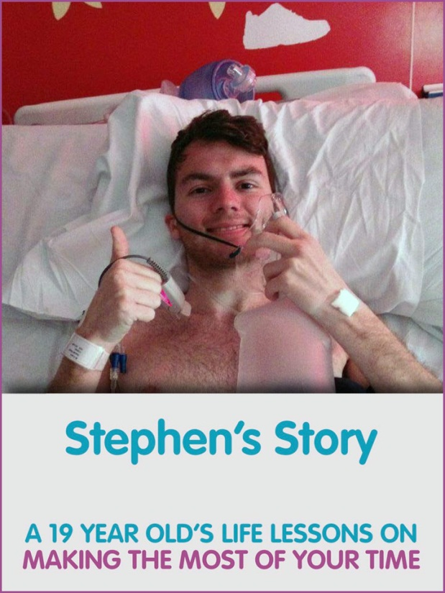
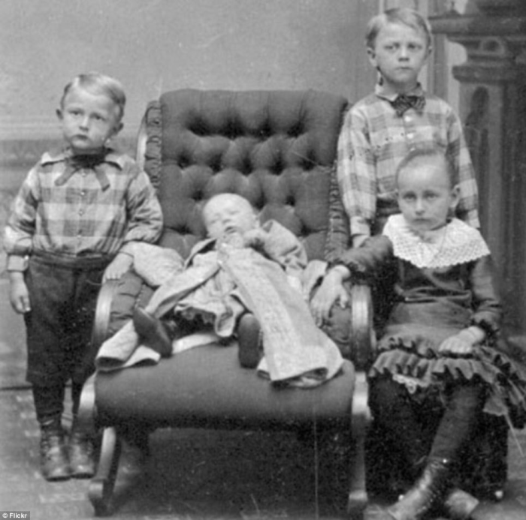
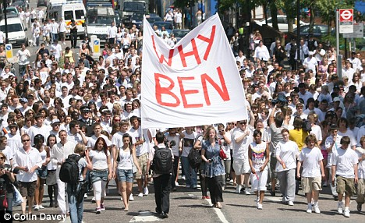
and the family

Slide 7
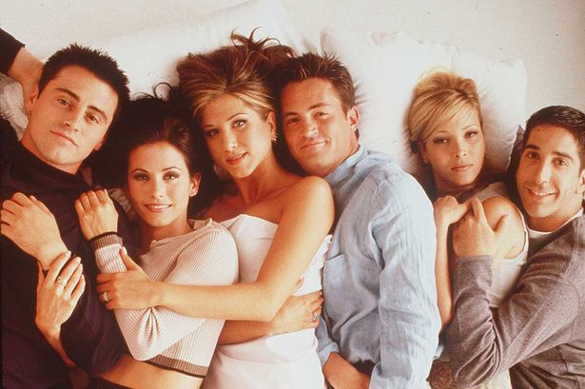
Friends are the new family
Sasha Roseneil has been interviewing people between the ages of 25 and 60 who live outside conventional relationships. In the New Statesman this week, she writes: "Far from being isolated - solitary individuals who flit from one unfulfilling relationship to another - the majority of the people we interviewed were enmeshed in complex networks of intimacy and care, and had strong commitments and connections to others. Increasingly it is friendship that really matters in people's lives. In or outside heterosexual couples, the people we interviewed were turning to friends for emotional support."
Sue Heath of the University of Southampton's department of sociology has been looking at the lives of the growing "neo-tribes" of twenty-somethings living communally and putting off the day when they will, with great caution, enter couple relationships. These young people prioritise friendship and, she argues, their experience of communal living may well be leading to "long-lasting significant ties of intimacy among friends". For Heath, friendship is rapidly gaining a significance that was once reserved only for family members.
Other researchers have noticed something similar happening among growing numbers of older people, often divorced parents, who choose to centre their lives on their children and friendship networks, and keep their romantic lives separate.
This rapidly growing trend has even been given a name to help sociologists keep an eye on it. If you live with your children and visit your lover then you are living in a "Lat" relationship - living apart together. With two out of five marriages ending in divorce it is clearly risky to put all our emotional eggs in the marital basket.

Slide 8
and the family
AO3 - how can you use this approach to evaluate structuralist theories?
Functionalism – explain how this criticises the idea of consensus
Can you also evaluate…
Marxism
Feminism

