Slide 1
Paper 2: Families and Households
Revision

Slide 2
Activity 1: Specification
1. Red – Amber – Green the content.
Postcards – Things I do not know …
Write a question.

Slide 3
Weak topics?
Social Policy?
Childhood?

Slide 4
What types of question can we expect to see?
Explain / Define (2 marks)
Using one example, briefly explain how (2m)
Suggest THREE reasons / factors (6 marks)
Outline and explain two ways (10 marks)
Applying the material from the item, evaluate the view / contribution … (20 marks)

Slide 5


Slide 6
Activity: Using the item.
Using these items what type of questions do you think could come up for
2m
6m
10m
20m

Slide 7
Who Said What …
In groups, create some ‘Who Said What’ cards from your part of the specification.
OR
20 Content Questions from your topic.

Slide 8
Whiteboards … Quick Quiz.
Key concepts.
If this is the answer, what is the question?

Slide 9
Adding Evaluations …
Key Concept Cards for each topic.
Add the evaluation points.

Slide 10
Paper 2: Families and Households
The Short Questions

Slide 11
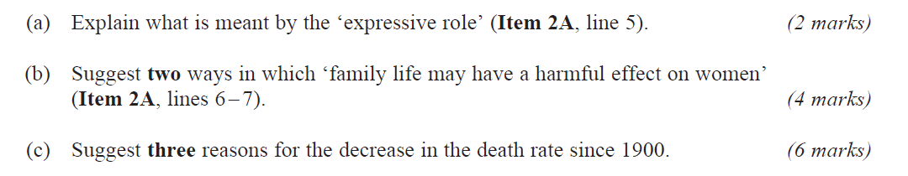
January 2009

Slide 12
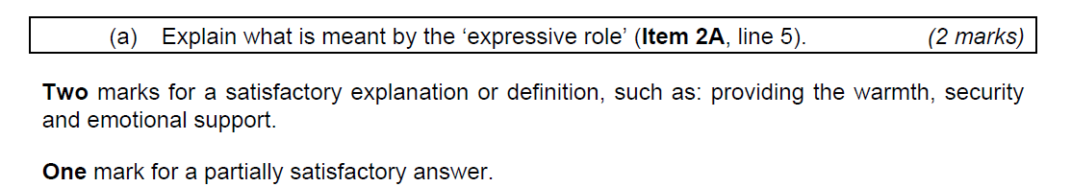
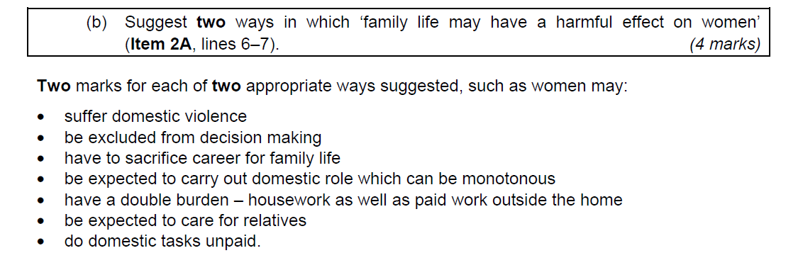
January 2009 - Answers

Slide 13
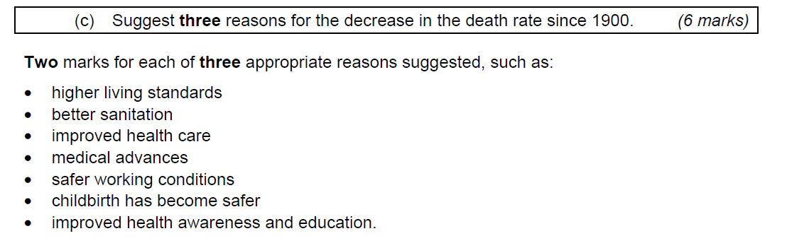
January 2009 - Answers

Slide 14
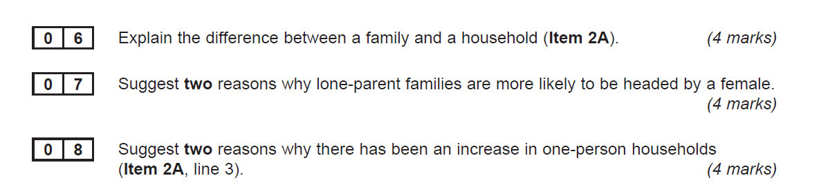
June 2009

Slide 15
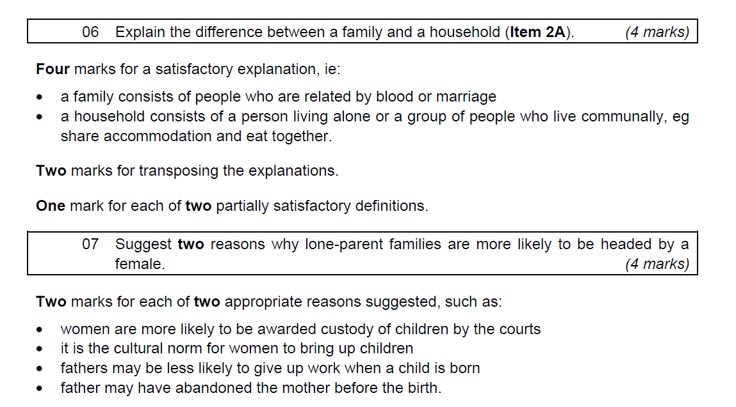
June 2009 - Answers

Slide 16
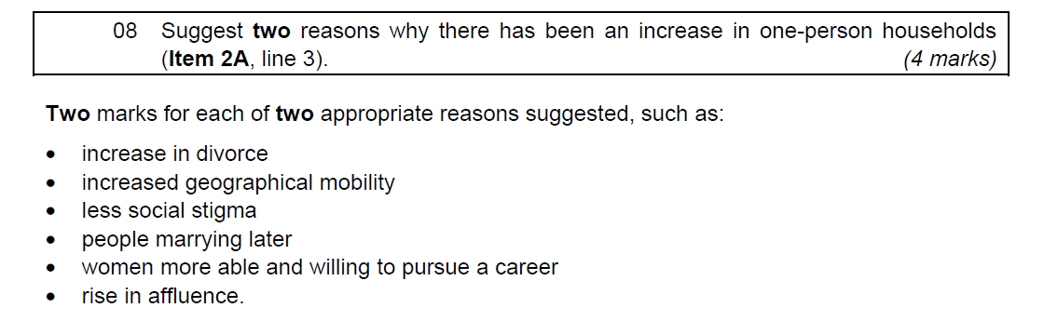
June 2009 - Answers

Slide 17
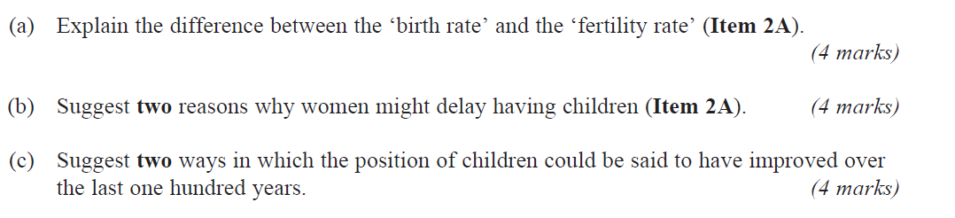
January 2010

Slide 18
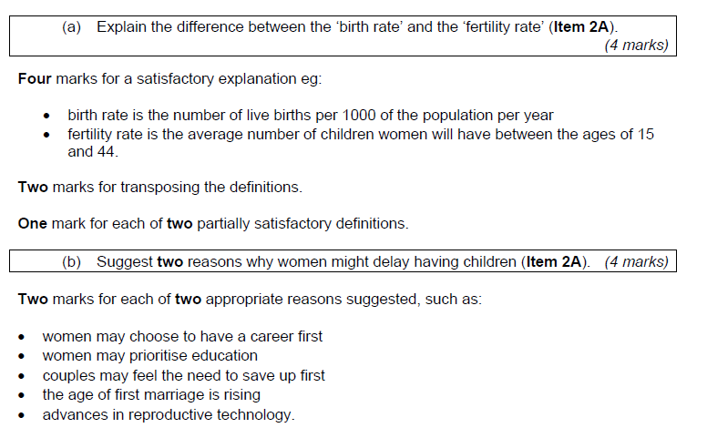
January 2010 - answers

Slide 19
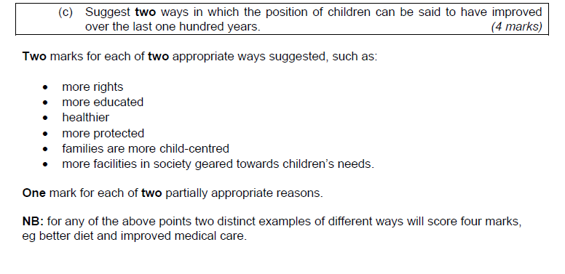
January 2010 answers

Slide 20
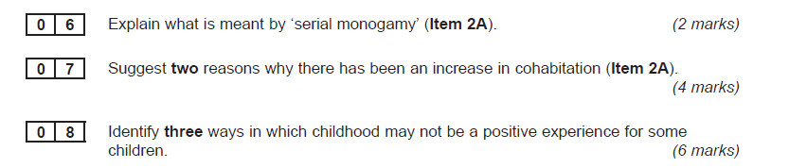
June 2010

Slide 21
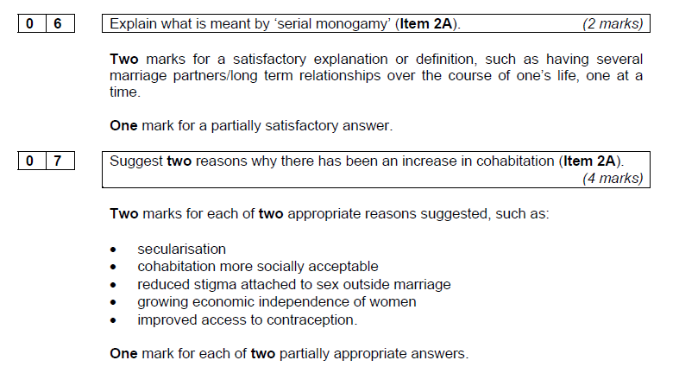
June 2010 Answers

Slide 22
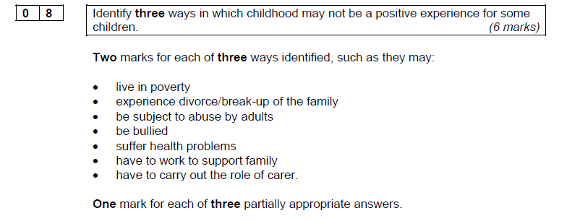
June 2010 Answers

Slide 23
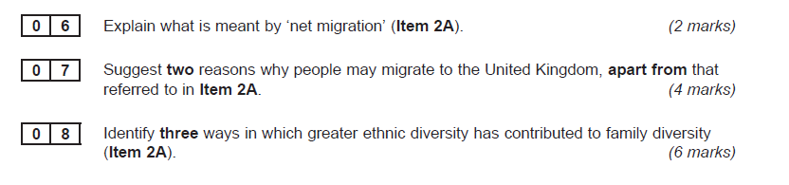
January 2011

Slide 24
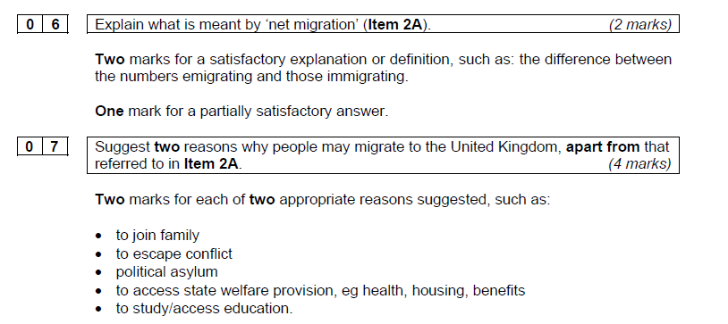
January 2011 Answers

Slide 25
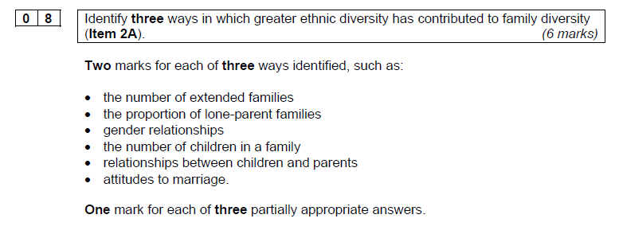
January 2011 Answers

Slide 26
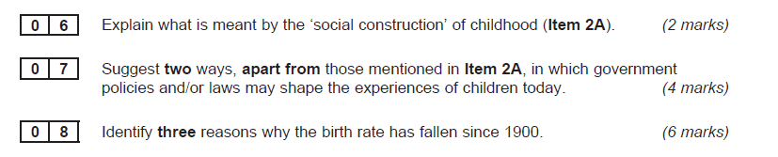
June 2011

Slide 27
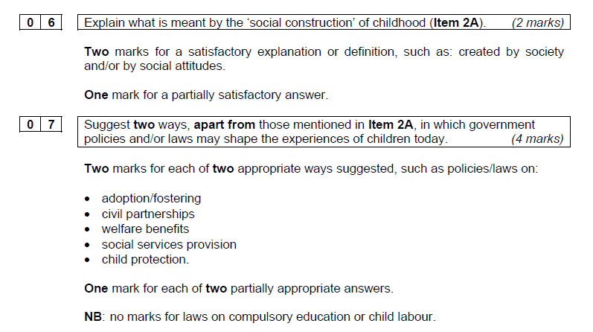
June 2011 Answers

Slide 28
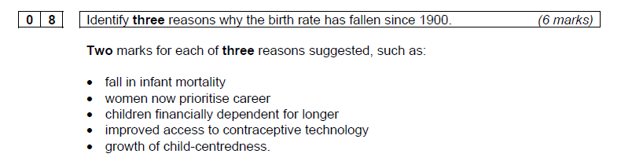
June 2011 Answers

Slide 29
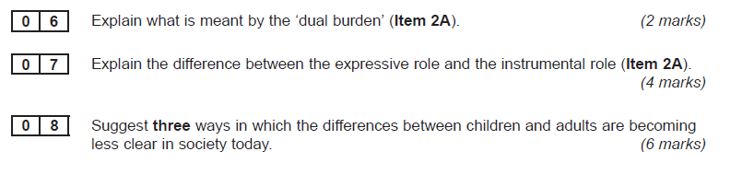
January 2012

Slide 30
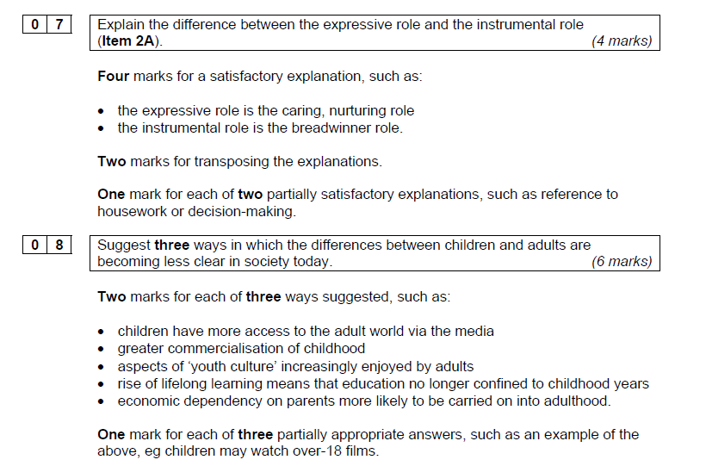
January 2012 Answers

Slide 31
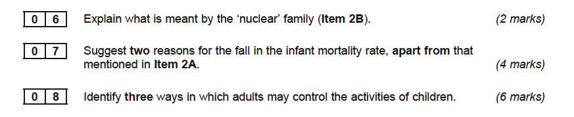
January 2013

Slide 32
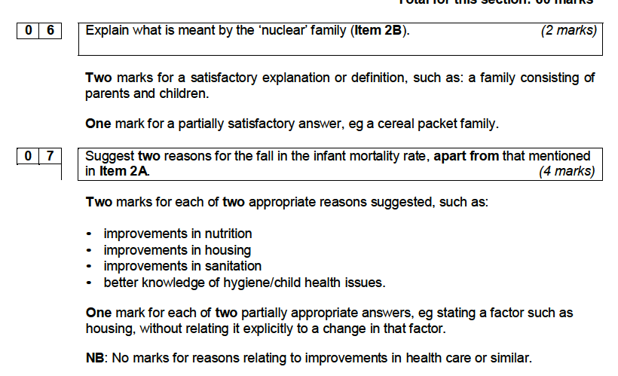

Slide 33
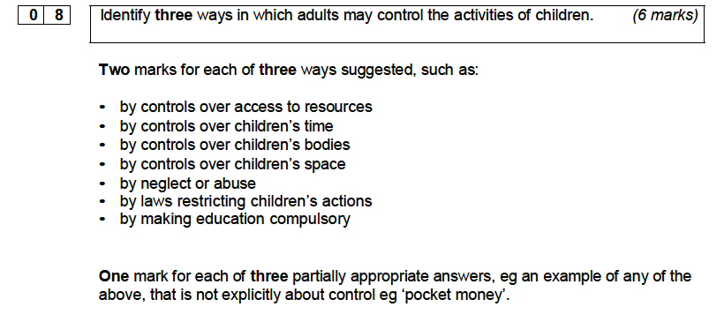

Slide 34
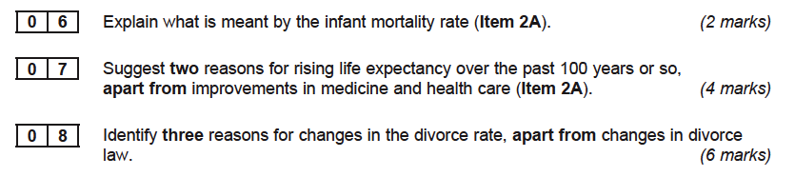
June 13

Slide 35
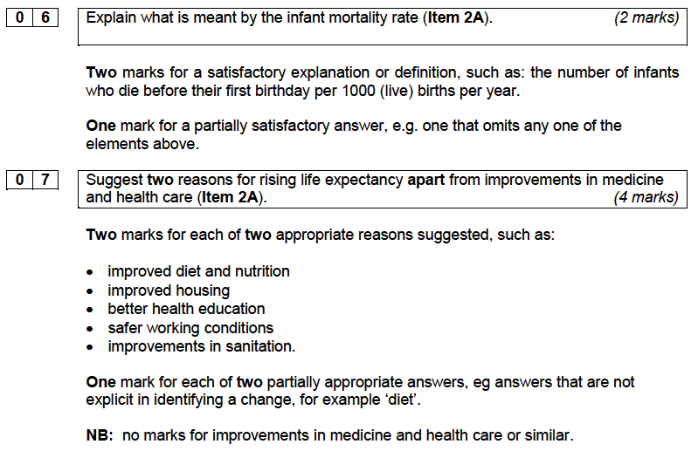

Slide 36
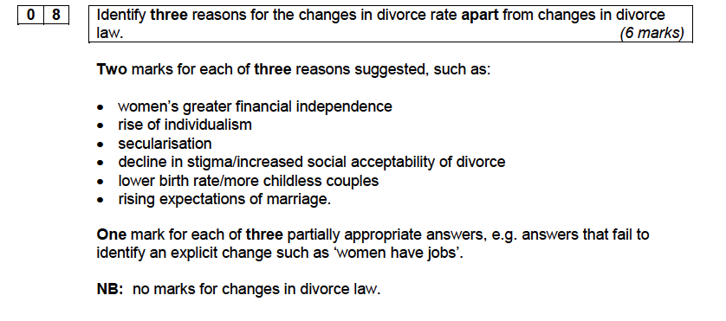

Slide 37
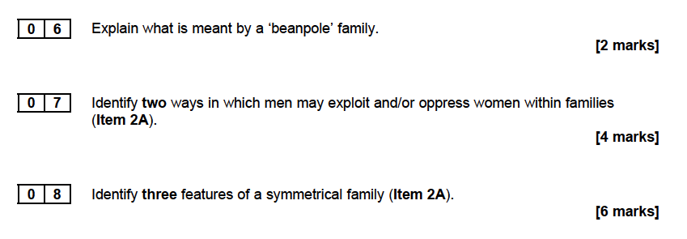
June 2014

Slide 38
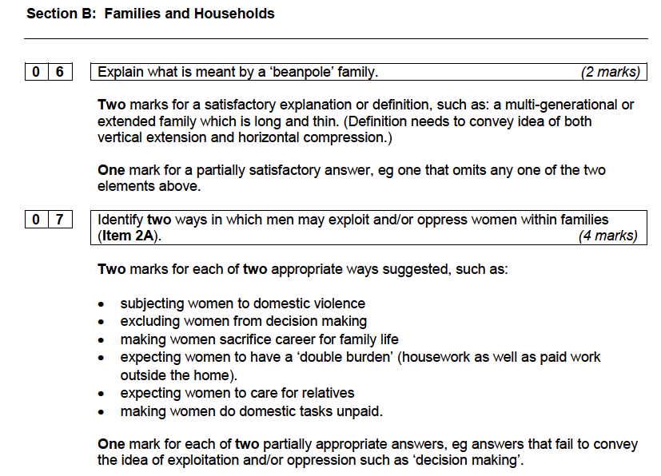

Slide 39
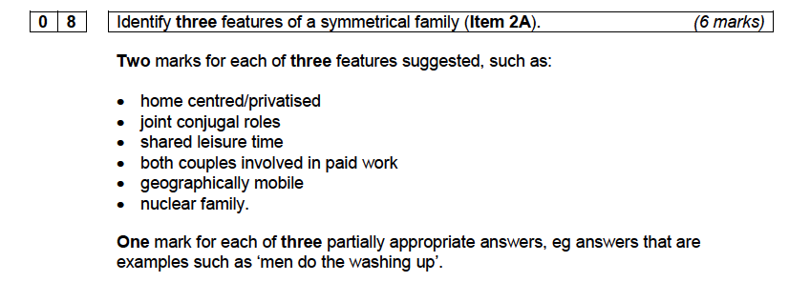

Slide 40
Paper 2: Sociology of Families and Households
Question Matrix – what came up when?
Plan all 20 mark questions.

