Slide 1
If Not Now, When?
2. If Not You, Who?

Slide 2
Growth Vs Fixed Mindset
https://www.youtube.com/watch?v=brpkjT9m2Oo

Slide 3
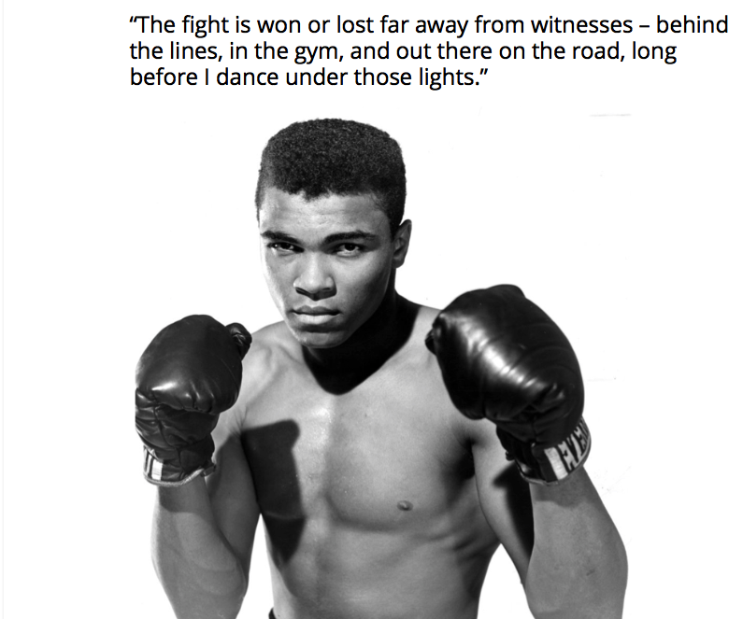

Slide 4
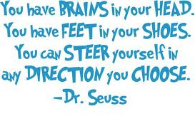

Slide 5
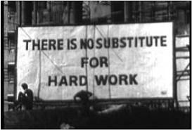

Slide 6
My Year 13 2013-2014
Dilene:
AS results: CDDE A2 results: BBC Economics: E – B
Kelly:
AS results: BBDD A2 results: A*AB Sociology: D-B
Charlie:
AS results: BCCD A2 results: A*BC Sociology: C-A*

Slide 7
Create your own story…..
Khushal:
AS results: CEEU A2 results: BBE
Jesal:
AS results: BDEE A2 results: ABC Geography: E - C
Elwira:
AS results: EEUU A2 results: BDB Psychology: E – B
Nicole:
AS results: ACCE A2 results: A*AB

Slide 8
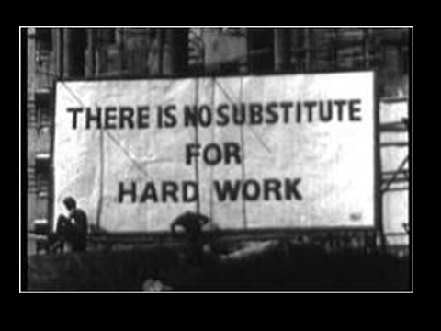

Slide 9
Success…How bad do you want it?
http://www.youtube.com/watch?v=UizlkbS61mQ

Slide 10
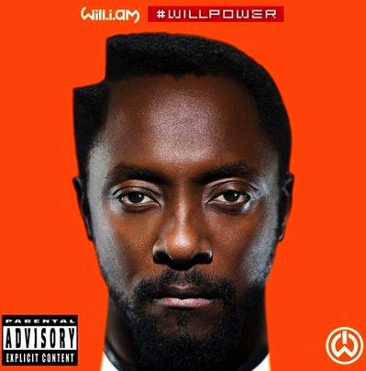

Noun: Willpower
control deliberately exerted to do something or to restrain one's own impulses.
"a stupendous effort of will"

Slide 11
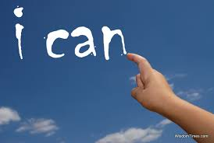

Slide 12
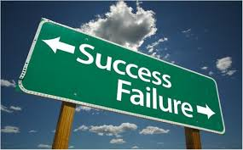
Mr H’s Top Tips for Willpower

Slide 13

1. Learn Healthier Habits
Turn wished for behaviours into habits.
Building routines to prompt you into the new behaviour.

Slide 14
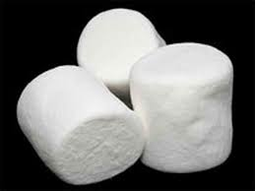
2. Distract Yourself
In Walter Mishel’s classic marshmallow study, the kids able to resist for longer tended to adopt distraction strategies such as covering their eyes or singing to themselves.

Slide 15
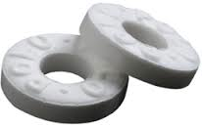
3. Have A Mint
Acts of self-control deplete glucose levels and in turn lower levels of blood glucose may lead to weaker performance on self-control tasks.

Slide 16
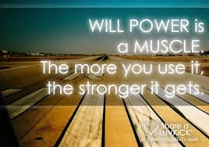
4. Train Your Willpower
Use your inner-voice.
‘Keep going’
‘You can do this’
‘Don’t give up’

Slide 17
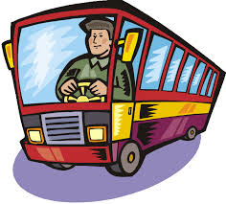
5. Climb Aboard The Mind-bus
Imagine you are the driver of a ‘mind-bus’ and all the difficult thoughts are awkward passengers. How would you confront these awkward passengers? Rehearse the methods.

Slide 18
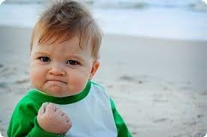
6. Clench Your Muscles
Various forms of muscle flexion, from fist clenching to calf muscle tightening, can augment your willpower by evoking non-conscious goal-related thoughts and emotions.

Slide 19
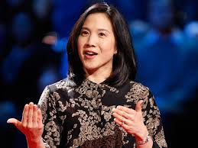
The key to success? Grit
https://www.youtube.com/watch?v=H14bBuluwB8
There is no strong correlation between IQ and grades.

