Slide 1
UCAS: What next?
Login to UCAS track
View your offer letter
Conditional
Unconditional
Unsuccessful
Withdrawal

Slide 2
Replying to offers
Firm
Insurance
Decline
https://www.ucas.com/ucas/undergraduate/apply-and-track/track-your-application/replying-your-offers

Slide 3
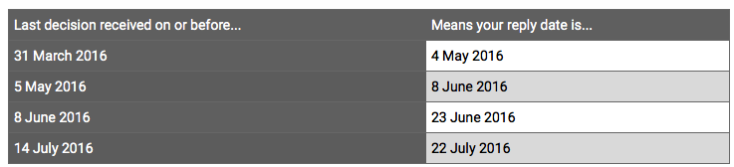
Deadlines for replying

Slide 4
No offers …
5 rejections or declines
UCAS Extra February – July.
Search for courses with Extra availability
Contact universities to see if you are suitable.
Apply for one course at a time.
Some institutions may accept an emailed amended personal statement.

Slide 5
Interviews Invitations
https://www.ucas.com/ucas/undergraduate/apply-and-track/track-your-application/interview-invitations

Slide 6

Interviews
https://www.youtube.com/watch?v=6AwsegxfzN8

Slide 7
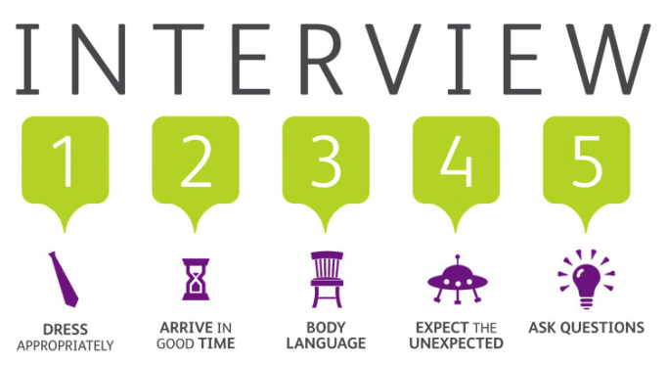
Notes:
1. Plan ahead
Check where and when – sort out any travel and accommodation you need – check their website for maps and directions.
Be ready for questions – some about your application, as well as your chance to ask about the course and the uni/college.
Know your stuff – show you know the latest in your subject area, and keep up to date with the news – they might ask to hear your views.
Practice – have mock interviews with a teacher or adviser – cover why you chose that course and what you enjoy most about your current studies.
Sleep well!
2. The interview
Dress smartly – you might not need a suit, but smart trousers/skirt and a shirt/blouse will show you're taking it seriously.
Get there early – have their phone number handy so you can let them know just in case you're delayed.
Good body language – don't slouch, yawn or fold your arms – stay calm and alert, sit up straight and make eye contact.
Don't worry if you don't understand – ask them to repeat or rephrase the question, make a good guess, or relate it to something you know better.
Expect the unexpected – they might do a surprise test to see how you react under pressure – just do your best.
Ask them questions too – this shows enthusiasm and gives you chance to get answers you haven't found yet.
3. Afterwards
Make notes – if you have more interviews coming up, it might be handy preparation to write down the questions and answers you've already had.
Reflect on how you did – decide what worked well and think of new answers for areas you want to improve in.
Then sit back and wait – once we've heard from the university or college, we'll let you know in Track if they're making you an offer.

