Slide 1

Total recall
Revision: What the Research Tells Us
With thanks to Alex Quigley

Slide 2
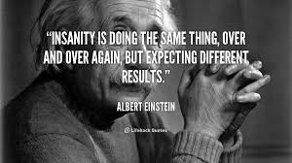

Slide 3
“ When it comes to retaining information, not all methods are created equal.”

Slide 4

Highlighting

Slide 5
John Dunlosky et al (2013)
Highlighting is, they suggest, a relatively ineffectual tool.
One of the main problems is that it is already a very familiar strategy and so is employed in an unthinking fashion
No real strategy evident and evidence shows that how much is highlighted is wildly variable given the same text.

Slide 6
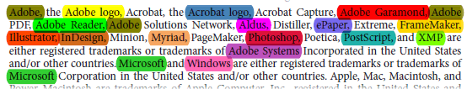
Another reason to ditch the highlighters is that when a revision technique feels too easy, it usually is.
Robert A Bjork has labelled the positive impact of difficult revision tasks ‘desirable difficulties’ . The added difficulty is harder to stick with but it proves longer lasting in the memory.
Verdict: ditch the highlighters

Slide 7
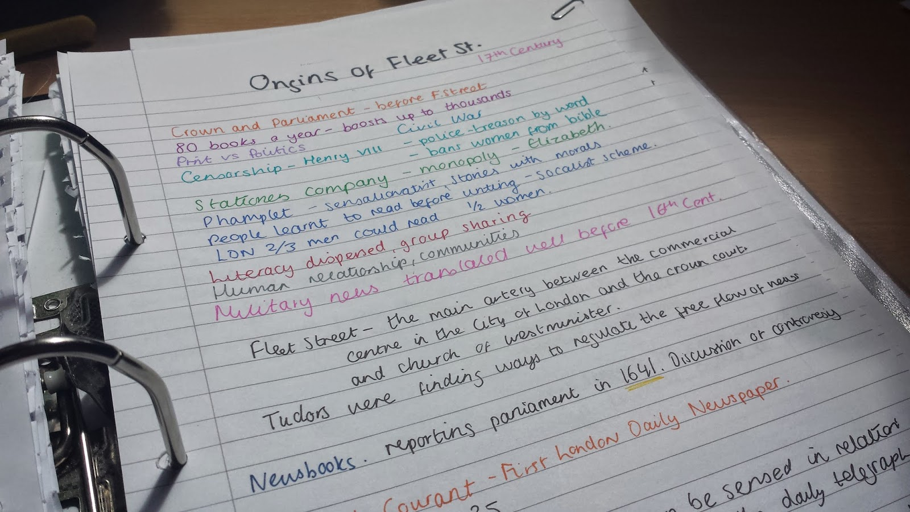
Taking revision notes

Slide 8
“It ain’t what you do, it’s the way that you do it.”
Simply copying out chunks of text is likely to prove an ineffective strategy.
Research indicates that elaboration is the key to effective revision notes.
Interpreting what we read and more actively connecting it together, drawing out questions and patterns from the information.

Slide 9
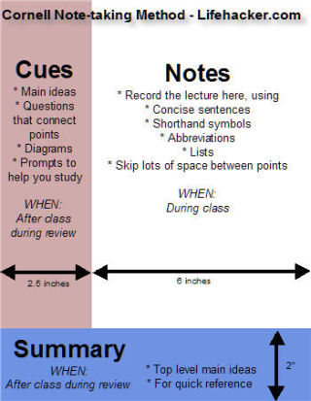
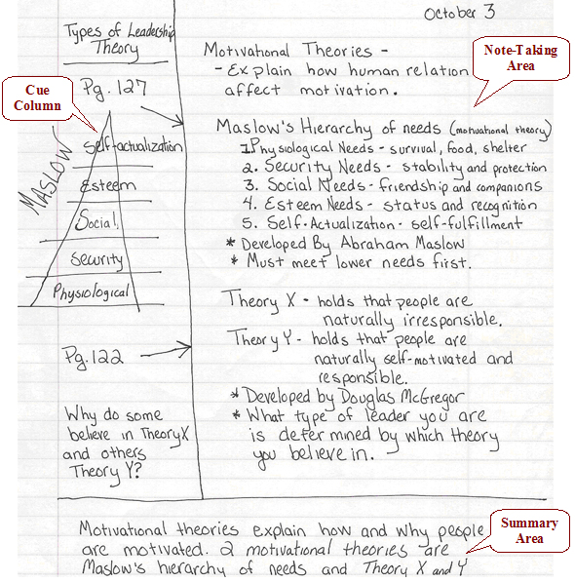
The “Cornell Method”
Verdict: structure required

Slide 10

Reciting

Slide 11
Facts, facts and more facts?
Cognitive psychology has shown that the working memory of students is limited. Under the stress and pressure of exam conditions, short term memory can falter.
By reciting crucial knowledge pertinent to an exam topic and learning it by rote, help makes the recall of that knowledge almost automatic
Reciting is also a valuable revision tool that can be deployed freely at any time

Slide 12
Mark A McDaniel et al (2009)
Relying on reciting won’t prove the most effective method of revision
Read-Recite-Review offers an enhancement that works
Simply reading the information is never enough but this active addition can prove more memorable. A little reciting, and a little checking, go a long way.
Verdict: if it is good enough for great actors

Slide 13
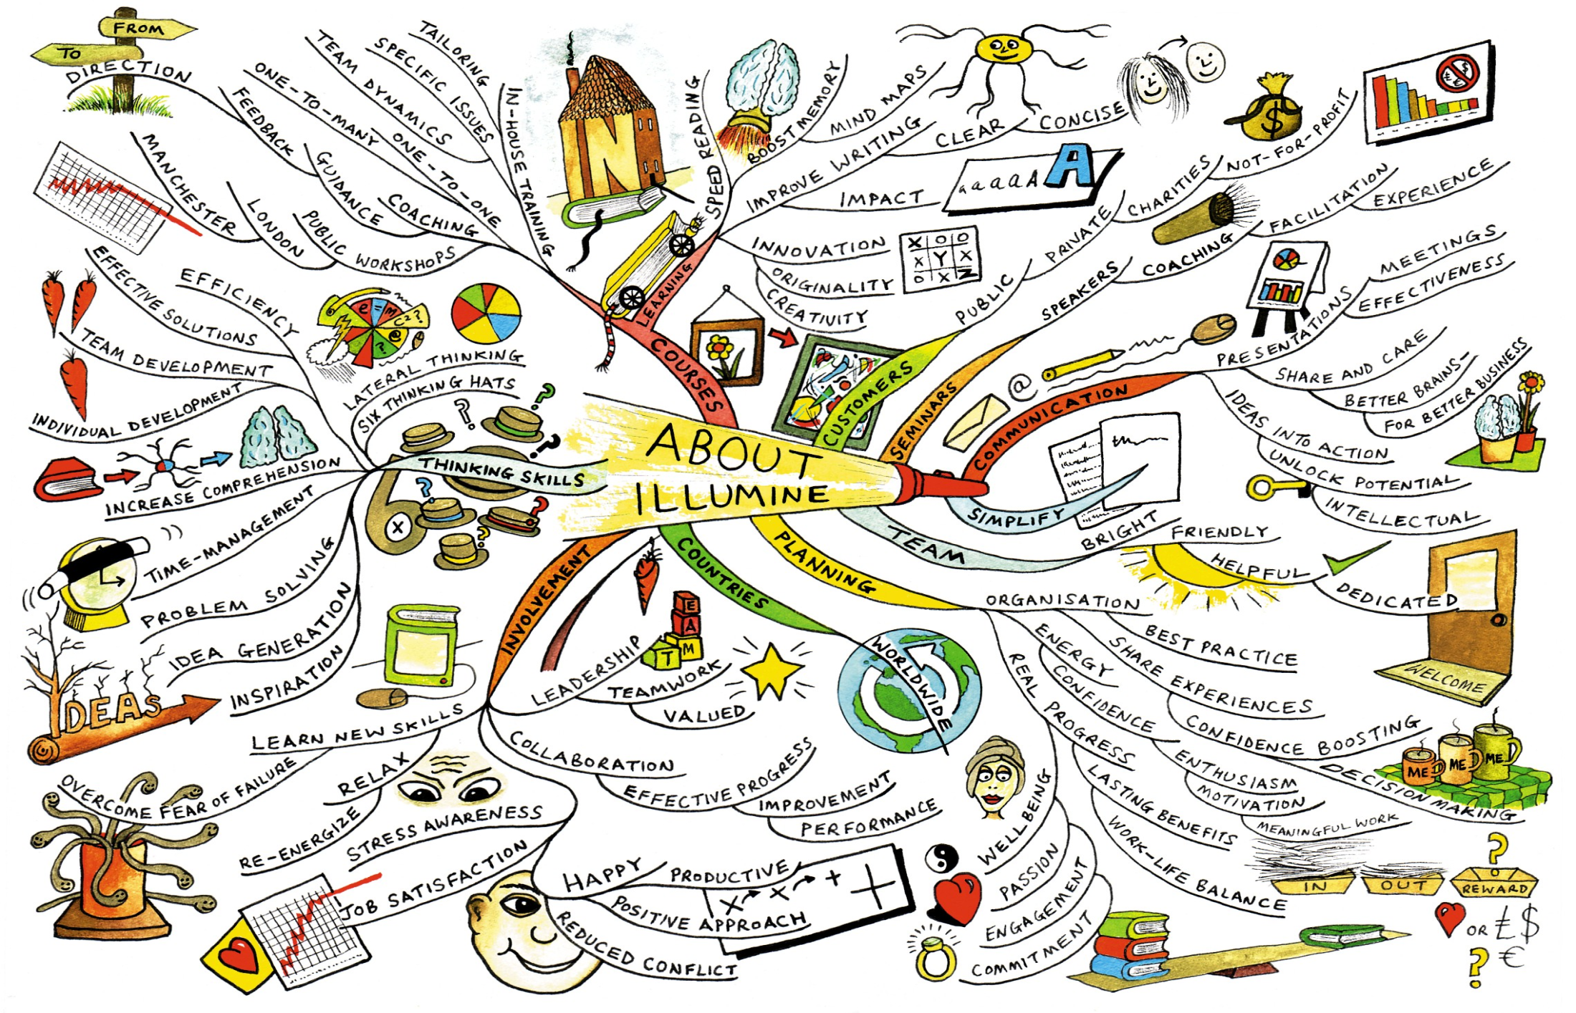
Graphic organisers

Slide 14
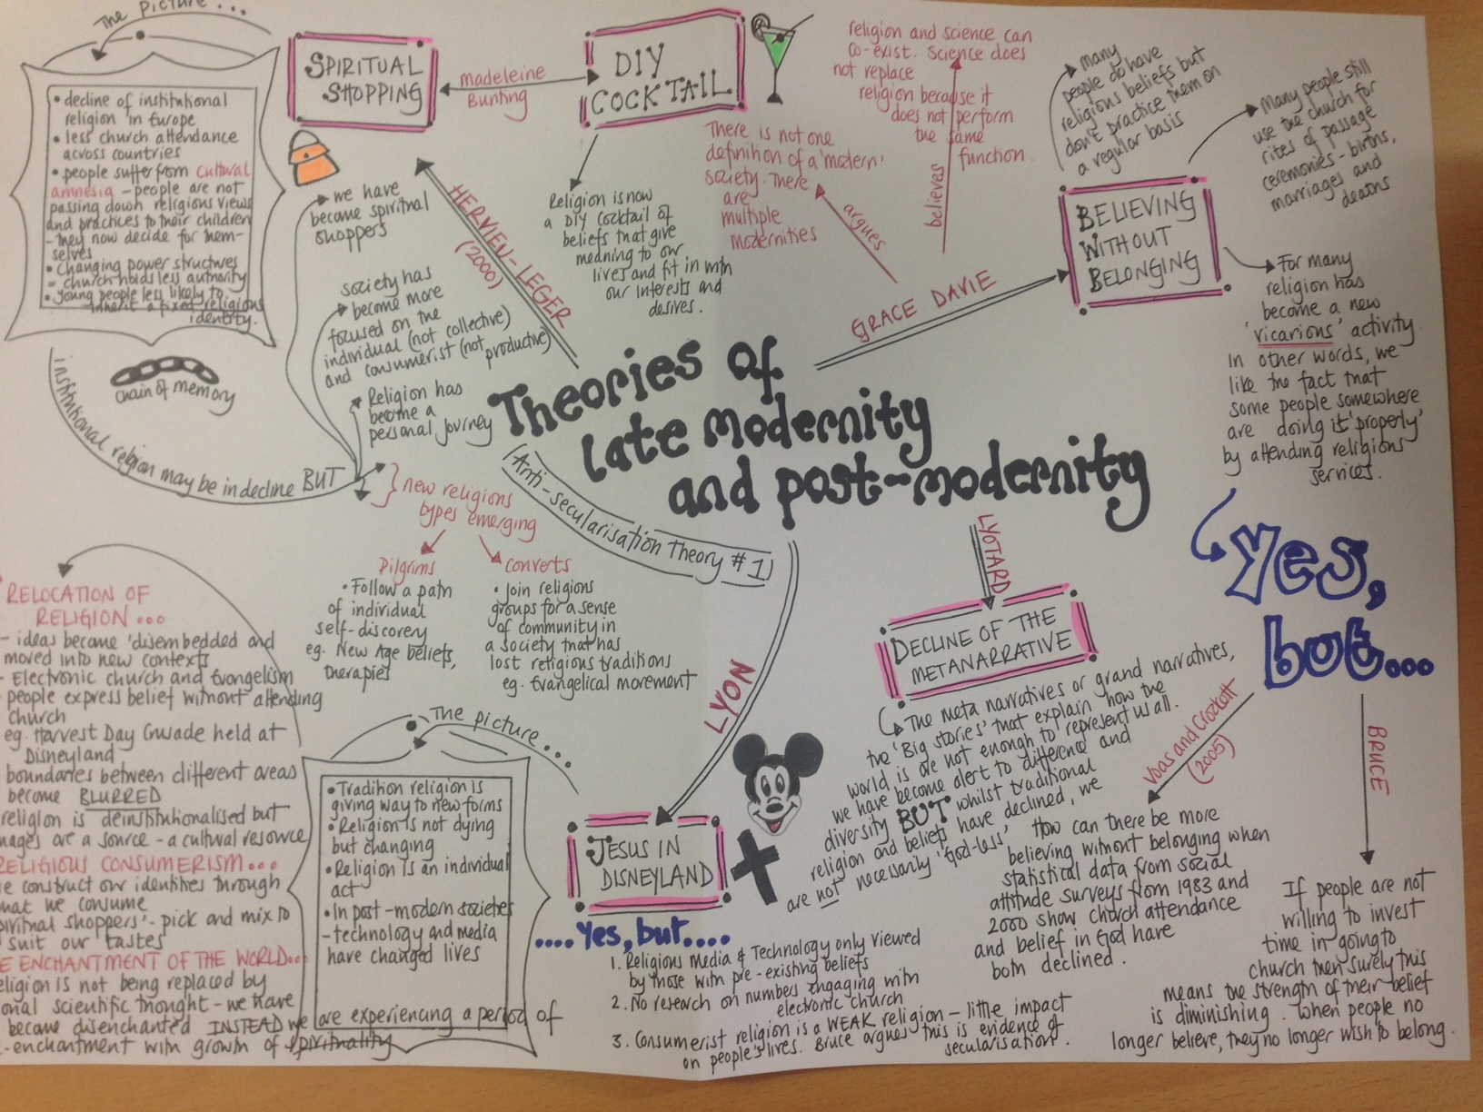

Slide 15
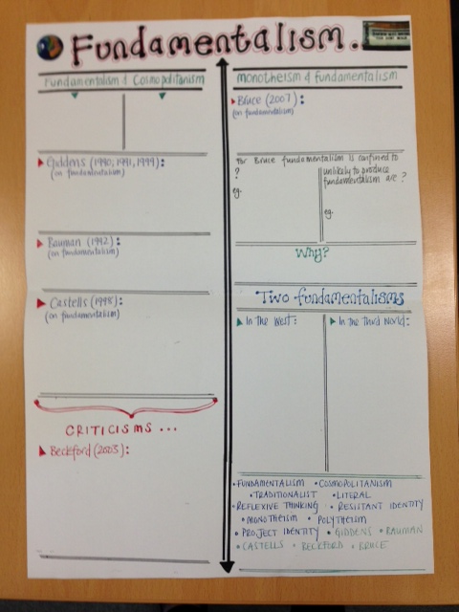
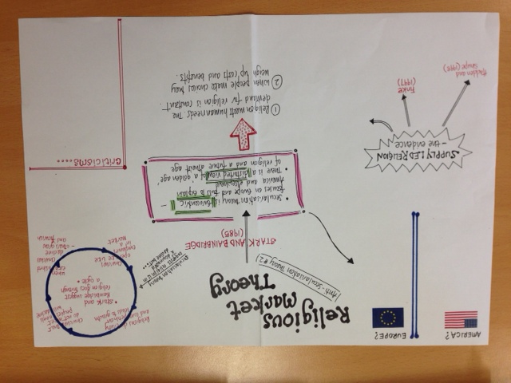

Slide 16
Graphic organisers
One of the strengths of graphic organisers is their ability to help clarify and organise often haphazard thinking.
There is a whole host of diagrams for different modes of thinking.
Venn diagrams, concept maps, spider diagrams, fishbone diagrams.
Concept maps have been shown to be an excellent device for testing knowledge on a given topic.
Verdict: it isn’t just pretty pictures – restructuring topics using graphic organisers makes its mark in the memory

Slide 17
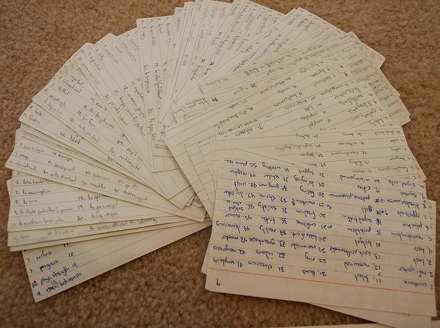
Flashcards

Slide 18

Testing

