Slide 1
Fact: There is no correlation between intelligence and A-level grades.
What causes academic success?

Slide 2
Success stories
Student D:
AS results: CDDE A2 results: BBC Economics: E – B
Student K:
AS results: BBDD A2 results: A*AB Sociology: D-A
Student C:
AS results: BCCD A2 results: A*BC Sociology: C-A*
Notes:
Dilene:
AS results: CDDE A2 results: BBC Economics: E – B
Kelly:
AS results: BBDD A2 results: A*AB Sociology: D-B
Charlie:
AS results: BCCD A2 results: A*BC Sociology: C-A*

Slide 3
Create your own story…..
Student K:
AS results: CEEU A2 results: BBE
Student J:
AS results: BDEE A2 results: ABC Geography: E - C
Student E:
AS results: EEUU A2 results: BDB Psychology: E – B
Student N:
AS results: ACCE A2 results: A*AB Sociology C – A*
Notes:
Khushal:
AS results: CEEU A2 results: BBE
Jesal:
AS results: BDEE A2 results: ABC Geography: E - C
Elwira:
AS results: EEUU A2 results: BDB Psychology: E – B
Nicole:
AS results: ACCE A2 results: A*AB

Slide 4
Oh oh … what happened here
Student M
AS results ABB A2 results BBC
AS Resit C – C.
Student D
AS Results BBC A2 results BDD
AS resit C – D.

Slide 5
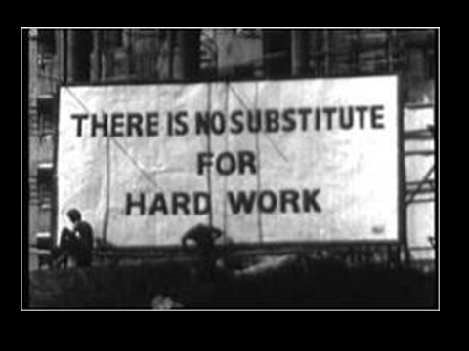

Slide 6

“Champions are made not born”
Matt Syed
http://www.youtube.com/watch?v=I1K6bOG8mj8

Slide 7
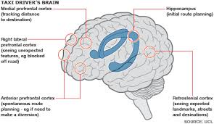

The brain is elastic
Maguire (2000)
Taxi drivers have bigger hippocampi.
The brain is like a muscle.

Slide 8
It’s about effort
List A
List B
FAHTER
FOOTBLAL
DCOTOR
OUTCOEM
TEACHRE
HERFAT
LBOFTOAL
RTOCOD
ECMUTOO
EERTACH

Slide 9
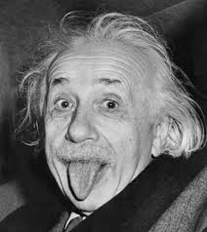
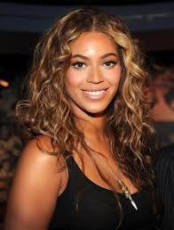
The key to success?
“It is not that I am smart, it’s just that I stick with problems longer”
“One thing about me, I practice until my feet bleed”

Slide 10
The Talent Myth: A Fixed Mindset
“Mindset” {noun}
A set of beliefs or a way of thinking that determines one’s behaviour; outlook and mental attitude.

Slide 11
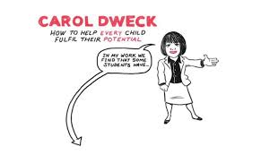
Growth Vs Fixed Mindset
https://www.youtube.com/watch?v=Yl9TVbAal5s

Slide 12
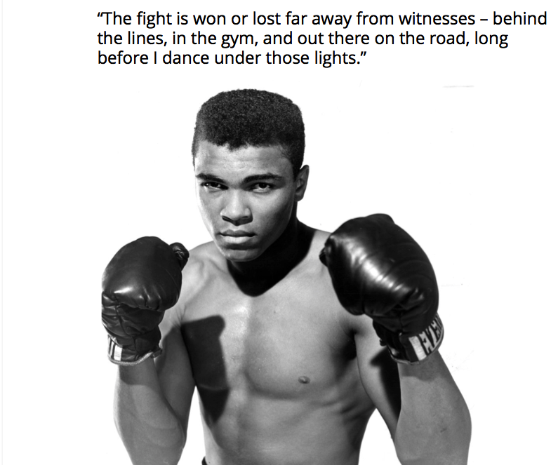

Slide 13
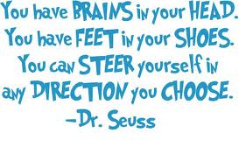

Slide 14
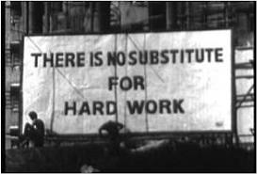

Slide 15
If Not Now, When?
2. If Not You, Who?

