Slide 1
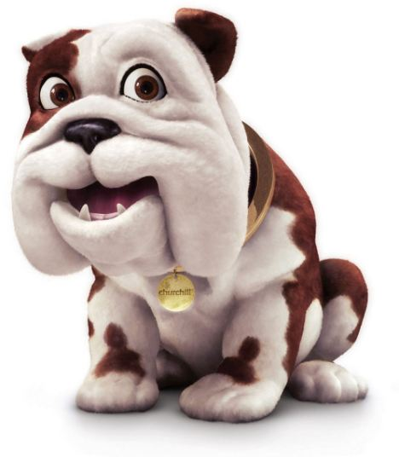
Now this is not the end.
It is not even the beginning of the end
but it is, perhaps, the end of the beginning.

Slide 2

Family Fortunes
The one thing I wish I did differently last year …

Slide 3
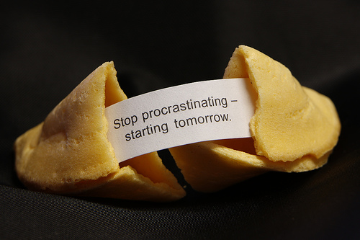
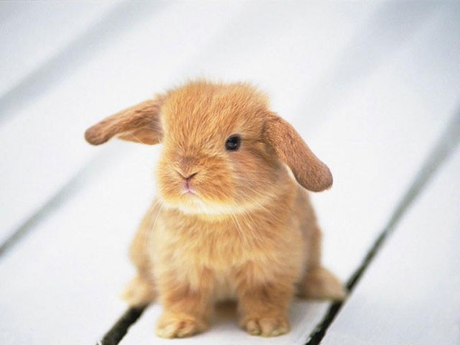
Procrastination
“The act of postponing, delaying or putting off”

Slide 4
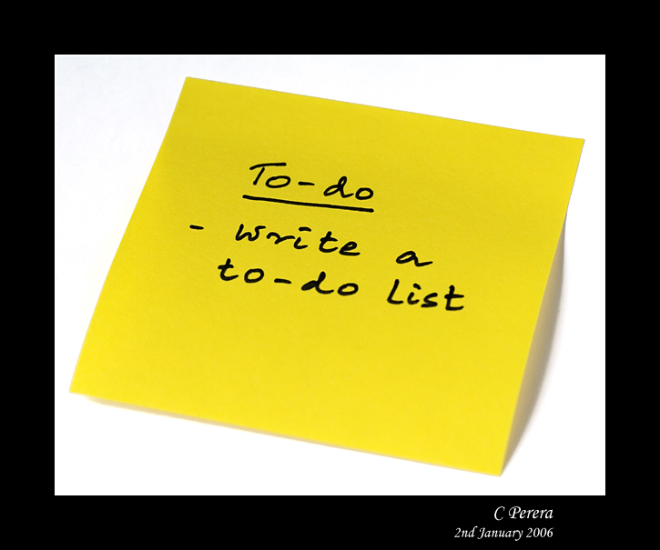
"Tomorrow is often the busiest day of the week." ~Spanish Proverb

Slide 5
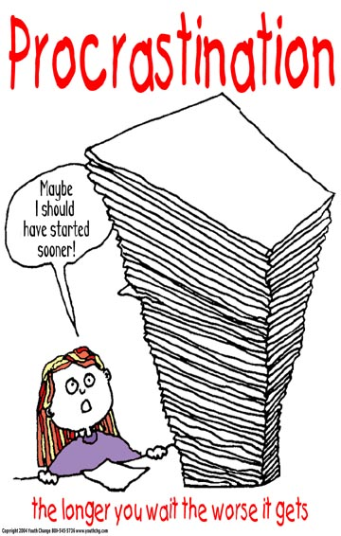
"I like work: it fascinates me. I can sit and look at it for hours." ~Jerome K. Jerome (Three Men in a Boat, 1889).

Slide 6
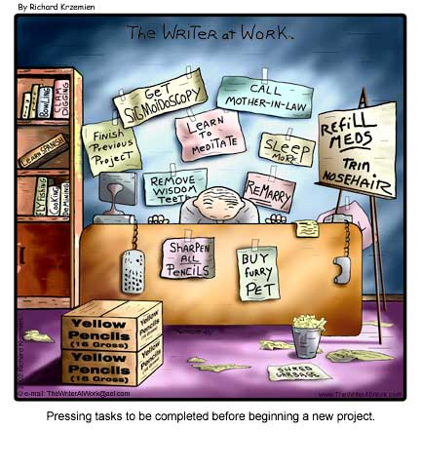
“Procrastination is the
thief of time”
Edward Young
Night Thoughts, 1742

Slide 7
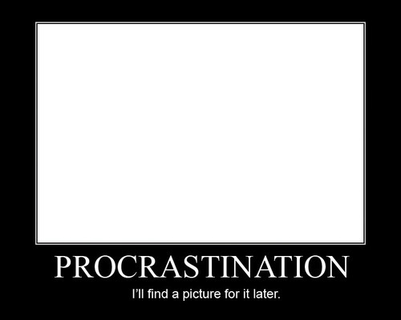


Slide 8
Procrastination Quiz
Do you spend lots of time writing out your to-do lists?
Do you wait for the “right mood” or the “right time” to tackle the important task at hand?
When you are about to start something – do you find yourself wandering off to get something to eat / speak to a friend / stare at the walls?
Do you check your emails more than 4 times a day – re-reading them each time?
Do you complete the easy tasks first (low-priority ones)?
Do you leave everything until the last minute?
When starting work do you find yourself checking facebook first? Just watching one more episode of Friends, even though you have seen it before … it was a good one?

Slide 9
The psychology of procrastination
Difficult or unpleasant task
You are disorganised
Feel overwhelmed
You are a perfectionist
You find it difficult to decide what to do when?

Slide 10
Mr Hickman’s anti-procrastination tips
Your time is precious
Get organised
To do list?
Study schedule?
Recognise when you are procrastinating
Reward yourself
http://www.youtube.com/watch?v=U921abH7jIk

Slide 11
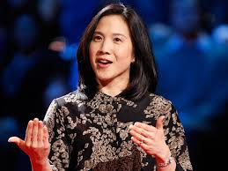
The key to success? Grit
https://www.youtube.com/watch?v=H14bBuluwB8
There is no strong correlation between IQ and grades.

Slide 12

Until Mock Exams
11 School Days
Working hard enough?
Working smart enough?

