Slide 1
Are you a tolerant person?
https://www.youtube.com/watch?v=m3SjCzA71eM
Yes / No

Slide 2
Tolerance
Noun:
An advocate of religious tolerance, forbearance, toleration, sufferance, liberality, open-mindedness, lack of prejudice, lack of bias, broad-mindedness, patience, sympathy, understanding …

Slide 3
Tolerance
Noun
A 1% maximum tolerance in measurement: deviation, fluctuation, variation, allowance, clearance …

Slide 4
The 1%
tolerance

Slide 5
Marginal Gains Theory
“The whole principle came from the idea that if you broke down everything you could think of that goes into riding a bike, and then improved it by 1%, you will get a significant increase when you put them all together”
Dave Brailsford (2012)
https://www.youtube.com/watch?v=fzjppuixP04

Slide 6
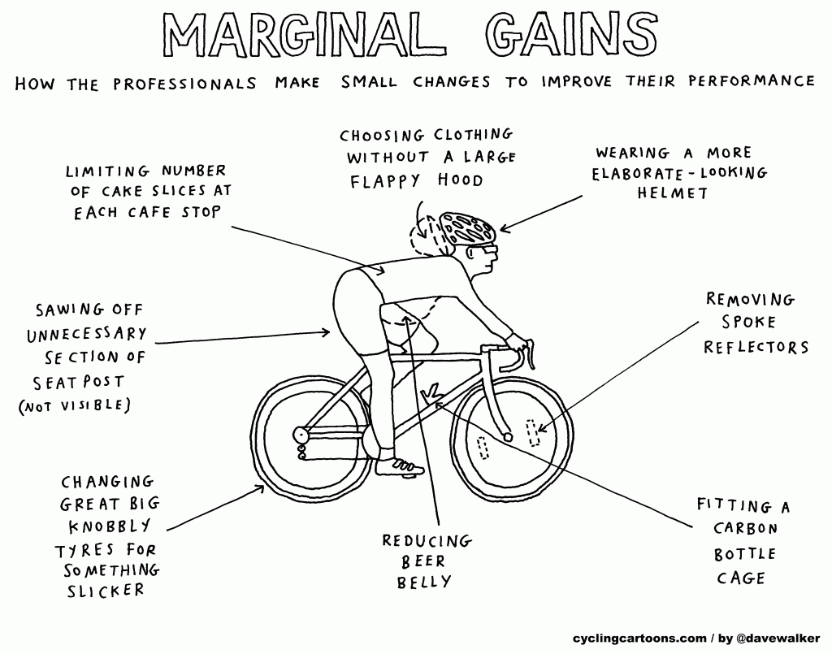

Slide 7
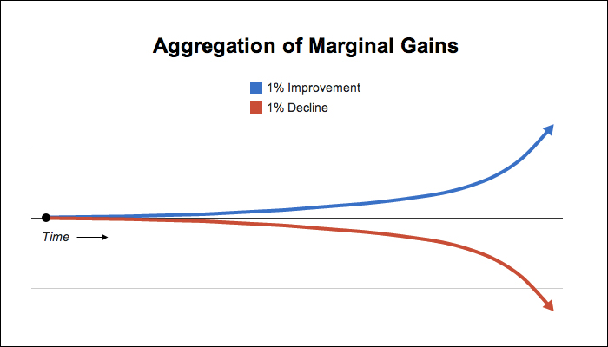
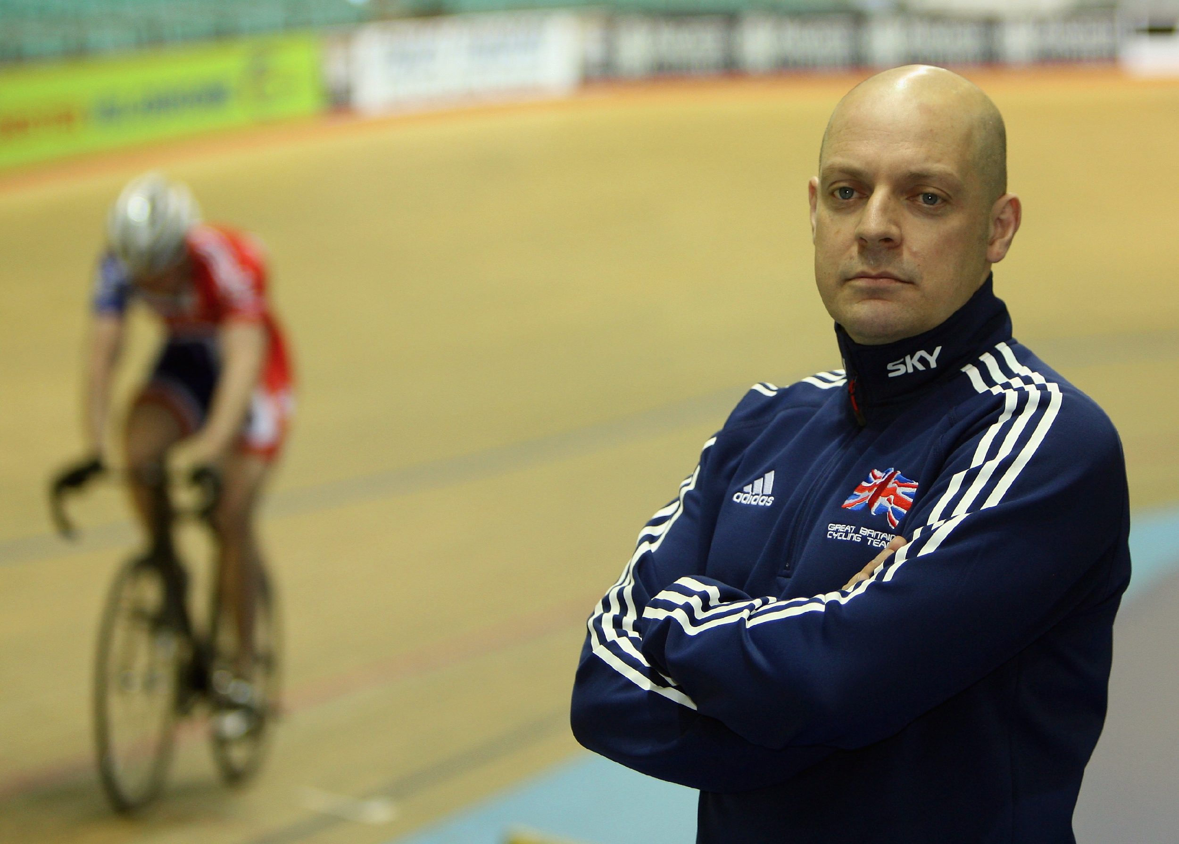
Marginal Gains
Sir David Brailsford

Slide 8
Think about your studies …
What marginal gains could you make this term?
Wider reading
Organisation / Time management
Note-taking
Engagement in class
Home learning
Exam preparation – Revision
AS Resits
Preparing for Life at University

Slide 9
If Not Now, When?
2. If Not You, Who?

Slide 10
Growth Vs Fixed Mindset
https://www.youtube.com/watch?v=brpkjT9m2Oo

Slide 11
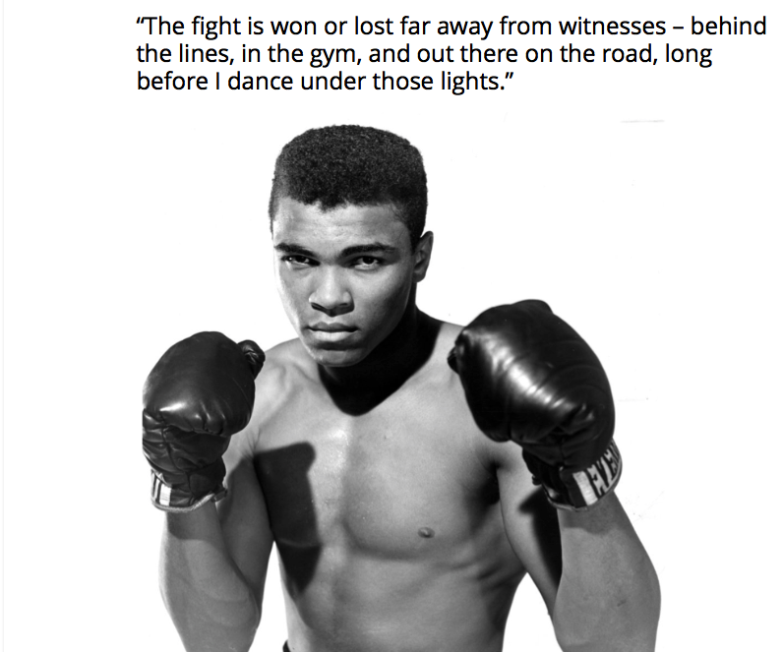

Slide 12
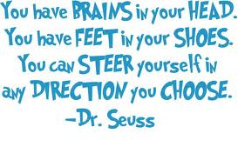

Slide 13


Slide 14
Create your own story…..
Student D:
AS results: CDDE A2 results: BBC Economics: E – B
Student K:
AS results: BBDD A2 results: A*AB Sociology: D-A
Student C:
AS results: BCCD A2 results: A*BC Sociology: C-A*
Notes:
Dilene:
AS results: CDDE A2 results: BBC Economics: E – B
Kelly:
AS results: BBDD A2 results: A*AB Sociology: D-B
Charlie:
AS results: BCCD A2 results: A*BC Sociology: C-A*

Slide 15
Create your own story…..
Student K:
AS results: CEEU A2 results: BBE
Student J:
AS results: BDEE A2 results: ABC Geography: E - C
Student E:
AS results: EEUU A2 results: BDB Psychology: E – B
Student N:
AS results: ACCE A2 results: A*AB Sociology C – A*
Notes:
Khushal:
AS results: CEEU A2 results: BBE
Jesal:
AS results: BDEE A2 results: ABC Geography: E - C
Elwira:
AS results: EEUU A2 results: BDB Psychology: E – B
Nicole:
AS results: ACCE A2 results: A*AB

Slide 16


Slide 17
Success…How bad do you want it?
http://www.youtube.com/watch?v=UizlkbS61mQ

