Slide 1
9
7
216

Slide 2
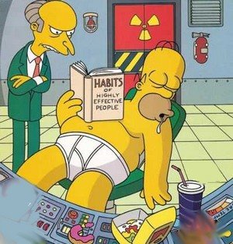
7 weeks have passed
Are you working hard enough?
Are you working smart enough?
Are you getting the balance right between your subjects?
Are you able to read ahead or around the topics?

Slide 3
Autumn Term Countdown
02.11.15
09.11.15
16.11.15
23.11.15
MOCKS
30.11.15
07.12.15
14.12.15
Thurs 26th REVIEW

Slide 4
How to make best use of half term

Slide 5
Rest
Fun
Consolidate
Read ahead
Wider reading
Exam focus

Slide 6
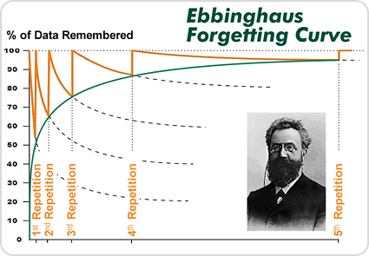

Slide 7
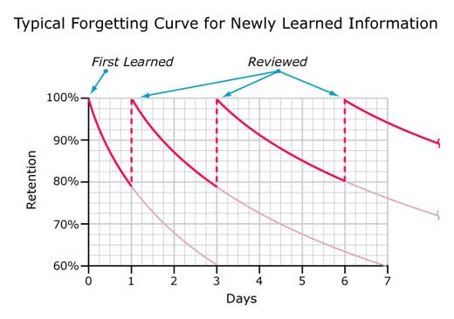

Slide 8

Deep Vs Surface

Slide 9
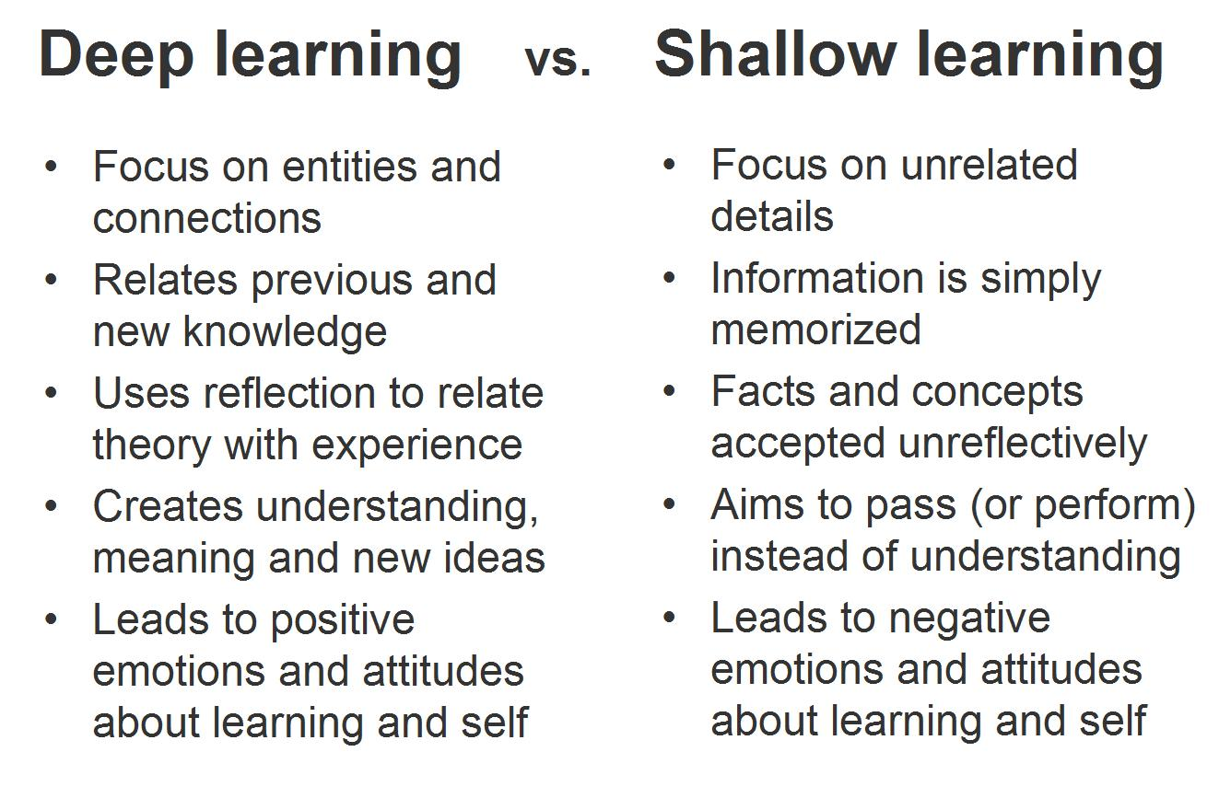

Slide 10
What should I be doing at half term?
Consolidate topics covered this term.
Read ahead and read widely around topics.
Have an exam focus – look up past papers and mark schemes.
Have a system and structure your study periods.

