Slide 1
Post-16 Bursaries 2011-2012
· Students aged at least 16 and under 19 years of age on 31/08/11 who are in care, are leaving care, are in direct receipt of Income Support or are disabled and in receipt of both Employment Support Allowance and Disability Living Allowance
* Students who are economically or socially disadvantaged and at risk of not taking up or continuing in their education. This group includes students with physical or other disabilities, medical conditions and/or learning difficulties.
· Students who have been in care, on probation, are young parents or are otherwise considered at risk.
* Asylum seekers
* Refugees (who will have access to 16-19 Bursary Funding if they are in receipt of supportive evidence from DWP).
· Lone parents

Slide 2
Post-16 Bursaries 2011-2012
Eligible students will be guaranteed a £1200 bursary plus support for other costs such as transport, equipment etc.
Timescales are very tight and any delay could mean that students do not get the money they are entitled to.

Slide 3

Imagine we go back in time
What do you wish you did differently in Year 12?
In pairs, make a list of 5 suggestions.

Slide 4
Personal Statements

Slide 5
Carpe Diem

Slide 6

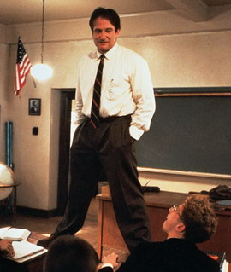
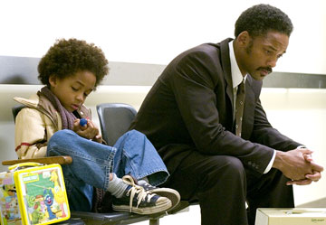

What links these things?

Slide 7


Slide 8

Notes:
Mayfly Nymph

Slide 9
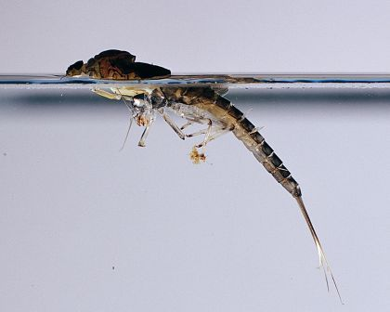
Notes:
Emerging from the water as an adult

Slide 10


Slide 11
Sieze the Day
Make your lives extraordinary …
http://www.youtube.com/watch?v=qQtmGcdSDAI

Slide 12
You want something. Get it. Period.
http://www.youtube.com/watch?v=MPnudujlBZI&feature=related
Notes:
In 1981, in San Francisco, Chris Gardner (Will Smith) invests his family's savings in portable bone-density scanners which he tries to demonstrate and sell to doctors. The investment proves to be a white elephant which financially breaks the family and as a result, his wife Linda (Thandie Newton) leaves him and moves to New York. Their son Christopher (Jaden Smith) remains with his father. While downtown trying to sell one of his scanners, Chris meets a manager for Dean Witter and impresses him by solving a Rubik's Cube during a short cab ride. Chris does not have enough money for the cab fare and flees the cab driver into a subway station where he barely escapes the cab driver but loses one of his bone scanners in the process. This new relationship with the Dean Witter manager earns him the chance to become an intern stockbroker. Despite arriving there unkempt and shabbily dressed due to an emergency, Chris is offered the internship. Chris is further set back when his bank account is garnished by the IRS for unpaid taxes, and he and his young son are evicted. As a result they are homeless, and are forced at one point to stay in a bathroom at a subway station. Motivation drives him to find the Glide Memorial United Methodist Church, which has a homeless shelter primarily for single mothers and their children. Due to demand for the limited rooms, Chris must frantically race from his internship work early each afternoon in order to land a place in line. Chris finds the bone scanner that he lost in the subway station from a demented man who believes it to be a time machine and it is now damaged, but Chris finally repairs it. Disadvantaged by his limited work hours, and knowing that maximizing his client contacts and profits is the only way to earn the one paid position that he and his 19 competitors are fighting for, Chris develops a number of ways to make phone sales calls more efficiently. He also reaches out to potential high value customers, defying protocol. One sympathetic prospect takes him and his son to a professional football game. Regardless of Chris's challenges, he never reveals his lowly circumstances to his co-workers, even going so far as to lend one of his bosses five dollars for a cab, a sum he can't afford.
Concluding his internship, Chris is called into a meeting with his managers. His work has paid off and he is offered the position. Fighting back tears, he rushes to his son's daycare, hugging him. They walk down the street, joking with each other and are passed by a man in a business suit (the real Chris Gardner in a cameo). The epilogue reveals that Chris went on to form his own multi-million dollar brokerage firm.

Slide 13
