Slide 1
3.6 The influence of early attachment on childhood and adult relationships
Starter: Discuss.
How important are our early relationships?
To what extent can people recover from separation, deprivation and privation?
How might we prove that our adult personalities are linked to our early infantile experiences?
How might this knowledge be useful?
Stick your name on a post-it note and place it on the scale on the board in response to the following question.
“Our early attachment experiences determine our later childhood and adult relationships”
On a scale of 1 – 10
(1 = not at all / 10 highly significant)
activity

Slide 2
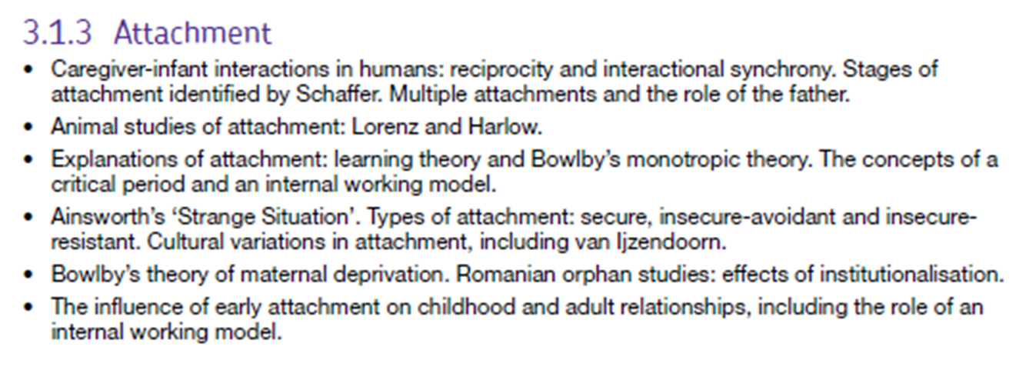
The Specification
A Valentine’s Day Treat
https://www.youtube.com/watch?v=3LM0nE81mIE

Slide 3
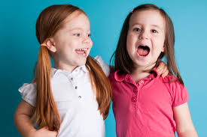
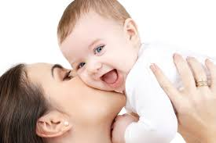
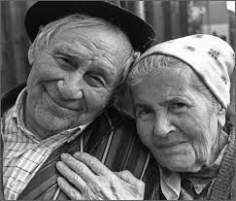

Influence of Early Attachment on Later Relationships
Lesson objectives:
Describe the research and theory on the influence of early attachments on later relationships
Apply the concepts to different scenarios
Evaluate the usefulness and validity of the theories and research
How do you earliest attachments affect your childhood friendships?
How do your earliest attachments affect your adult relationships?

Slide 4
Attachment theory – The continuity hypothesis.
Attachment with parents
Relationship
with peers
Later romantic
relationships
Attachments are an instinctive thing that are formed to help survival.
The first attachment we form is to our parents and will depend on how sensitive the mothers care is (Ainsworth).
The attachment type you develop in childhood (secure/insecure) will continue into later relationships (continuity hypothesis).

Slide 5
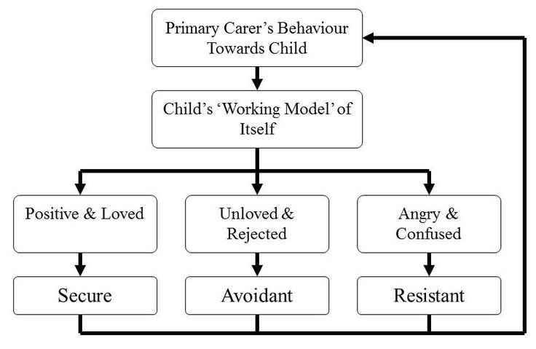
Attachment Theory: The Foundations
Recap

Slide 6

Internal working model
“Love in infancy is as important for mental health as vitamins and proteins for physical health” John Bowlby
Recap

Slide 7
Internal Working Model
The monotropic attachment is unique; it is the first to develop and the strongest bond of all.
Forms a model / template / blueprint for all future relationships.
Continuity hypothesis – there is consistency between early emotional experiences and later relationships.
Recap

Slide 8
Why attachment matters!
https://vimeo.com/88333079
https://vimeo.com/88337039

Slide 9
Relationships in later childhood
activity
Attachment type is associated with the quality of peer relationships in childhood: securely attached infants go on to form the best quality friendships while insecurely attached infants struggle.
Myron-Wilson and Smith (1998) found that insecure-avoidant infants are most likely to be bullied while insecure-resistant infants are most likely to be bullies (questionnaire to 196 children aged 7-11 from London)
Task: Why do you think this bullying pattern exists? Use your knowledge of the behaviour displayed by each attachment type

Slide 10
Childhood relationships
Continuity between attachment style and quality of childhood relationships.
Children who form attachments with each other early in life do not go on to form adult sexual relationships later.
Evidence (pg.139)
Summarise here!
activity

Slide 11
Childhood relationships
Continuity between attachment style and quality of childhood relationships.
Children who form attachments with each other early in life do not go on to form adult sexual relationships later.
Evidence (pg.139)
Youngblade – securely attached children were more curious, competent, pro-social, self-reliant.
Mullis – Late childhood attachment behaviour are transferred from parent to close friends.
Westermarck – children who form close friendships under age of 6 do not go on to form adult sexual relationships with each other.
How useful is this debate?

Slide 12
Childhood Evaluation.
Children with secure attachment seem to do better than those with insecure attachments.
Early attachment types influence emotional, social and cognitive skills.
Attachments on other children - evolutionary behaviour to prevent incest?
Deterministic.
Individual differences.

Slide 13
From our Mother’s arms to our Lover’s arms
Extension Activity:
Read the article.
Questions:
What is the argument and evidence presented?
How could you criticise this?

Slide 14
Hazan and Shaver’s “Love Quiz”
Procedure: analysed 620 replies to a “love quiz” printed in a local newspaper. The quiz had three sections:
Assessing respondents’ current or most significant relationship
General love experiences
Assessing attachment type by responding to one of three statements
Task: Use page 140 to complete the following task.
A Valentine’s Day Treat

Slide 15
Hazan & Shaver The LOVE Study
Summarise
Aim:
Sample:
Method:
Results:
Conclusions:
Activity: Draw your hand on the page …
Using just the space within your fingers – summarise this study!
activity

Slide 16
Hazan & Shaver : GRAVER
Social desirability
Correlation not causation
Volunteer Sample
Evidence for continuity hypothesis?
Standardised questions
Questionnaire
More women than men
Checklist for answers

Slide 17
Other Adult evidence.
In support of continuity hypothesis.
Against continuity hypothesis.
activity

Slide 18
Other Adult evidence.
In support of continuity hypothesis.
McCarthy – women with insecure avoidant attachment had less successful romantic relationships.
Kirkpatrick – 300 dating couples – those with secure attachment = more successful & stable relationships.
Belsky – women with secure attachment reported less conflict in relationship – able to manage conflict.
Brennan – individuals classed as insecure-avoidant engage in sex without needing the love.
Kunce – women classed as insecure attachment – became compulsive caregivers – ‘mothered’ their partners.
Against continuity hypothesis.
Wood – quality of romantic relationships is from interaction of two people.
IWM - not fully supported. Steele 0.17 impact. Other factors – parental divorce and other negative life events.
Temperament hypothesis.

Slide 19
Question: How does the internal working model impact future relationships?
Task: answer the question above using your own knowledge
IWM = this template will be the basis of our assumptions about all relationships so we will seek out, and form, relationships that mirror that. We will also behave in a way that mirrors our IWM (e.g. insecure-resistant may be controlling or argumentative in relationships)

Slide 20
(AO3) Evaluation of the internal working model: how do we study it?
Bowlby argued that the internal working model is unconscious (e.g. we aren’t aware of it existing and can’t describe/explain their effect on us). Why is this a problem for us as researchers?
Because how can we expect people to report on something they are not aware of? People can only describe how they consciously understand their relationships (and this will be influenced by loads of other variables – media, previous experiences, expectations, etc) so, at best, we get a partial picture of the internal working model

Slide 21
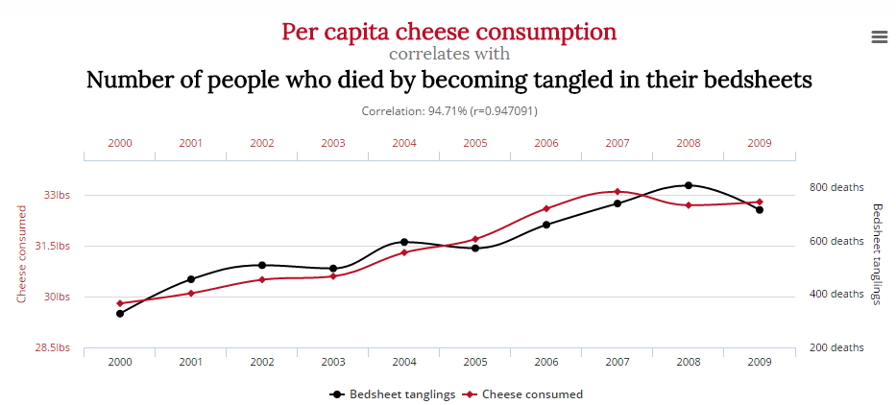
Big evaluation point: causation
Just because there is a relationship between two factors, does that mean there is a causal relationship (e.g. one causes the other)?

Slide 22
(A02) Apply it!
activity
Ned and Nadia are 2 year old children. They are both assessed for attachment type using the Strange Situation. Ned is categorised as insecure-avoidant (type A) while Nadia is secure (type B). Using Bowlby’s theory of the internal working model, describe how this may affect their future romantic relationships (4 marks)
Ned: will struggle forming effective romantic relationships (1 mark) – may not be able to form one at all and he may be cold/not affectionate if he does (1 mark)
Nadia: should be able to successfully form and maintain a romantic relationship (1 mark) as she already has a secure model in her head, she can confidently apply it later in life (1 mark)

Slide 23
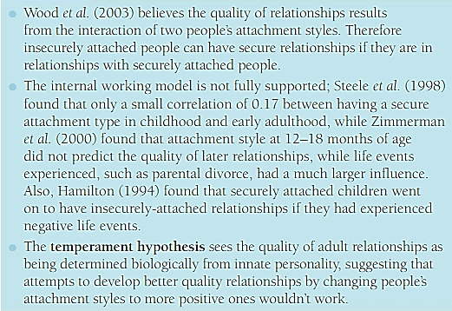
Further evaluation
Conclusion task: using the evidence below and from throughout the lesson, write a paragraph responding to the question: “how important are early attachments for later relationships?”. Try to balance it with at least two points of view
activity

Slide 24
Unit summary: attachment
Lesson objectives:
Describe the research and theory on the influence of early attachments on later relationships
Apply the concepts to different scenarios
Evaluate the usefulness and validity of the theories and research
Caregiver-infant interactions
Attachment figures
Schafer’s stages of attachment
Animal studies of attachment
Learning theory of attachment
Bowlby’s Monotropic theory of attachment
Ainsworth’s Strange Situation
Cultural variations in attachment
Bowlby’s theory of Maternal Deprivation
Effects of Institutionalisation on attachment
Effects of early attachment on later relationships

Slide 25
3.6 The influence of early attachment on childhood and adult relationships
Plenary
Do you want to change your post-it note?
Why or why not?
“Our early attachment experiences determine our later childhood and adult relationships.”
On a scale of 1 – 10
(1 = not at all / 10 = highly significant)

Slide 26
Plenary 2: A final Quiz.
What is Bowlby’s idea of the internal working model?
The mental representation you have of relationships, formed from your attachment with your primary caregiver during the critical period
What are the three attachment types identified by Ainsworth?
Secure, insecure-resistant, insecure-avoidant
What did Hazan and Shaver do?
They conducted a “Love quiz” in the local newspaper, asking people about their childhood attachments and views on romantic love
What did Hazan and Shaver find?
There was a strong correlation between childhood attachment and ideas on romantic love/success in adult relationships – secure = good and longer lasting romantic relatonships.

