Slide 1
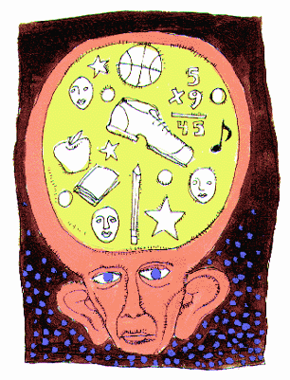
The Working Model of Memory
L.O. Outline the WMM.
L.O. Explain key studies.
L.O. Evaluate its usefulness.

Slide 2
Starter: Memory Test
In pairs / threes.
Send one person to memorise the diagram and describe it to you.
You should each draw out the diagram in your books.

Slide 3
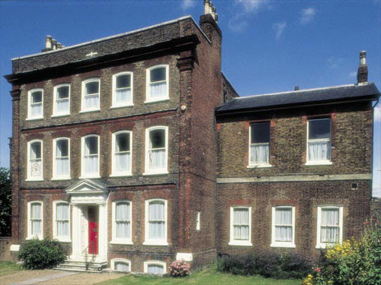
Operating your working memory
Baddeley (1997) has suggested that you can get a good feel for the operation of working memory by the following task.
Try to work out how many windows there are in your home.
If you are like most people, you will have formed a mental image of your home and counted the windows either by imagining the outside of the house or by walking through the house room by room.
  The image will be set up and manipulated in your visuo-spatial scratch pad
  The tally of windows will be held in the phonological loop as you count them sub-vocally.
  The whole operation will be supervised by the central executive,
    which will allocate the tasks and
    recognize when the final total has been reached.

Slide 4
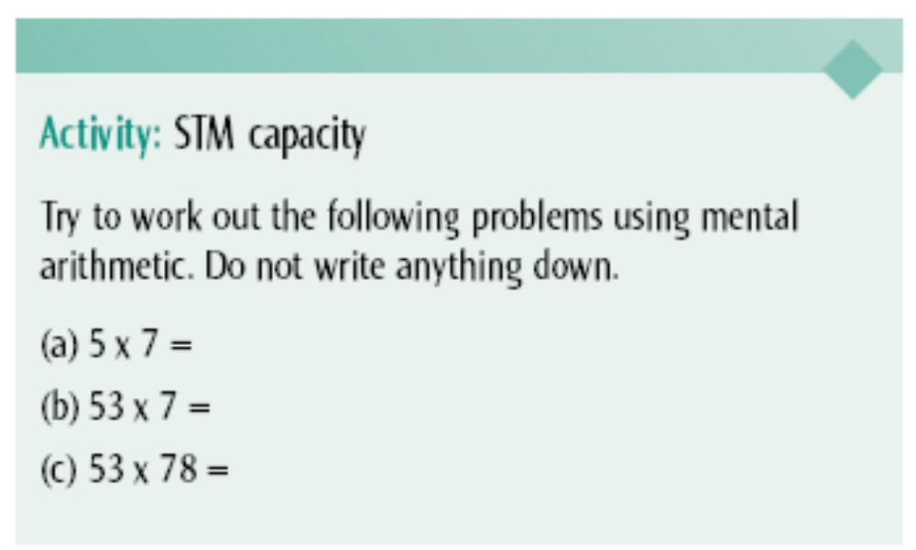
Which parts of the working memory are you using?

Slide 5
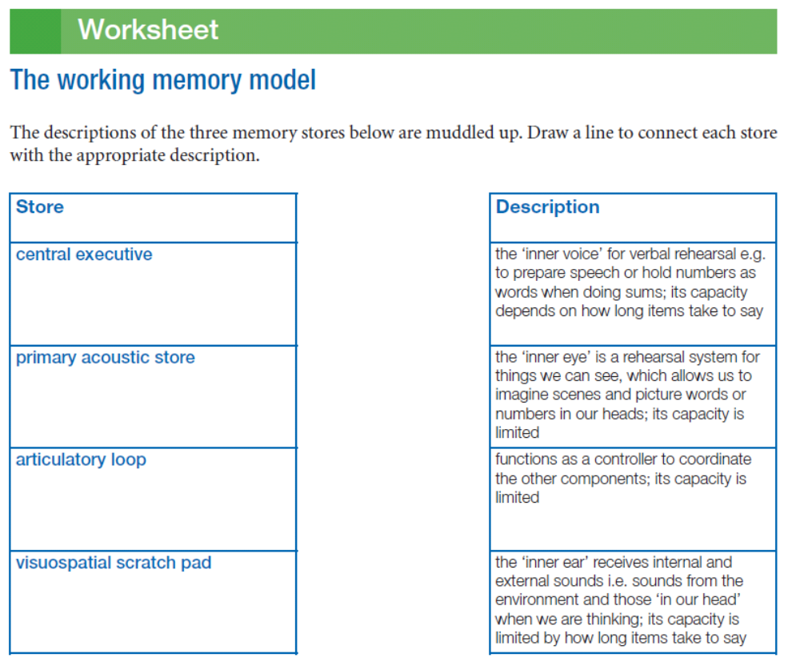

Slide 6
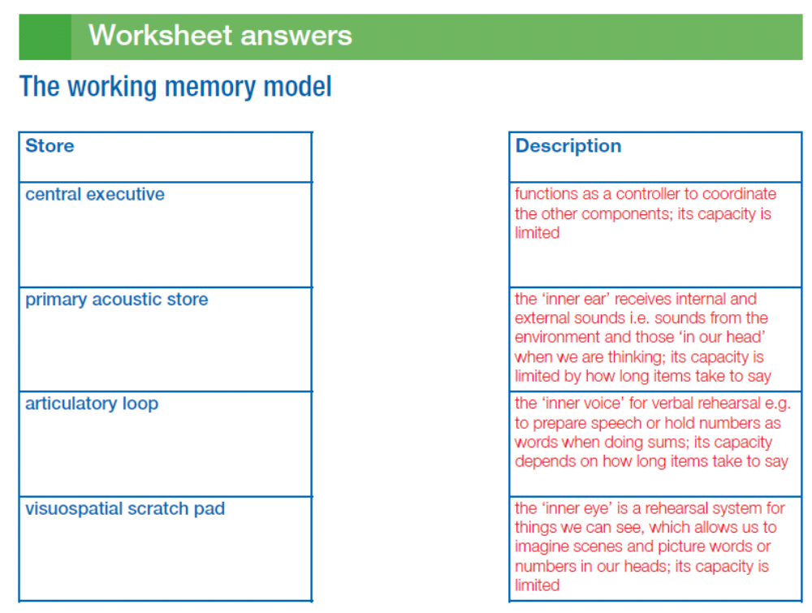

Slide 7
WMM Lesson 2:
Review WMM.
Outline evidence
Evaluate the model

Slide 8




The Working Memory Model (2000)
Central executive
Episodic Buffer
Visuo-spatial
sketchpad
Phonological Loop

Slide 9

Central executive
Drives the system.
Decides how attention is directed
Allocates the resources
Has no storage capacity
Has limited capacity so cannot attend to many things at once

Slide 10
Episodic Buffer (2000)
General storage space for both acoustic and visual information
It integrates information from the central executive, the phonological loop, the visual sketchpad and the long-term memory.
Has limited capacity

Slide 11

The phonological Loop
Deals with auditory information and the order of information
Baddeley(1986) divided it into two components:
The phonological store ( the inner ear )
Which holds information in speech based form for 1-2 seconds
The articulatory rehearsal process:
Used to rehearse verbal information from the phonological store
Memory traces in the auditory store decay in 1.5 -2 seconds but can be maintained by articulatory control process

Slide 12
The visuo-spatial sketchpad
Holds visual (what things look like) and spatial (relationship between things) information for a very short time.
You use it when you are planning a spatial task i.e. going from your home to the college.

Slide 13
Working Memory model
Studies to support

Slide 14
Dual Task Studies
Baddeley & Hitch (1976)
Aim: To investigate if participants use different parts of the working memory at the same time.
Method: An experiment where Pps had to perform two tasks at the same time. (Digit span and verbal reasoning)
Results: As digits increased, participants took longer to answer.
Conclusion: Verbal reasoning was using the central executive and digit span made use of the phonological loop.

Slide 15
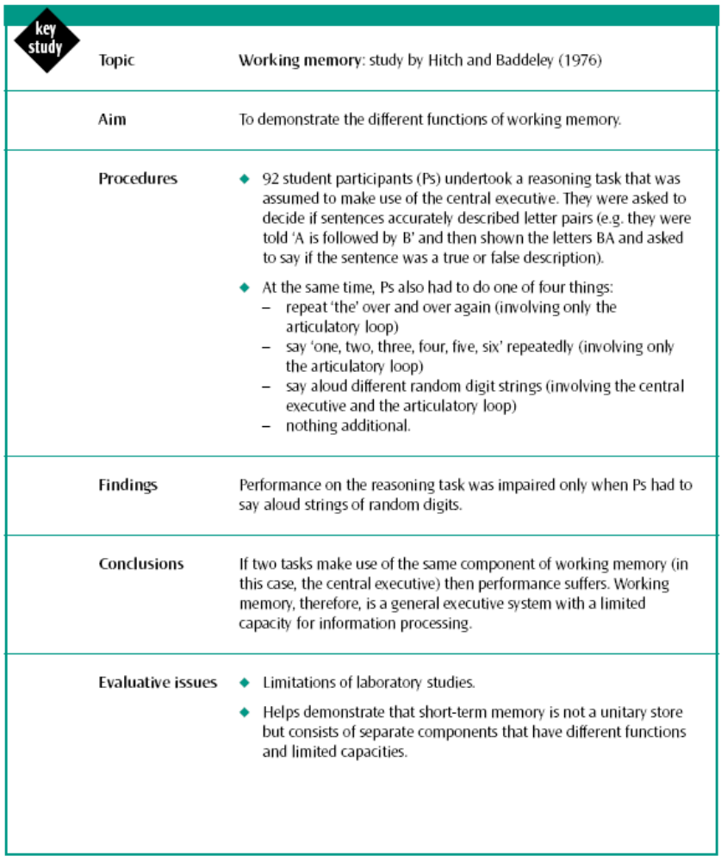

Slide 16
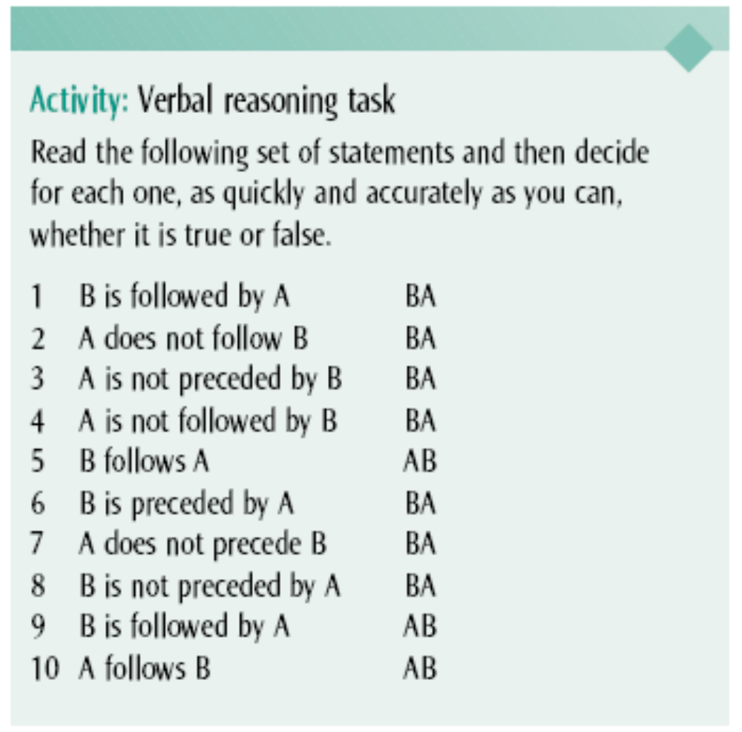
Working Memory Experiment
Group 1
  “The, the, the, the, the”
3.12, 2.47, 2.27, 3.14, 5.29, 2.38, 3.10
Group 2
  Generate random number
3.25, 4.24, 4.54, 3.46
Control Group
  Just completes the task
1.44

Slide 17
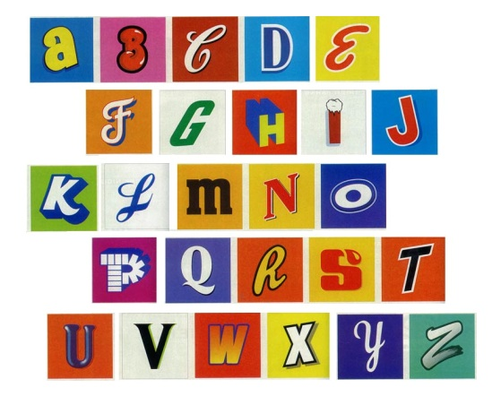
Studies: the central executive
Baddeley (1996)
Asked participants to think of random digits that bore no connection to each other (by tapping in numbers on a keyboard). Either carried out on its own, or with one of the following tasks:
Reciting the alphabet
Counting from 1
Alternating between letters and numbers e.g. A1 b2 c3
Generated number stream was much less random in condition 3 – Baddeley said they were competing for the same central executive resources.

Slide 18
Evidence to support WMM
Brain scans show that verbal and spatial working memories are located in different areas of the brain. –
Phonological store is in Wernicke’s area and articulatory rehearsal loop is in Broca’s

Slide 19
Studies: The phonological loop
Baddeley, Thompson & Buchanan (1975)- word length effect.
HARM
WIT
TWICE
BUS
TIN
ORGANISATION
UNIVERSITY
ASSOSCIATION
NEUROLOGICAL
UNDENIABLE
Presented words for very brief periods of time. One condition – 5 words, one syllable, familiar. Two condition: 5 polysyllabic words. Average correct recall over several trials showed participants remembered the short words much better. This is the ‘word length effect’.
What does this tell us about the phonological loop?

Slide 20
Studies: The phonological loop
ARTICULATORY SUPPRESSION
Baddeley et al also found that the word length effect disappeared (short words recalled no better than long words) under conditions of articulatory suppression (given a task that would normally make use of articulatory loop e.g. Saying la-la-la-la-la - this means that the word length effect depends on having a verbal rehearsal system.

Slide 21
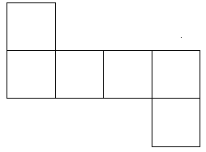
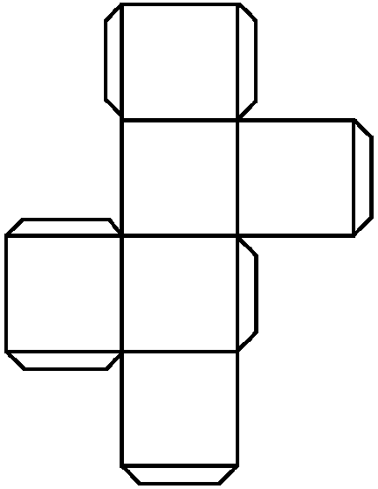

Studies: The visuospatial sketchpad
Shepard & Feng (1972)
Imagine folding the shapes into a cube... Do the arrows meet?
Time taken to make the decision was related to the time taken if the participants had actually been required to do the folding.
VISUAL IMAGES WORK IN VERY SIMILAR WAYS TO REAL LIFE PERCEPTION.

Slide 22
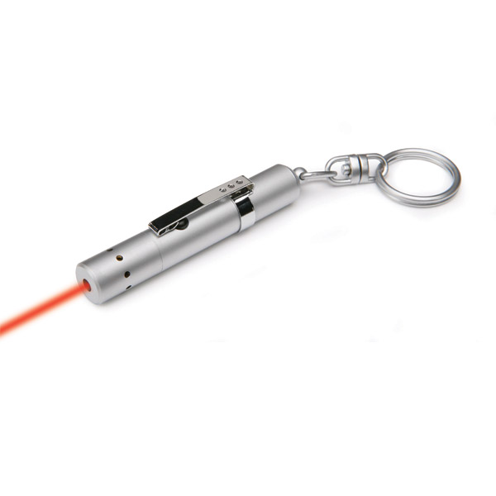
Studies: The visuo-spatial sketchpad
Baddeley, Grant, Wight & Thompson (1973)
Participants were given a visual tracking task: track a moving line with a pointer at the same they were given one of two tasks:
To describe the angle of the letter F (which system did this task involve?)
2. To perform a verbal task (which system did this task involve?)
They performed better in the second task Why?
F

Slide 23
Strengths
Strengths of the WMM
Brain scans (PET scans) have shown that a different area of the brain is active when carrying out verbal tasks than when carrying out visual tasks. This supports the idea that there are different parts of memory for visual and verbal tasks.
This model sees memory as an active process and not merely a passive store (like the MSM). This is in keeping with more modern views of memory that don’t see it as a ‘thing’ but a function or process (like a computer).
The case study of K.F – after brain damage from a motorbike accident his memory for verbal information was impaired, but his memory of visual information was unaffected.

Slide 24
Limitations of WMM
The role of the central executive is unclear, although Baddeley and Hitch said it was the most important part of the model. For example, they suggested that it has its own limited capacity, but it is impossible to measure this separately from the capacity of the slave systems (phonological loop and the visual spatial scratchpad).
This model really only explains short term memory and so tells us very little about the processes involved in long term memory.

Slide 25
Working Memory Model 3
Plenary
Recap:
The 4 main parts of the working memory model are…
One type of evidence to support this model is …. Task experiments.
One piece of evidence to support this model was conducted by …
Further evidence for the articulatory loop comes from the p……. S……. effect and the w….-l….. effect

Slide 26
Other studies which support working memory model
Other studies which support working memory model
Create a summary for one of these.
Feedback to class
Logie et al. (1989)
  Video game. Visual or verbal distractor.
  Visual task disrupted visual tasks of the game
Robbins et al. (1996)
  Chess board – memorize positions of pieces. Diff conditions. 1 – articulatory suppression. 2 visuospatial blocking. Central exec blocking – random numbers.
  Articulatory suppression only task which affected performance
Paulesu et al. (1993)
  PET scan – measure blood flow.
  Sound rehearsal task or letter memory.
  Different parts of brain active for diff parts of phonological loop – store sound or mental rehearsal
KF (p.219)
  Road accident – visual short term memory normal. Verbal short term memory poor. Shows there are different stores
Listen to the summaries of each experiment and write a couple of lines to explain each one.

Slide 27
Working Memory Model
Which part of the working memory model controls the other parts?
What does the episodic buffer do?
What evidence is there for 2 separate sub-systems of the phonological loop?
Describe the two sub systems of the phonological store.
Which part of the phonological loop holds information in a verbal form?
Where does the phonological store receive information from?
What is the best way to remember the visuospatial scratchpad (according to Elizabeth)
What does the visuospatial scratch pad help us to monitor?
What is the role of the central executive?
In Robbins et al which 2 conditions showed little effect on performance?
How many chess pieces did participants have to remember in Robbins experiment?

Slide 28
Homework.
Describe and evaluate the Working Memory Model. Refer to evidence in your answer.
(10 marks).
DUE: Tuesday!!!

