Slide 1
Starter Activity
In group, using the odds and ends in the room. Construct a 3D model of both MSM and Working Memory Model.
Include:
All components.
Critiques.

Slide 2
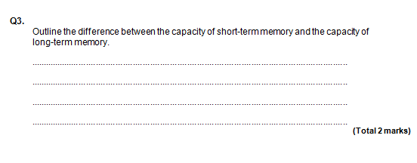

Slide 3
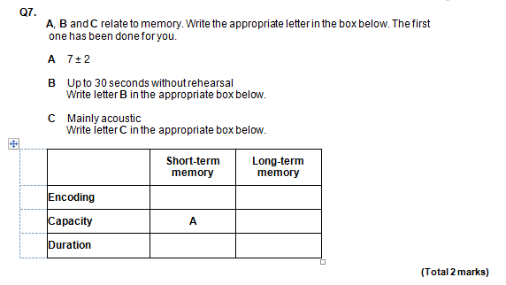

Slide 4
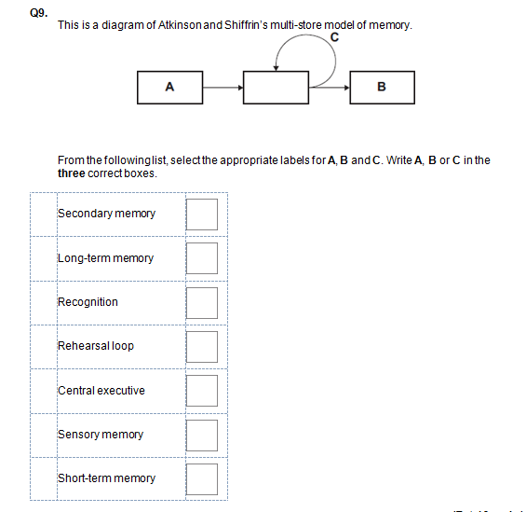

Slide 5
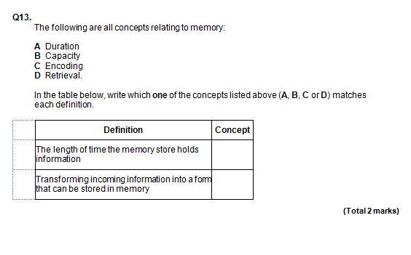

Slide 6
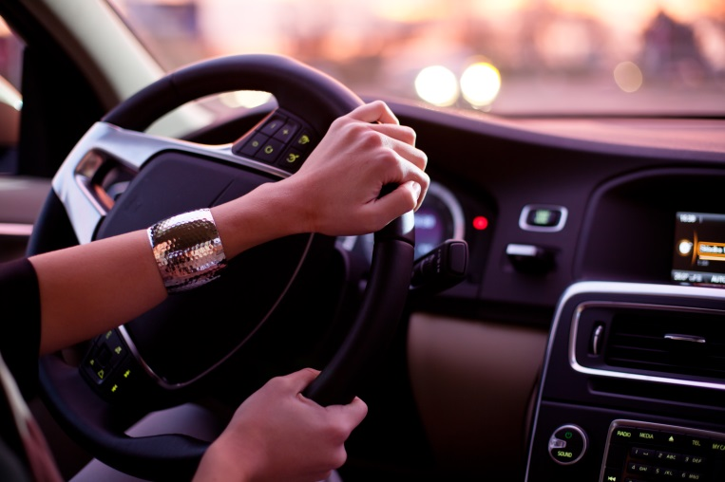

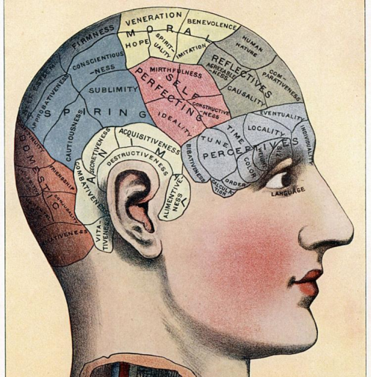


Looooooong Term Memory (LTM)

Slide 7

Starter
Start
What did you do last summer?
What is the capital of France?
Can you ride a bicycle? How do you do it?
What were you doing when you found out about 9/11?
How did you feel on your first day of primary school.
Are these questions testing STM or LTM?
How are your memories for these questions different?
https://www.youtube.com/watch?v=V9OWEEuviHE

Slide 8

What is Long Term Memory?
Long term memory holds all the facts you have learned, the skills you have practised and your personal memories.
It can store vast amount of information
It has no finite capacity

Slide 9
Long-term memory
Procedural - implicit. Not usually conscious
Knowing how
Declarative - explicit. Can be inspected consciously.
Knowing that
Episodic - Personal events.
Semantic - knowledge, etc.
Autobiographical - episodic memory
Flash bulb memory

Slide 10


Different Types of Long Term Memory
Episodic Memory
Semantic Memory
Procedural Memory

Slide 11
Episodic Memory
Memory tied to your own personal experiences
Examples:
  what did you have for dinner?
  do you like to eat apples?
  Autobiographical episodic memory – memory for specific life events that have personal meaning, e.g. where you went on holiday last year.
Notes:
Key words: long-term memory; explicit memory; declarative memory; episodic memory

Slide 12
Tulving (1989) Semantic and Episodic Memory
3 out of 6 participants showed differences in neural-imaging when completing episodic and semantic tasks.
Episodic and semantic LTMs appear in different areas of the brain. (Episodic – anterior frontal lobes / Semantic in posterior frontal lobe.)

Slide 13
Hassibis et al (2007) Neural basis of episodic memory.
21 Ppts recall either recent episodic memories or a fictitious experience whilst being scanned (fMRI).
When they thought about the imagined scene, different parts of the brain were identified compared with when they imagined a real scene.

Slide 14

Flashbulb Memory
A detailed and vivid memory of an event that is stored after one occasion and lasts a lifetime.
Events can be autobiographical such as births & deaths or historical events 9/11

Slide 15

Flashbulb Memories – Year 12
Task: Class spider gram of all our flashbulb memories…

Slide 16
Conway et al (1994) Flashbulb
  Aim: to investigate a flashbulb memory for the memorable event of Margaret Thatcher’s resignation.
  Method: opportunity sample of 923 participants were interviewed soon after she resigned. Just over a third were interviewed 11months later. Details of the memory resignation were assessed for vividness and accuracy.
  Results: 86% had an accurate memory which could be considered a flashbulb memory.
  Conclusion: A flashbulb memory was formed from the distinctive event.
  Evaluation: Longitudinal study and nearly 2/3 participants were lost. Makes the remaining sample likely to be biased and results may lack generalisability.

Slide 17
Episodic - Evaluation
Are episodic and semantic memories really all that different? Is there some overlap between the two systems.

Slide 18
Semantic Memory
Information about the world such as general facts and definitions.
Examples:
  who was Winston Churchill?
  what is a cloud?
  what is the climate at the north pole?
Unlike episodic memories, your knowledge does NOT include your personal experience
  i.e., You may never have been to the north pole but do know about it.
Notes:
Key words: long-term memory; explicit memory; declarative memory; semantic memory

Slide 19

Semantic memory
Don’t need to know when and where you learnt the fact.
Differs to episodic which is tied to time and place.
Thought to be hierarchically organised –
A
B
C
D
E

Slide 20
Task: Investigating semantic categorisation in LTM
Group task:
10 people remember some information that is organised semantically (Group A)
10 people remember some information that is random (Group B)
Procedure: Spend 3 mins verbally rehearsing the information you see in front of you
Then write down what you can remember
What do you think the results are going to be?

Slide 21
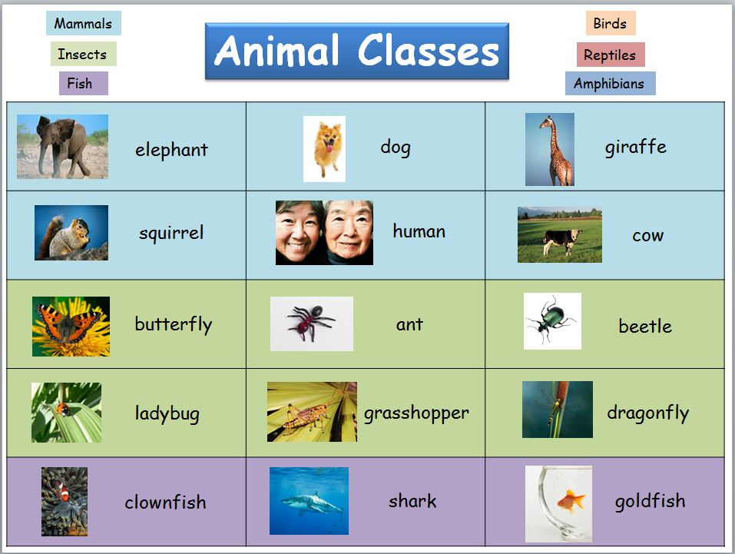
Group A

Slide 22
Group B
Elephant
Butterfly
Human
Dragonfly
Dog
Giraffe
Squirrel
Ant
Cow
Shark
Clownfish
ladybug
Goldfish
Beetle
Dragonfly

Slide 23
Write down as many words as you can remember?

Slide 24
Results – How many items were recalled?
GROUP A | GROUP B

Slide 25
Bower et al (1969) Semantic Memory
  Aim: to investigate semantic categorisation in long-term memory.
  Method: two groups of participants with same words presented differently. 4 trials of 28 words (112 in total) either hierarchically (instrument, string, parcel, paper, photocopier, etc) or randomly. Hey were then asked to free recall as many words as possible.
  Results: ‘organised conditioned’ significantly higher – mean: 73 – than ‘random condition’ – mean: 21.
  Conclusion: as recall is facilitated by organisation, long-term memory storage is probably semantically organised.
  Evaluation: when participants carry out memory experiments, an assumption is made about how the material is encoded. It is assumed participants make semantic associations between the words in organised but not in random. But it may not be the case. And such controlled laboratory experiments may tell little about how memory works in the real world.
Information is systematically linked to related information.

Slide 26
Case Study CL
Vicari et al (2007) 8 year old girl who had brain damage due to a tumour.
She had deficiencies in her episodic LTM but had excellent semantic LTM.

Slide 27
Evaluation of Semantic Memory
Semantic memories may involve a network of associated neural links rather than one specific area. Spread throughout the brain structures.
Not a single type of memory.

Slide 28

Procedural Memory
Motor or action based memory, (enables you to perform specific learned skills or habitual responses).
Does not require conscious recall.
Examples:
  Riding a bike
  How to speak grammatically
  Tying your shoe laces
Notes:
Key words: long-term memory; implicit memory; non-declarative memory; procedural memory

Slide 29
Finke at al (2012) Case Study PM
68 year old professional cellist – brain damage.
He could not remember musical facts but could remember how to play and learn how to play new pieces.

Slide 30
Case studies: Clive Wearing
Suffered from a rare brain infection that left him with a moment to moment memory.
Some procedural memories he had previously stored were still available to him.
If asked “can you play the piano?” he replied “no” – declarative knowledge.
In fact he could play the piano when sat in front of it – procedural memory.

Slide 31
Case Studies: HM
27year old suffered severe epilepsy.
Surgeons carried out drastic operation to remove most of his hippocampus.
Memory was affected – he could remember most events before operation but none after.
Both episodic and semantic memories were damaged.
Although he could not remember what he had for breakfast, he learnt how to play tennis.
The part of his brain concerned with procedural memories (cerebellum) was not affected.

Slide 32
‘HM’ - A case study of a brain damaged patient
‘HM’ was 27 years old and suffered from severe epilepsy
Surgeons removed left hippocampus in brain to deal with this
He could not form new memories after the operation, both episodic and semantic memories were affected
Although he could acquire new procedural memories, for example, he learnt to play tennis (The part of the brain associated with procedural memories, the cerebellum, was not affected)

Slide 33
‘Clive Wearing’ – A case study of a brain damaged patient
http://www.youtube.com/watch?v=OmkiMlvLKto
Famous musician who suffered a rare brain infection in 1985 that left him with only a moment to moment memory
However, some of the procedural memories that he had previously stored, like playing the piano were available to him

Slide 34
Evaluation - Procedural
Lack of research evidence.

Slide 35
Plenary – What types of LTM are in this video clip.
https://www.youtube.com/watch?v=kXJUt6XUtQ0

Slide 36
Describe and evaluate what psychologists mean by long term memory. Refer to evidence in your answer.
Plan the A01 – A02.

