Slide 1
Mocks Feedback
1. Compare your answers to mark scheme.
2. Annotate your script with what was missing.
3. WWW EBI
4. Home Learning – Choose one extended writing question and complete for homework.

Slide 2
3. Attachment
3.1 Caregiver-infant interactions in humans: reciprocity and interactional synchrony. Stages of attachment identified by Schaffer. Multiple attachments and the role of the father.
3.2 Animal studies of attachment: Lorenz and Harlow.
3.3 Explanations of attachment: learning theory and Bowlby’s monotropic theory. The concepts of a critical period and an internal working model.
3.4 Ainsworth’s ‘Strange Situation’. Types of attachment: secure, insecure-avoidant and insecure-resistant. Cultural variations in attachment, including van Ijzendoorn.
3.5 Bowlby’s theory of maternal deprivation. Romanian orphan studies: effects of institutionalisation.
3.6 The influence of early attachment on childhood and adult relationships, including the role of an internal working model.

Slide 3
Attachment Starter
In groups – look through the slides.
How would you define attachment?
What two words best describe each picture?
Write three questions you have about the attachment process?

Slide 4
Carer – Infant Interaction
Bodily contact
Mimicking
Caregiverese
Interactional synchrony
Reciprocity

Slide 5
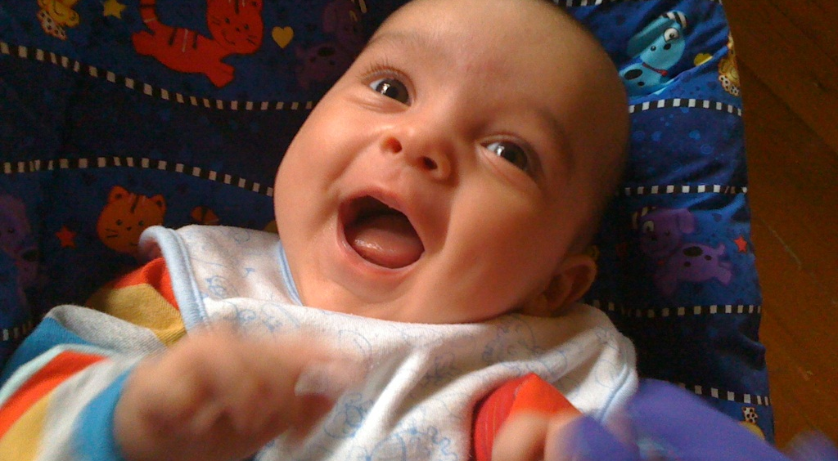
Hari aged 4 months

Slide 6
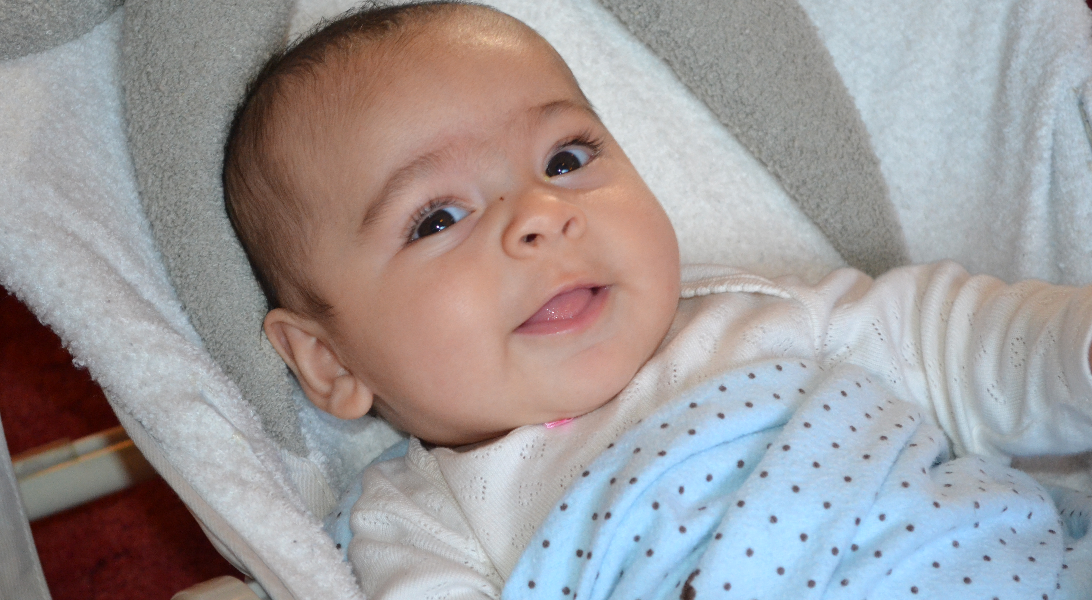
Ajuni aged 3 months

Slide 7
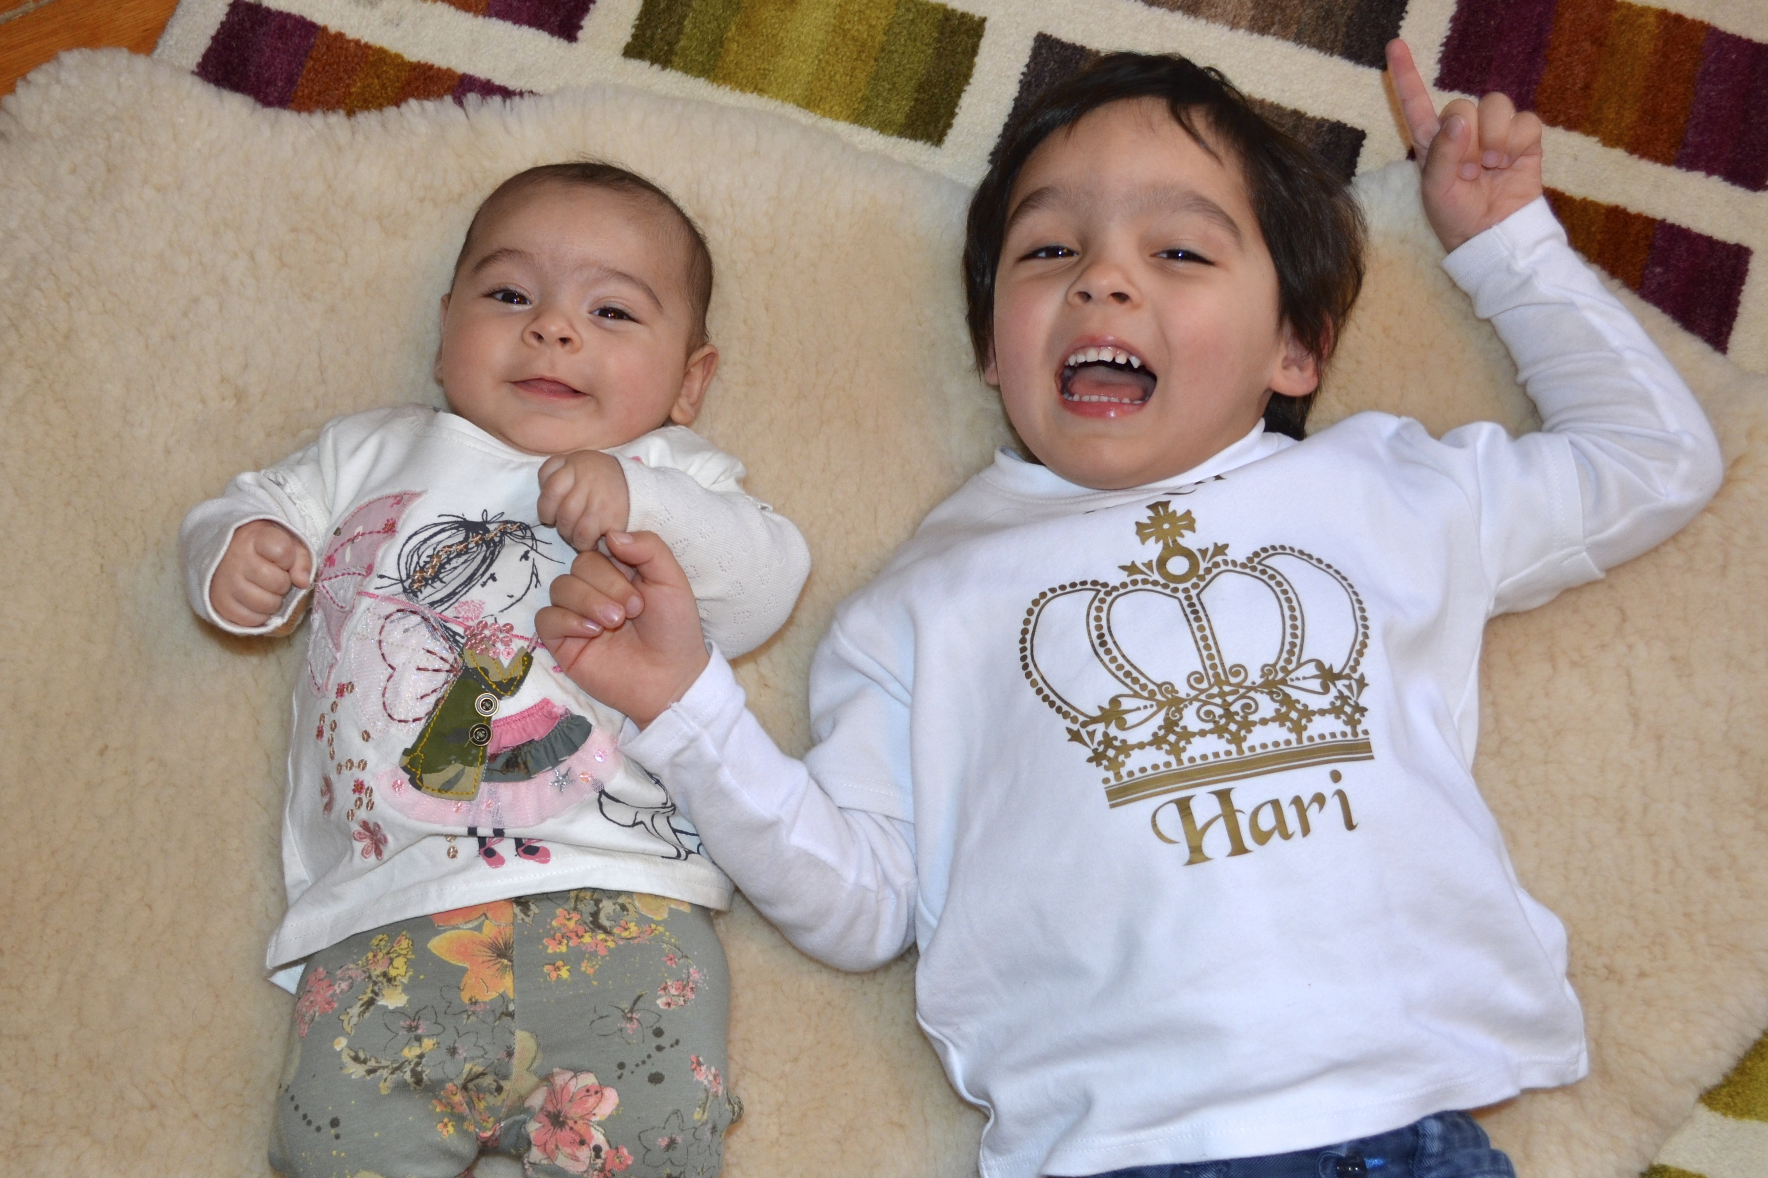
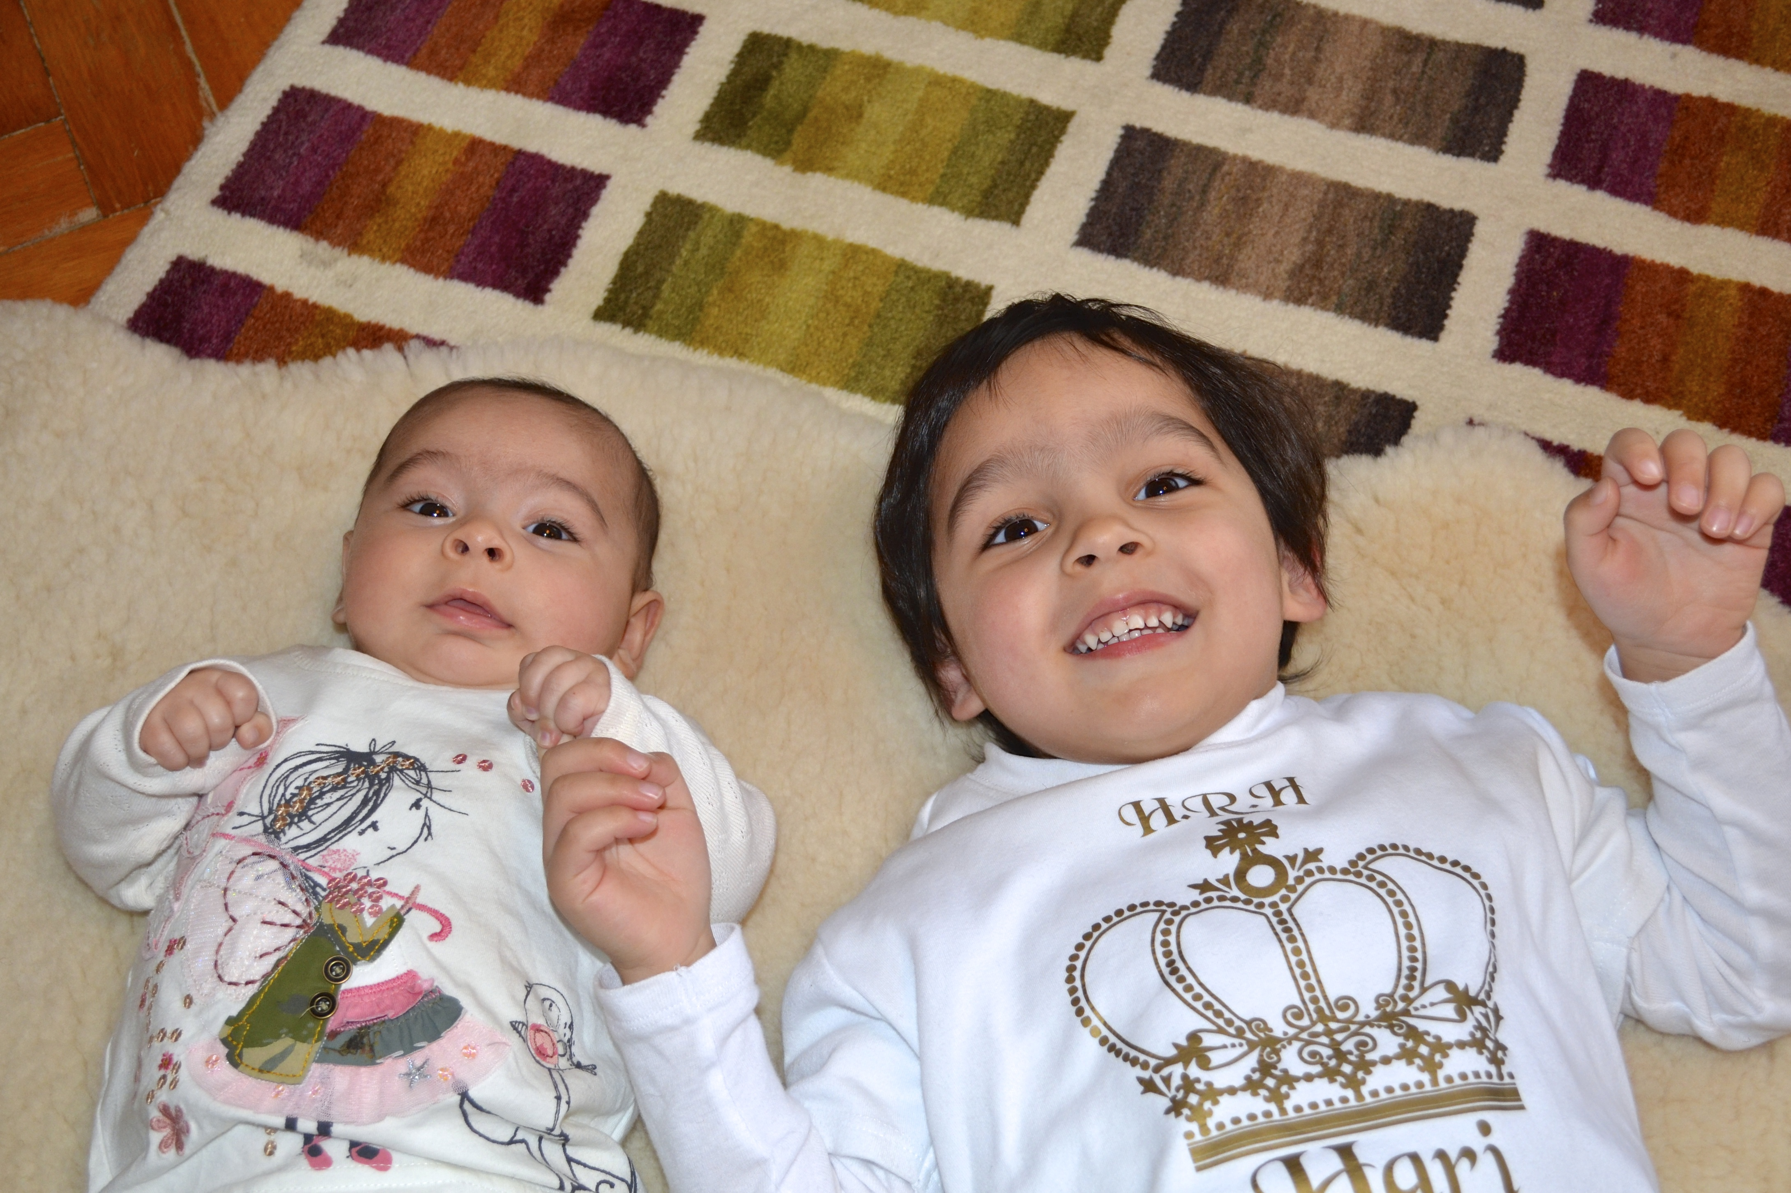

Slide 8

October 2015

Slide 9
Evidence for attachment
Klaus & Kennel – physical contact.
Melzoff & Moore – mimic facial expressions.
Papousek – cross-cultural study of tone and caregiverese
Condon & Sander – video analysis of infants coordinated actions with parents (interactional sychrony)

Slide 10
Evaluation
Observational studies of young infants have a health warning!
How do you know what is happening? Is the mimicry or sychrony intentional? Is it true communication?
Observations do not tell us the purpose of synchrony or reciprocity.
☺ However, they tend to be well-controlled and babies do not care if they are filmed so a valid method of enquiry.

Slide 11
Break-Time Research.
Investigating Synchronicity in Adult Communication.
At break – closely observe two people talking.
Look at their facial expressions, gestures, postures.

Slide 12
Schaffer’s Stages of attachment
Pre-attachment phase (0-3 months)
Indiscriminate attachment (3 – 7 months)
Discriminate attachment (7/8 +)
Multiple attachments (9 months +)

Slide 13
Schaffer & Emerson (1964) Social Attachment
A
M
R
C
G
R
A
V
E
R

Slide 14
Schaffer and Emerson (1964) studied 60 babies from Glasgow at monthly intervals for the first 18 months of life using a longitudinal method.
Children were all studied in their own homes and visited monthly for approximately one year. Interactions with their carers were analysed to establish if and when infants started to display separation anxiety.
Results revealed that attachments were most likely to form with carers who were sensitive to the baby's signals, rather than the person they spent the most time with.
By 10 months old, most of the babies had several attachments, including attachments to mothers, fathers, siblings and extended family. It was observed that the mother was the main attachment figure for roughly half of the babies when they were 18 months old and the father for most of the others.
Based on this finding, this would suggest that being sensitive and responsive (including playing and communicating an infant) is more instrumental in attachment development than physical care.

Slide 15
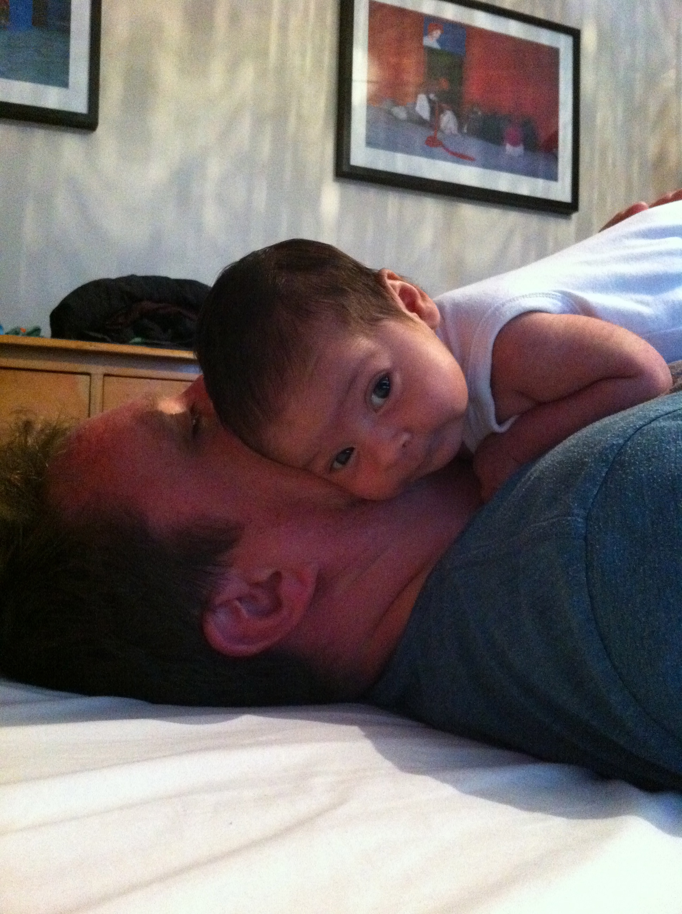
What is the role of fathers?
Post-it Note Challenge.
What words summarise the role of fathers?
Ajuni – 6 weeks

Slide 16
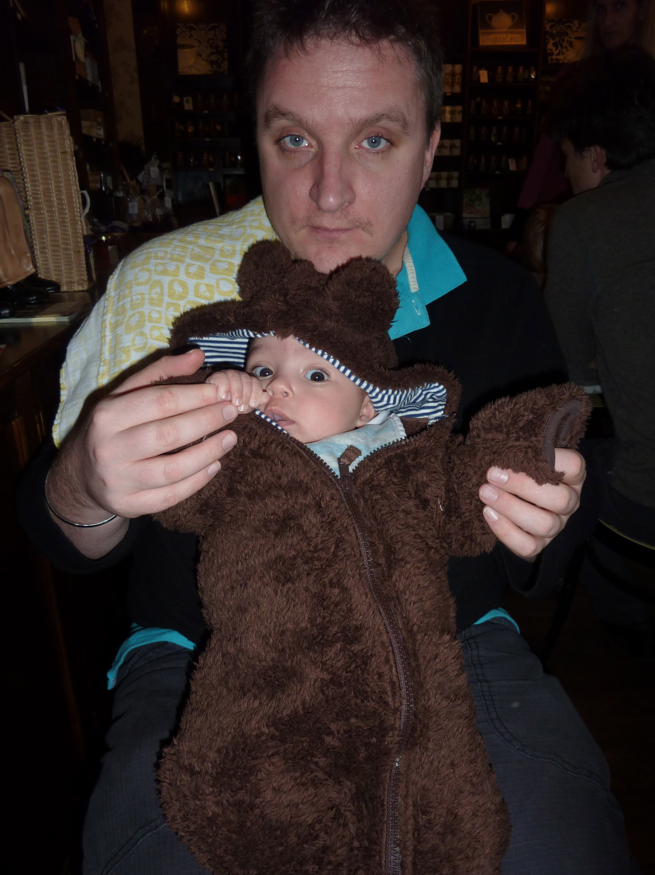
Hari aged 2 months

Slide 17
Dads: A contested area of research
John Bowlby
Theory of monotropy
Children have one prime attachment - all other relationships were minor.
Shaffer & Emerson
Mother first, then Father.
Micheal Rutter
Multiple attachments – it is normal for children to form emotional bonds with many carers.
Read through the research on pg. 108
In groups, answer the key questions on the next slide

Slide 18
The relationship between fathers and children
Sensitivity
Experiences with own parents
Marital Intimacy
Supportive co-parenting

Slide 19
Question to ask about the role of fathers?
Are fathers primary attachment figures or secondary attachment figures?
Do mothers and fathers have separate roles or are they the same?
If fathers have a distinct role why aren’t children without fathers different?
Why don’t fathers generally become primary attachments?
Why is this research politically sensitive?

Slide 20
The role of Fathers?
Evidence suggests fathers are just as able as mothers to form sensitively responsive, secure attachments with children.
Fathers who spend quality time with their children – the children develop more secure attachments – better adult relationships

Slide 21
A02 - Application: Boris
Research into the role of the father in attachment has allowed psychologists to advise parents about their children’s development. Boris is the father of a 9 month old girl. Emily. Boris has noticed that recently when Emily is distressed she only accepts comfort from her mother. This upsets him and leaves him feeling unimportant.
Question: Referring to research into the role of fathers what advise would you give Boris about his role and what could he do?

Slide 22
3. 1 Exam Questions -
Explain what is meant by interactional synchrony. (2 marks)
Define attachment (2 marks)
Explain what is meant by multiple attachments (3 marks)
Outline research into caregiver-infant interactions. (4 marks)
Outline the role of the father in attachment. (6 marks)
Outline stages of development as identified by Shaffer. (4 marks)
Outline one criticism of Shaffer’s stages of development. (4 marks)
Describe and evaluate Shaffer’s stages of attachment (12 marks)

