Slide 1


Forgetting
Aim
Identify explanations of forgetting
Explain what is meant by trace decay, displacement, interference, retrieval theory and motivated forgetting
Evaluate these explanations.
Start
Why do people forget? Write down your ideas.

Slide 2

The Multistore model of memory states that LTM has an unlimited capacity, and memories have a duration of potentially a lifetime.
However, we know by experience that we forget information stored in the LTM.
But does that mean the memories are gone (availability), or we just can’t reach them (accessibility) ?

Slide 3
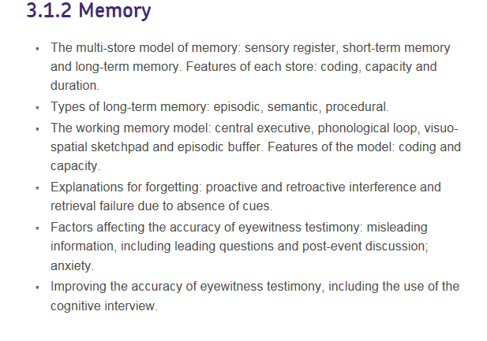
Specification

Slide 4

Forgetting
The inability to recall or recognise something that was previously learned.
Have a go at trace decay experiment.
www.psychlotron.org.uk

Slide 5
Which theory best explains the Serial Position Effect?
TRACE DECAY?
Does not explain why earliest material is remembered better (Primacy Effect) than the material in the middle which came latter.
Explains why material is lost from middle and why less is lost from the end (Recency Effect) but it does not explain the primacy effect.
Offers best explanation, material in middle of curve is subject to both Pro-active & Retro-active interference, but the material at start and end of the list only one of these.
DISPLACEMENT?
INTERFERENCE?
Primacy Effect
Serial Position Curve
Recency Effect
Retro-active Interference only
Pro-active Interference only
Both Pro-active & Retro-active Interference
Can you think of examples from LTM when this may not be the case?

Slide 6
Create a table
Explanations of forgetting:
Theory | Description | Evidence | Evaluation

Slide 7
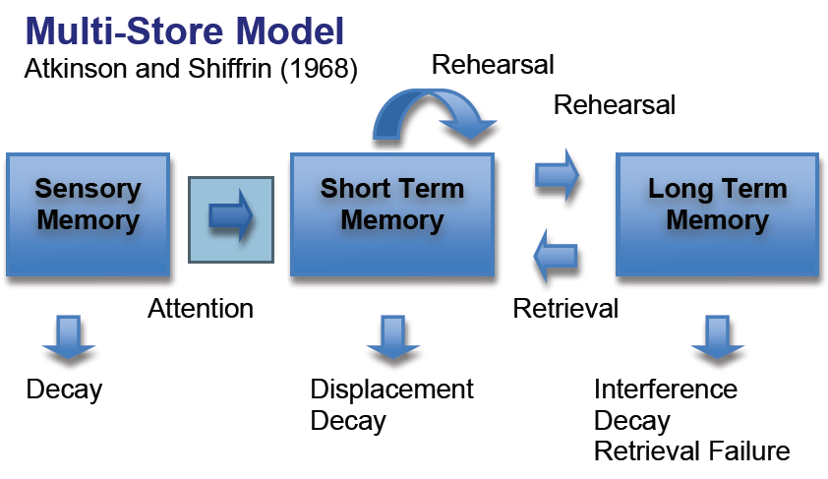
What are the main features of the Multi – Store Model of Memory

Slide 8
Trace Decay (STM)
www.psychlotron.org.uk

Slide 9
The simple idea that memories are lost over time is called
TRACE DECAY
First proposed by Hans Ebbinghaus in 1885 based on testing his own memory for non-sense syllables (such as BEJ, ZUX) which had no associations.
Ebbinghaus found that his memory decayed over time, called the “FORGETTING CURVE”.
RECALL %
TIME = DAYS
This is NOT an adequate explanation for forgetting in LTM because -
Items which cannot be remembered at one time can be recalled later.
Older meaningful memories of important events can often be remembered better than newer but less relevant ones.

Slide 10
Trace Decay in STM?
Distractor task practice – count back in three’s from 333.
Student Exercise
MemEx1
Instructions:- Read the consonants that appear below then count backwards in three’s from the number given. Write down the letters you recall when asked.
L Z M , P V Q, X F D
763
STOP! WRITE NOW!
B F Y , G Z J, P D L
435
STOP! WRITE NOW!
K M R , H G Y, J T Z
917
STOP! WRITE NOW!
M Q L , T L Y, F R N
329
STOP! WRITE NOW!
This shows that the longer the interval before recall the more items that are lost from memory. This is what we would expect because Peterson & Peterson showed that the duration of S.T.M. is between 18 – 30 secs.

Slide 11
Trace Decay (STM)
Trace decay
  Based on the idea that information is physically represented as a memory trace (i.e. arrangement of neurons – structural change in the brain.
  The trace is fragile and disintegrates if not constantly refreshed
  In STM after about 20s, the trace has decayed completely & recall is no longer possible

Slide 12
Trace Decay: Evidence
☺ Peterson & Peterson (1959)
  Recall of trigrams after varying intervals
  Interference task to prevent rehearsal
☺ Found less that 10% recall after 18s
  Claimed evidence for decay in STM
☹ Difficult to test trace decay as participants will automatically rehearse.
☹ Forgetting may be due to interference rather than decay (Waugh & Norman, 1985)
www.psychlotron.org.uk

Slide 13
Displacement (STM)
Short Term Memory
www.psychlotron.org.uk

Slide 14
Is the simple idea that new memories will replace old ones
DISPLACEMENT
This theory assumes that a memory store has a limited capacity, so which types of memory will it apply to?
Miller (1956) found that when STM was full up (5 – 9 items) new material would push out the old.
NEW INFORMATION INPUT
OTHER INFORMATION IS LOST
S.T.M.
7⁺₋2 items
Evidence from the digit span tests! Also Sperling (1960) found that SENSORY MEMORY also has a very limited capacity so this theory would also explain forgetting here but-
This is NOT an adequate explanation for forgetting in LTM because -
As far as we can tell LTM has an unlimited capacity.
We can recover memories that we thought were forgotten.

Slide 15
Displacement
Displacement
  Based on the idea that STM has a strictly limited capacity for information
  If STM is full and new information is registered, then some existing info is pushed out or overwritten.
  Good description of forgetting in STM when applied to the MSM model.
  Digit-span evidence.
  ☹ Does not account for WMM – Is STM more complex than a limited capacity store.
www.psychlotron.org.uk

Slide 16
Forgetting: interference
Interference: one memory disturbs the ability to recall another. This might result in forgetting or distorting one or the other or both. This is more likely to happen if the memories are similar.
Proactive interference:
Previously learnt information interferes with the new information you are trying to store.
Retroactive interference:
A new memory interferes with older ones.
Old memory
New memory
Old memory
New memory
Proactive interference
Pro=forward
Retroactive interference
Retro=backward

Slide 17
Interference (mainly LTM)
Retroactive – later learning disrupts memory of earlier learning
e.g. Learning French then later Spanish – The Spanish can disrupt the knowledge of the French
Proactive – Previous learning interferes with what is being learnt
e.g. Change location of cutlery in kitchen, but keep going to the old drawer
What happens in between learning and recall
Old phone number interferes with new phone number
New phone number interferes with old phone number.

Slide 18
Proactive interference
This is when previous learning interferes with later learning. (When an older memory interferes with a new one).
E.g. When you rearrange the location of items in a room, and you keep going back to the place where the items used to be instead of where they are now.

Slide 19
Retroactive interference
This is when later learning disrupts earlier learning. (When a newer memory interferes with an older one).
E.g. new facts about WMM could alter what you know about the MSM

Slide 20
Proactive or retroactive ?
Imagine you have learned to drive a car in the UK (You have learned to drive on the left side of the road).
You then fly to Spain and hire a car. Driving out of the airport, you narrowly avoid causing an accident because you failed to drive on the right.
What type of intereference caused this?

Slide 21
Answer: Proactive interference: Your old memory of driving on the left interfered with the later learning of driving on the right.
You return to the UK and driving out of the car park, you find yourself in the right hand lane.
This is another type of interference. Which?

Slide 22
Answer: Retroactive interference: the new (recent) memory of driving on the right in Spain has interfered with your earlier, original learning of driving on the left.

Slide 23
Retroactive Interference – Underwood & Postman (1960)
Learn word pairs
Set A
Dog- Balloon
Carrot – Fence
Moon – Chair
Baby – Market
Parcel – Lamp
Wine - Pencil
River – Cheese
Hammer - Football

Slide 24
Retroactive Interference
Learn word pairs
Set B
Dog- Paper
Carrot- Milk
Moon- Ankle
Baby- Petal
Parcel-Tent
Wine - Dog
River – Book
Hammer - Plastic
Learn word pairs
Set A
Dog- Balloon
Carrot – Fence
Moon – Chair
Baby – Market
Parcel – Lamp
Wine - Pencil
River – Cheese
Hammer - Football

Slide 25
Retroactive Interference
Learn word pairs
Set B
Dog- Paper
Carrot- Milk
Moon- Ankle
Baby- Petal
Parcel-Tent
Wine - Dog
River – Book
Hammer - Plastic
Learn word pairs
Set A
Dog- Balloon
Carrot – Fence
Moon – Chair
Baby – Market
Parcel – Lamp
Wine - Pencil
River – Cheese
Hammer - Football

Slide 26
Interference - Warr
Proactive
When list A interferes with list B recall.
Retroactive
When list B interferes with list A recall.

Slide 27
Underwood & Postman(1960)
Aim: to find out if new learning interferes with previous learning.
Procedure: Participants were divided into two groups. Group A were asked to learn a list of word pairs i.e. cat-tree, they were then asked to learn a second list of word pairs where the second paired word was different i.e. cat – glass. Group B were asked to learn the first list of word pairs only. Both groups were asked to recall the first list of word pairs.
Results: Group B recall of the first list was more accurate than the recall of group A.
Conclusion: This suggests that learning items in the second list interfered with participants’ ability to recall the list. This is an example of retroactive interference.

Slide 28
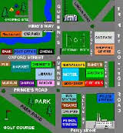
Schmidt et al (2000) Remembering streets of childhood.
How is this a study of RETROACTIVE interference?
Pg. 77

Slide 29
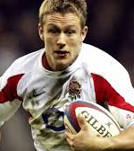
A real life study: Baddelley & Hitch (1977)
Rugby players study.
They had to remember the names of the teams they had played.
The more teams they played the poorer the recall as new teams interfered with memory of old ones. (retroactive interference)

Slide 30
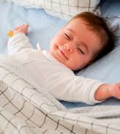
Abel & Baum (2013)
Pps given a list of word-pairs to remember and a second list of similar word-pairs.
Tested after 12 hours sleep or wakefulness.
Sleep reduced both retroactive and proactive interference.

Slide 31
PROACTIVE
INTERFERENCE
RETROACTIVE
For example you are learning Spanish this year, last year you leant French.
Where information learnt earlier interferes with that learnt later.
Where information learnt later interferes with that learnt first.
Qu. What is it if John calls his current girlfriend by the name of his ex?

Slide 32
Evaluation of Interference
☺ Support from lots of laboratory studies.
☺ Good explanation of forgetting in LTM.
Studies lack ecological validity
Semantic or episodic memories are more resistant to interference
Does concept explain all types of forgetting or just a very specific circumstances when two sets of information are similar.

Slide 33
Apply it: Outline the interference theory of forgetting, referring to Caleb’s experience in your answer. ( 4 marks)
Caleb saw a film about Zombies a while ago, and went to see a different one recently. A friend, Ashton, asked him some questions about the first film but Caleb found he had trouble recalling the details accurately. A second friend, Anais then joined in and wanted to know about the recent film Caleb went to see. But again, Caleb seemed to forget some parts.

Slide 34
Caleb had difficulty remembering details of the first film when Ashton asked him due to retroactive interference. This is because he had seen a newer film afterwards and this new memory had interefered with the memory of the original film.
He had difficulty remembering the newer film when Anais asked due to proactive interference. This was……

Slide 35
Exam question
Explain how proactive interference differs from retroactive interference ( 3 marks)

Slide 36
Multiple choice
Proactive interference occurs when:
(a) Newer memories cause forgetting of older ones
(b) Memories fade over time
(c.) Older memories cause forgetting of newer ones
(d) We don’t have the right information to trigger out memory.

Slide 37
Answer:
C

Slide 38
Multiple choice
Which of the following examples is the best example of retroactive interference?
A) A student revises for her Spanish exam, then her French exam and has trouble recalling her Spanish
B) A student revises for her Spanish exam, then her French exam and has trouble recalling her French
C) You have anew mobile number but keep telling people your old one
D) You accidentally call your new boyfriend or girlfriend by your old one’s name

Slide 39
Answer
A

Slide 40
Tip of the Tongue
To Start…
Have you ever experienced ‘tip of the tongue’ phenomenon?
Or come down the stairs to get something only to completely forget what it was once you get down...
Annoying isn’t it? ☺
Why do you think it happens?

Slide 41
Cue Dependent
Experiment
You will see a number of things on the screen. In each case, write down the first thing you think of/remember…

Slide 42
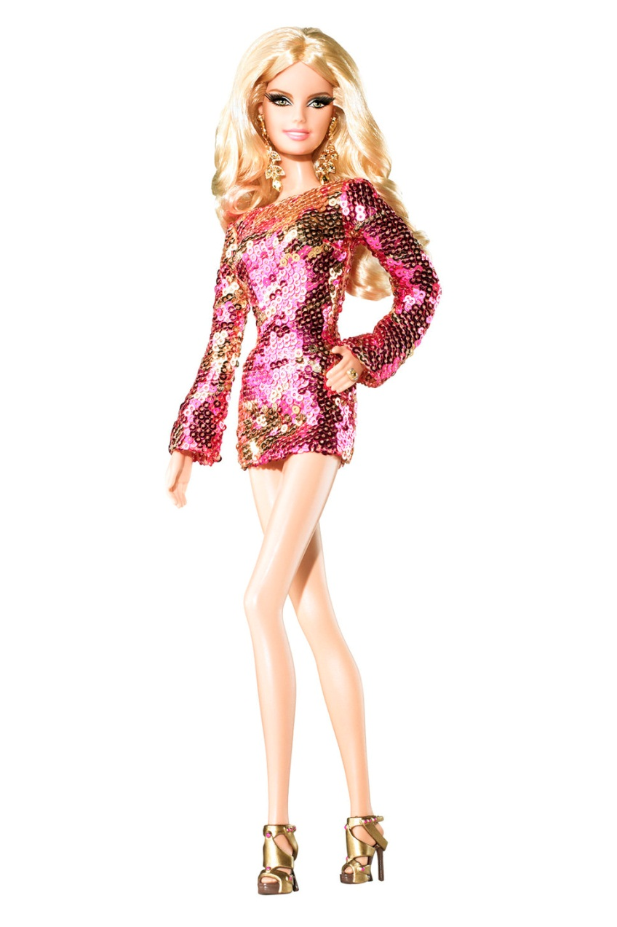
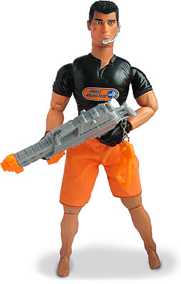
Cue Dependent

Slide 43

Cue Dependent
The Smell of…

Slide 44

Cue Dependent
The taste of…

Slide 45
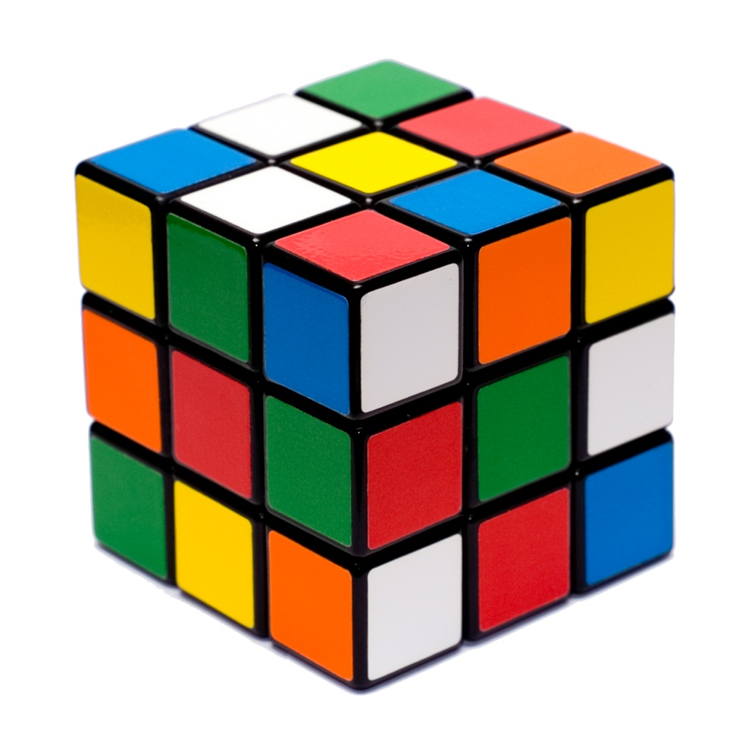
Cue Dependent

Slide 46
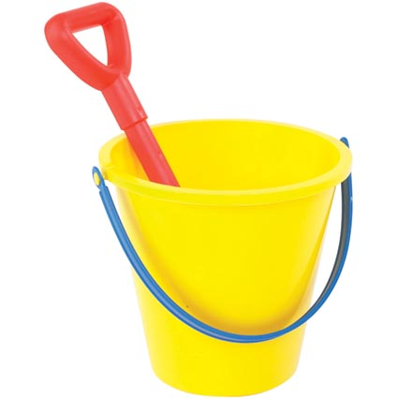
Cue Dependent

Slide 47
Cue Dependent
Why might these objects help us to recall our memories?

Slide 48
Cue Dependent
Retrieval failure Forgetting, Tulving (1972)
This is when we cannot access the memory until the correct retrieval cue is used.
When we encode a new memory we also store information that occurred around it, such as the way we felt or the place we were in. If we cannot remember or recall it, it could be because we are not in a similar situation to when the memory was originally stored.
‘Encoding Specificity Principle’ (Tulving) = “the greater the similarity between the encoding event and the retrieval event, the greater the likelihood of recalling the original memory.”

Slide 49
Cue Dependent
There are two types of cue dependent forgetting…
Context
State
What could each of these mean?

Slide 50


If information has been encoded and stored successfully in LTM but still cannot be remembered then this could be due to –
Cue Dependant Forgetting
“Tip of the Tongue” is a common experience when we simply need the right clue (or Cue) to help us recall something.
The cue usually relates to the conditions of encoding, in semantic memory it often organisational – eg: categories.
State Dependant forgetting
Is when your internal state, mood or condition at the time of encoding information provides a cue to remembering it.
Context Dependant forgetting
WORDS WORDS WORKS
Is when the external environmental factors at the time of encoding information provides a cue to remembering it.

Slide 51
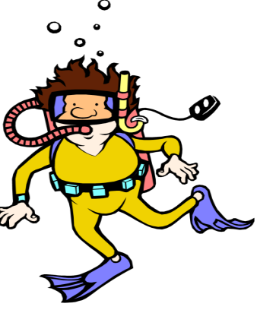

Context-dependent forgetting
Context-dependent forgetting can occur when the environment during recall is different from the environment you were in when you were learning.
Aim: Godden and Baddeley (1975) investigated the effect of environment on recall.
This study took place in Scotland.
Procedure:
18 divers from a diving club were asked to learn lists of 36 unrelated words of two or three syllables
4 conditions :
Learn on beach- recall on beach
Learn on beach- recall under water
Learn under water- recall on beach
Learn under water- recall under water
Results
Conclusion: the results show that the context acted as a cue to recall as the participants recalled more words when they learnt and recalled the words in the same environment than when they learnt and recalled the words in different environments.

Slide 52
Godden and Baddeley (1975) Context Dependent
Aim: To see if cues from the environment affect recall.
Method: Field experiment with deep-sea divers who learned lists on land or underwater. Recall tested in same or different context.
Results: Learn & recall in same context 30% improvement in context.
Conclusion: Environmental context affects memory.
Evaluation: Extreme conditions do not really reflect memory in everyday.

Slide 53
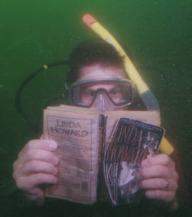
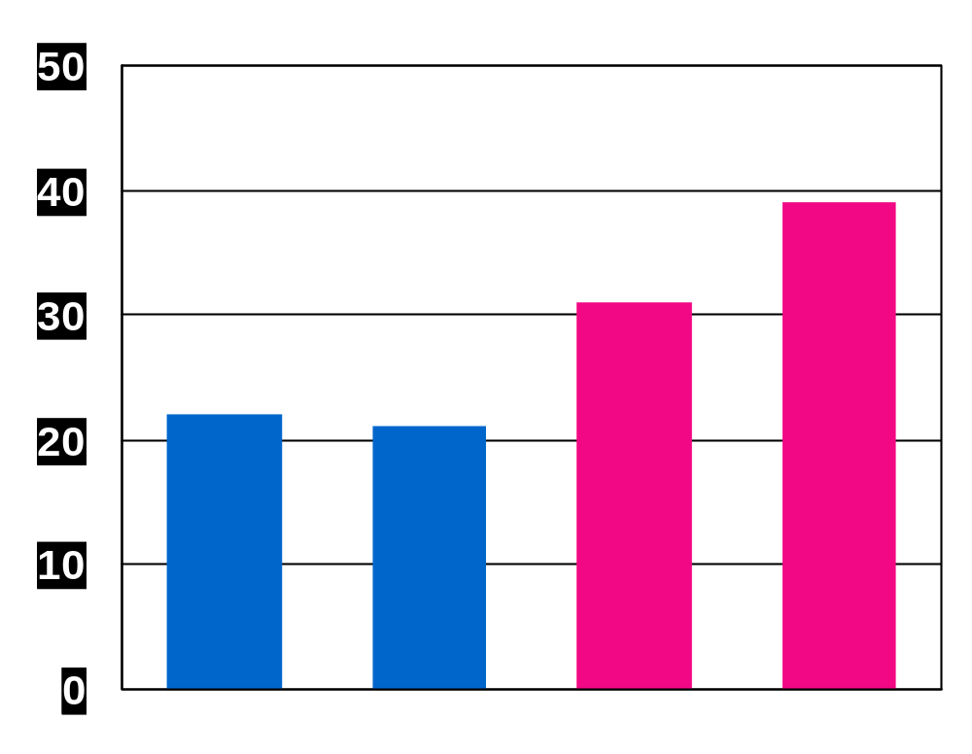
Context-dependent effects
Key Study: Godden & Baddeley (1975)
Words heard underwater are best recalled underwater
Words heard on land are best recalled on land
Percentage
of words
recalled
Water/
land
Land/
water
Water/
water
Land/
land
Different contexts
for hearing
and recall
Same contexts
for hearing
and recall
Notes:
key words: forgetting; retrieval; retrieval cues; context-dependent effects
Notes:
This graph refers to a study by Duncan Godden and Alan Baddeley (1975). In this study, scuba divers listened to a list of words either while they were on land or while they were underwater. They were later asked to recall as many words as possible. Results indicate that contextual consistency (i.e. land-land or water/water) results in better performance.

Slide 54
Overton (1972) State Dependent
Aim: investigate the effect of alcohol on state-dependent retrieval.
Method: Participants asked to learn material drunk or sober.
Results: Participants who had learnt material when drunk had problems in recalling information when sober but where more likely to recall when drunk again.
Conclusion: People tend to remember material better when there is a match between mood at learning and at retrieval.

Slide 55

State dependent effects
Recall improved if internal physiological or emotional state is the same during testing and initial encoding.
Drunk during
learning
Recall better
if drunk
Than if sober
Notes:
key words: forgetting; retrieval; retrieval cues; state-dependent effects
Notes:
Example of state-dependent effect: A person who hides money while drunk may forget the location until drunk again.
For this example, I usually stress that this this is not a call to get drunk before an exam in order to improve your grade. I point out that subjects who are sober at the initial time of learning and during testing do significantly better than those in an intoxicated state.

Slide 56

Darley et al (1973) State Dependent
Ppt’s who hid money while high on marijuana were less able to recall where when not high than when high again.
Question: Why might this research be considered unethical?

Slide 57
Evaluation of Cue Dependent Forgetting
Lots of empirical evidence.
Godden & Baddeley (1975)
Forgetting is greatest when context and state are not very similar
Studies lack ecological validity.
Studies have dubious ethics.
How does this apply to our AS revision

Slide 58
Evaluation
This study has limited ecological validity because the environment was familiar to the divers but the task was artificial as we are not usually asked to learn a list of meaningless words in our everyday life.
Another weakness is that the groups who learnt and recalled in different environments were disrupted (they had to change environment) whereas the groups who learnt and recalled in the same environment were not disrupted. This could have influenced their recall.
However it was a controlled experiment so it can be replicated so reliability can be tested.
There is further support for the influence of contextual cues. Abernathy (1940) found that students performed better in tests if the tests took place in the same room as the learning of the material had taken place, and were administered by the same instructor who had taught the information.
The studies carried out do not take into account the meaning of the material and the level of motivation of the person when learning the information.
Real –life applications:
This is used as a strategy to improve recall in eye-witness memory when the witnesses are asked to describe the context in which the incident they have witnessed took place during cognitive interviews.
This theory is difficult to disprove as if recall does not occur is it because the information is not stored or because you are not providing the right cue? (circular argument)

Slide 59
Real world application
How can ideas of state dependent and cue dependent retrieval support us in:
Improving revision techniques.
Improving witness recall at crime scene.

Slide 60
Apply it
Paul drove his friends out to eat one summer’s day. Just as they got to the restaurant car park he suddenely realised something- he had forgotten his wallet. “I keep my wallet and jacket in different places, but always pick them up together”. Paul said, but because its such a lovely evening, I decided not to bother with the jacket.
Explain how Paul forgetting his jacket meant that he also forgot his wallet. ( 3 marks)

Slide 61
Exam questions
In the context of forgetting, what is meant by a cue? You should use an example in your answer. ( 2 marks)
Describe one study in which retrieval failure was investigated. Indicate in your chosen study the method used and the results obtained. ( 4 marks)

Slide 62
Multiple choice
Retrieval failure occurs when:
A) Information disappears from memory and is no longer available
B) Information was never encoded in LTM in the first place
C) We don’t have the right cues to recall a memory
D) WE have a lot of relevant cues and we pay attention to them

Slide 63
Answer
C

Slide 64
Multiple choice
Godden & Baddeley found lower levels of recall when
A) Learning & recall both took place under water
B) Learning & recall both took place on land
C) Recall took place only a short time after learning
D) Learning took place on land and recall took place underwater

Slide 65
Answer
D

Slide 66
Motivated forgetting
Suppression
Deliberate and conscious forgetting
Forgetting on demand
e.g. Racing Car Drivers
Repression
Motivated forgetting without conscious awareness
e.g. Childhood Trauma

Slide 67
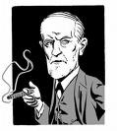
MOTIVATED FORGETTING – is the idea that we forget some things (from LTM) because it is not in our best interests to recall them; this could be due to ..
Repression
Freud (1901) suggested that this Ego Defence Mechanism protected the conscious part of the mind (Ego) from the primitive, socially unacceptable drives in the unconscious mind (Id).
Evidence in support of repression.
Evidence against repression.

Slide 68
Williams (1994) Repression
Aim: Investigate repression
Method: Interviews 129 women shown by hospital documents to have been abused between 10 months and 12 years. Interviewed later between 18 – 31 years.
Result: 38% had NO memory of the event.
Conclusion: Some participants had repressed the memory.
Evaluation: Ethical?

Slide 69
Case Study: Irene
Irene, a young 20 year old woman, lived with her mother in an attic. Her mother had reached the final stages of TB. Irene slowly watched her mother dying for 60 days and nights. When her mother died, she tried to revive the corpse.
Soon after, Irene had no memory of the events surrounding her mother’s death. ‘What did she die from? Was I there?
Sometime later, Irene began to have fits during which she would act out events from her life, including her mothers death. She remembered none of this and had no conscious memory. Clearly, the event had not disappeared from memory.
How can we explain this?

Slide 70
Case study: Eileen
In 1969, Eileen’s eight year old friend Susan disappeared. Twenty years later, Eileen suddenly remembered what had happened to her friend. Eileen’s daughter reminded her of Susan and the memories came flooding back. She remembered she had seen her own father sexually abuse and beat her to death with a rock. He threatened to kill Eileen if she told anyone. 20 years after the event her father was found guilty of murder and imprisoned.
How do we access repressed memories?

Slide 71
Motivated Forgetting
Retrieval not available through conscious thoughts.
Access only via Freudian techniques – free association.
The memory is retrieved through CATHARSIS (release of emotional tension)

Slide 72
Evaluation of Motivated Forgetting
☺ Lots of evidence from clinical studies – written reports from psychiatric patients.
To investigate participants must experience something traumatic – not possible in Lab.
Is this type of research ethical?
Do women in Williams’ study choose to not remember their abuse?
How do we know repressed memories are real? Could they be FALSE MEMORY SYNDROME?

Slide 73
False Memory Syndrome
The memory of an event which never happened.
Pynoos and Nadar (1989)
Children’s memories of a sniper attack.
Loftus (1993)
‘planted’ memories.
Lost child in a shopping centre
Are repressed memories all real? Or are they false memories?

Slide 74
Plenary
How might your knowledge of memory and theories of forgetting influence your revision techniques.
Devise 5 Top Tips …

