Slide 1
Pop Quiz
Define the following key terms:
Social roles
Unanimity
Agentic state
Authoritarian personality
Locus of Control
Minority influence
Coding
Capacity

Slide 2
THE MOCKS!!!
What do you need to know?
Conformity
  Majority influence: Asch/Mori & Arai
  Conformity to Social Roles: Zimbardo
  Obedience: Milgram + replication
  Locus of Control
  Social Support
  Minority influence: Moscovici
  Social influences in social change
What do you need to know?
Memory
  Multi-store model
  Types of Long term memory
  Working memory model
  Explanations of forgetting: interference and cue dependent forgetting
  Factors affecting the accuracy of eyewitness testimony
  Improving the accuracy of eyewitness testimony: the cognitive interview

Slide 3
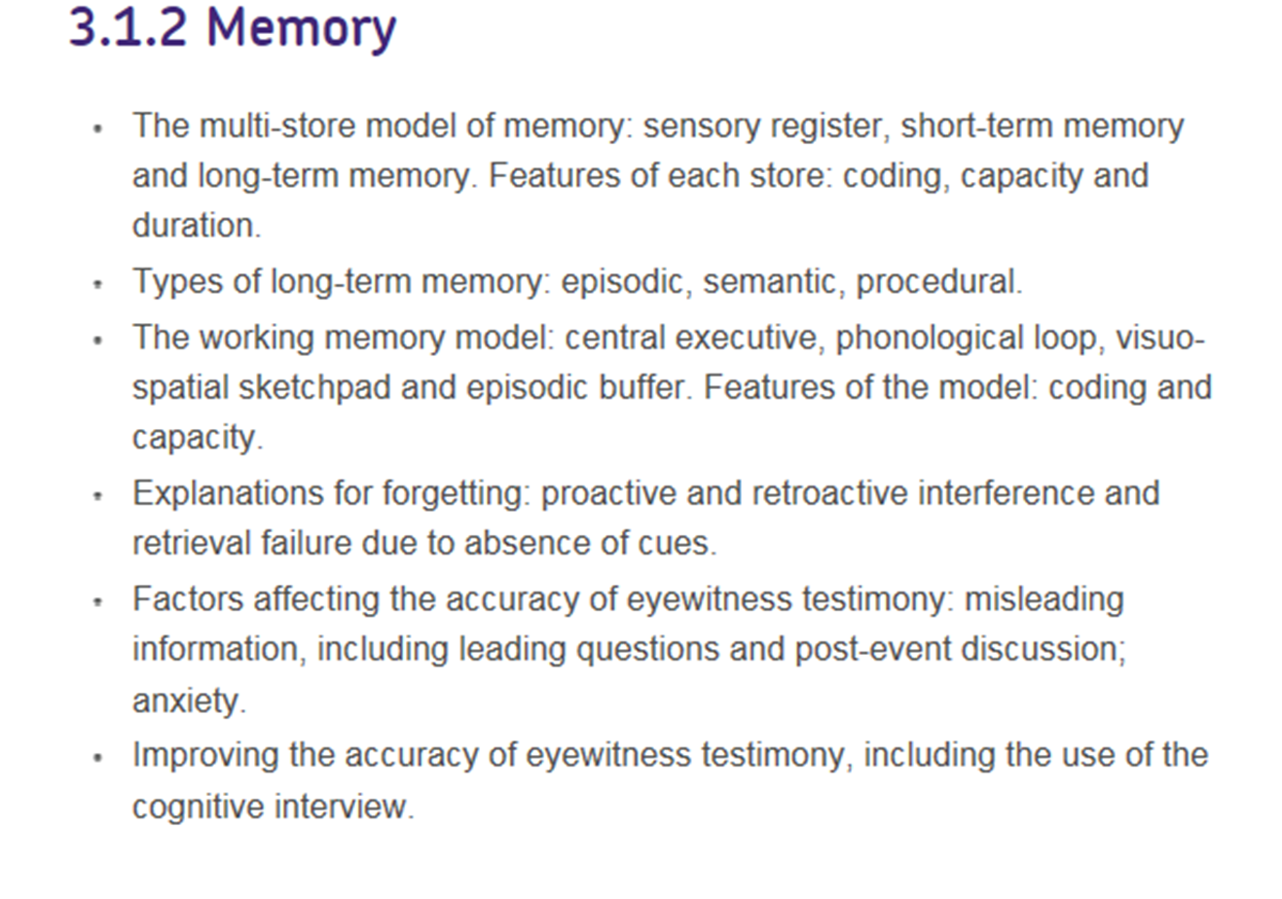
The Specification

Slide 4
Read the Article: Picking Cotton
What are the problems with eye witness testimony?
What factors affect the accuracy of our eye witness testimony?
What are the practical problems with the unreliability of eye witness testimony?

Slide 5
“There are lots of people who mistake their imagination for their memory”
Josh Billings
Eye Witness Testimony

Slide 6
Key Terms
Eye witness testimony
Schema
Misleading Information
Post-event discussion
False Memories
Anxiety

Slide 7
Key Terms
Evidence provided by observers
A mental picture of information, events.
Information that leads you to a certain conclusion
Information added to memory after the event
Memories created by suggestion
Unpleasant state of emotional arousal

Slide 8
Schema
What do you expect to find in the kitchen?
  Either make a list or draw your kitchen.
  Compare your kitchen with a partner.
  Is there anything unusual?
Our schema influence our memories by filling in gaps with what we expect to see/happen.
If a situation doesn’t fit with our schema then our memory might be distorted.
However, our schema are not fixed, they are changed by our experience.

Slide 9
Schema Theory
Schema: An organised packet of information about the world, events or people.
Schemas are developed through accommodation and assimilation.
Schemas enable us to process and interpret information.

Slide 10

Reconstructive Memory: Bartlett
Activity: Chinese Whispers
Write a short and simple message 10 or 15 words.
How does the message compare to the original?
Why is it different?

Slide 11

F. Bartlett (1932)
Reconstructive Memory
Memory is an active process which uses existing knowledge (schemas) to understand new information. Not just a copy of something.

Slide 12
Reconstructive Memory: Bartlett (1932)
‘War of Ghosts’ – A North American folk story, which was given to participants to read.
Aim: to see if people. when given something unfamiliar to remember, would alter the info.
Method: Over varying periods, from a few hours to several months, participants were asked to recall everything they could about the story.
Results: participants imposed their own meaning on the story. In particular, participants:
Omitted some details and added new details
Gave reasons for incidents
Added emphasis on some parts
Changed the order of incidents
Conclusions: Our memory is influenced by our existing knowledge (schemas) and beliefs. Sometimes we fill in the gaps in our memory.

Slide 13
Reconstructive Memory:
What are the Practical Applications?
You cannot rely on accuracy of memories.
Two people may give different versions of events.
We do tend to emphasise certain aspects of the things we remember and play down others.
Our previous knowledge clearly influences the way we remember things.

Slide 14
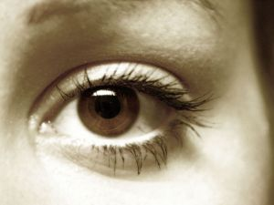
Activity 3: Factors affecting EWT
Are you a good eye witness?
Awareness test
EWT test 2

Slide 15
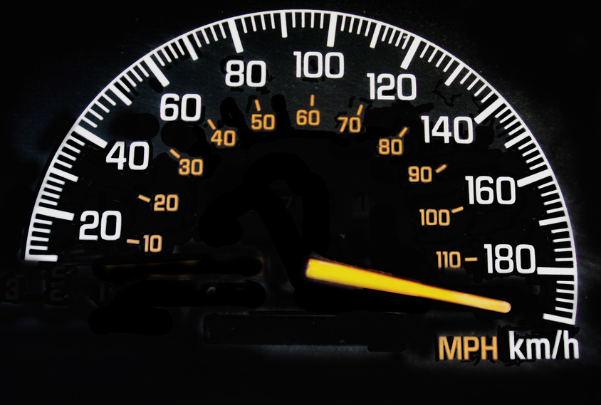
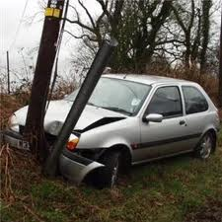
Loftus & Palmer (1974)

Slide 16
A little experiment...
You are going to watch some clips.
Please follow your instruction and record your answer on your piece of paper.
Show no one else

Slide 17
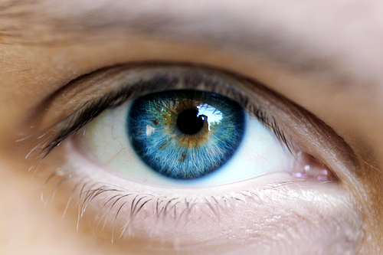
Eye Witness Testimony

Slide 18
Background
How accurate are our memories?
Can you change someone’s memories?
Bartlett’s research into reconstructive memory is largely qualitative – Loftus wanted to establish a quantitative measure of memory distortion.

Slide 19
Aims
Investigate the effects of language on memory.
Do leading questions influence our memory and recall.
Leading questions are ones which have a certain answer.
“Mr Hickman is the best, isn’t he?”

Slide 20
Method
Two Lab Experiments.
Independent Groups Design
IV?
DV?

Slide 21
Loftus & Palmer Experiment 1
The participants - 45 students in small groups
The procedure - Students watched film clips of car accidents.
Seven film clips between 5 and 30 seconds from a safety promotional film.
Shown in different orders to different groups.
Staged crashes so the speed of the vehicle was known.
Standardised questionnaires to be completed afterwards.

Slide 22
Write an account of what they had seen
Answer questions about what they had seen
One question was the critical question

Slide 23
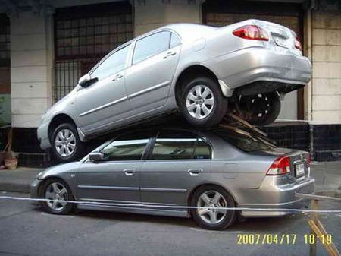
The Critical Question:
About how fast were the cars going when they (*******) each other?
There were five conditions (verbs) in the experiment (Five groups of students)

Slide 24
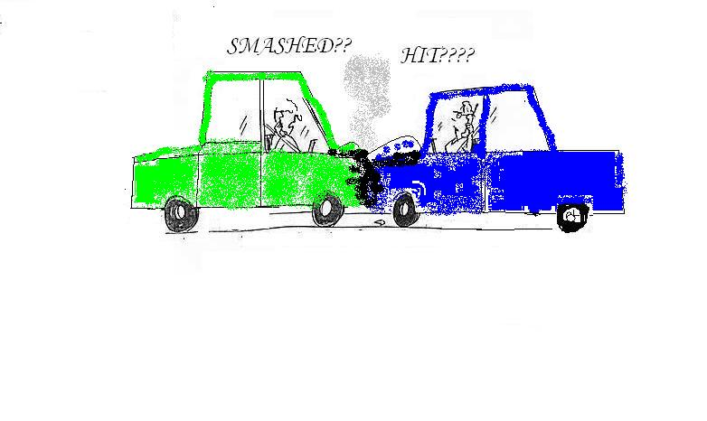
The five conditions (verbs) were:
  Contacted
  Hit
  Bumped
  Collided
  Smashed

Slide 25
Results – Experiment 1
Accuracy of speed estimates.
Impact of the ‘critical’ verb?
Film | Actual Speed | Mean
1 | 20 | 37.7
2 | 30 | 36.2
3 | 40 | 39.7
4 | 40 | 36.1

Slide 26
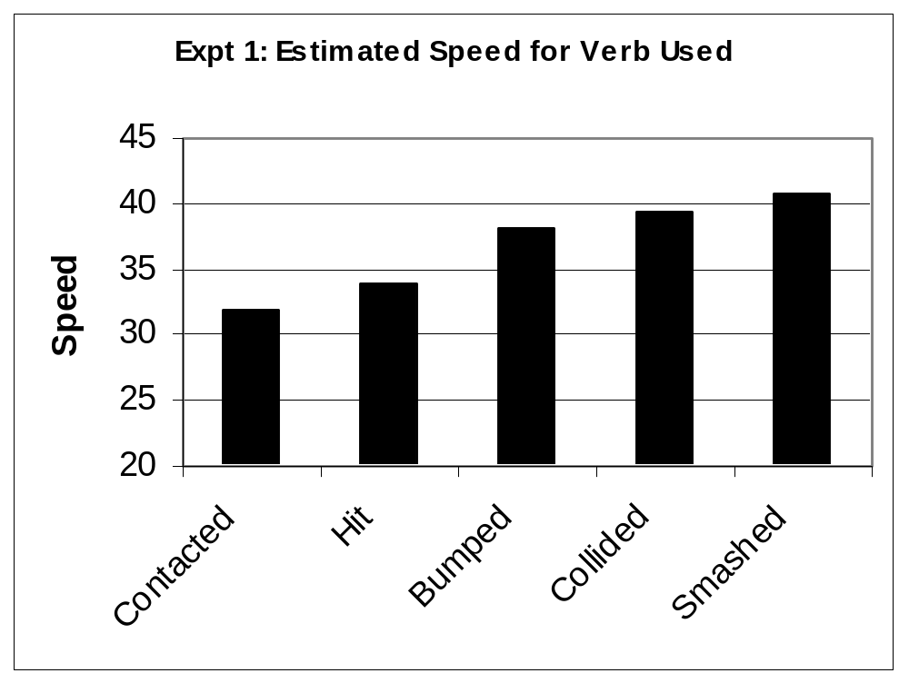

Slide 27
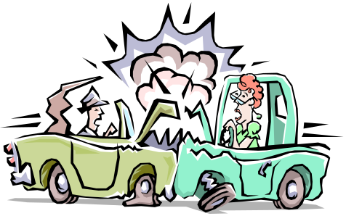
Loftus and Palmer suggest 2 explanations for the results of Experiment 1:
Response Bias: The different speed estimates occurred because the critical word (e.g. ‘smashed’ or ‘hit’) influences, or biases, a person’s response.
Memory is altered: The critical word changes a person’s memory so they actually ‘see’ the accident differently, i.e. more or less severe.
In order to prove this second point, L&P tested this in their second experiment – would people remember details that aren’t true?

Slide 28
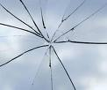
Eye Witness Testimony
The second experiment by Loftus & Palmer
Aim: To investigate whether participants who were asked the ‘smashed’ question were more likely to report seeing broken glass than those who were not.
Lab experiment
Independent Groups

Slide 29
Loftus & Palmer
Experiment 2
The participants - 150 students (three groups of 50 students)
The procedure - Students watched a one minute film which showed a 4 second multiple car accident

Slide 30
After the film the participants were divided into
3 experimental groups
Each subject completed two questionnaires – one straight after the film and one a week later

Slide 31
Loftus & Palmer
Experiment 2- Questionnaire 1.
Group 1 was asked:
“How fast were the cars going when they hit each other?”

Slide 32
Loftus & Palmer
Experiment 2 – Questionnaire 1
Group 2 was asked:
“How fast were the cars going when they smashed into each other?”

Slide 33
Loftus & Palmer
Experiment 2 – Questionnaire 1.
Group 3 was asked
no question about the speed of the cars

Slide 34
Loftus & Palmer
Experiment 2 – Questionnaire 2.
One week later...
The participants returned and were asked 10 yes or no questions about the incident including the critical question
“Did you see any broken glass?”

Slide 35
Results 1. Estimate of Speed
Subjects in the smashed condition gave higher speed estimates than hit
 | Speed of car
Smashed | 10.46mph
Hit | 8mph

Slide 36

Which group do you think ‘saw’ more broken glass?

Slide 37
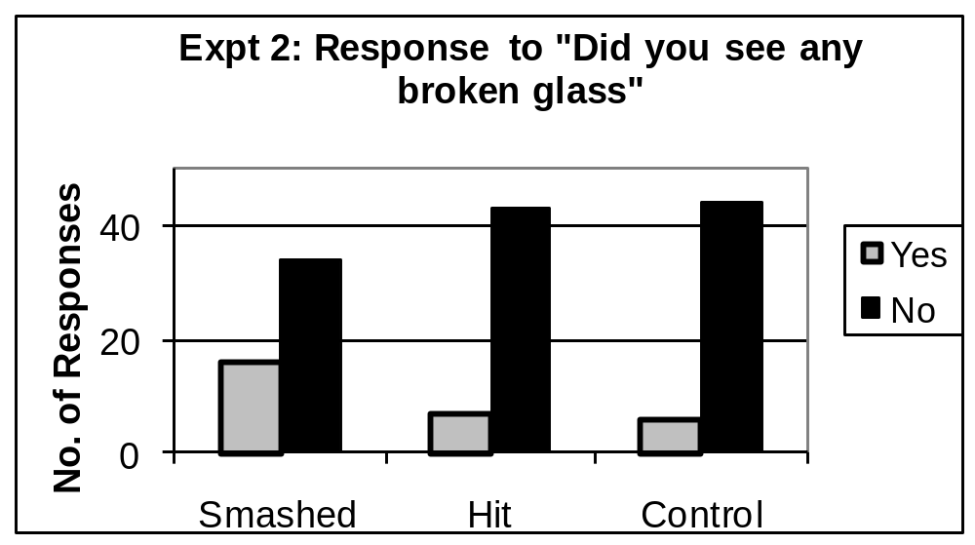
Loftus & Palmer
Experiment 2
The findings
Which group saw more broken glass?

Slide 38
Loftus & Palmer
Experiment 2
The findings
Which group saw more broken glass?
Response | Smash | Hit | COntrol
Yes | 16 | 7 | 6
No | 34 | 43 | 44

Slide 39
In Experiment 2 the results again showed that the way a question is asked can influence the answer given:
This however was not due to a response bias - as all participants were all asked if they had seen any broken glass.
This suggests that the leading question had actually altered the participants memory of the event.

Slide 40
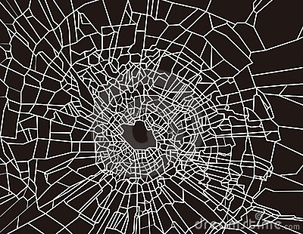
Evaluating the Loftus and Palmer Study

Slide 41
Recap Test
What were the 5 words in the primary experiment?
What was the dependent variable in the first experiment?
What were the three groups used in experiment 2?
What was the critical question in the second experiment?
How many participants took part in experiment 1?
How many participants took part in experiment 2
Which verb in the first experiment elicited the slowest (on average) speed estimates?

Slide 42
Loftus & Palmer - Criticisms
Was this research in any way unethical?
Did this research have ecological validity?
Was this a repeated measures design
or an independent measures design?

Slide 43
What do we consider when we evaluate a study?
Generalisability (G)
Reliability / Controls (R)
Application / Usefulness (A)
Validity (including Ecological) (V)
Ethics (E)
Research Method (R)

Slide 44
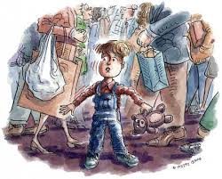
False memories can be created.
Loftus & Pickrell (1995)
Families provide 3 true stories of Pps childhoods and one false one is included about getting lost in a department store.
29% of participants remember the ‘false’ story with details.
https://www.youtube.com/watch?v=PQr_IJvYzbA

Slide 45
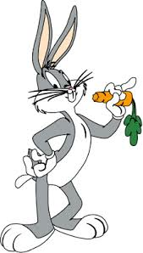
Loftus & Pickrell (2003) False Memories
120 students who had been to Disneyland - evaluate an advertising campaign.
30% who read advert with Bugs Bunny suggest they remember seeing him.
40% who read advert with bug bunny and saw a cardboard cutout saw him – with some claiming they saw Mickey and Bugs together.

Slide 46
How does anxiety influence recall?
Makes it worse.
Makes it better.

Slide 47
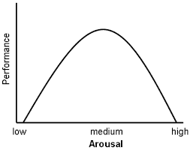
Yerkes-Dodson Inverted U-Hypothesis

Slide 48
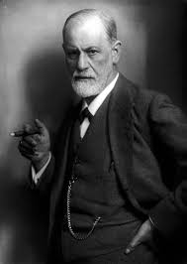
Repression
Traumatic events may be repressed and pushed into the unconscious.
Motivated forgetting acts as a defence against difficult memories.

Slide 49
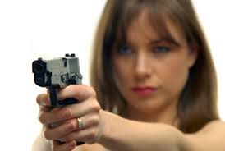
Loftus (1987) Weapon Focus
Lab Study
If a person has a weapon then our focus is on the weapon which reduces the accuracy of recall for face or other characteristics.

Slide 50
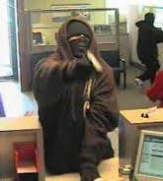
Christianson & Hubinette (1993)
Real Bank Robberies
Real Life Case Studies.
Recall of witnesses increased when in stressful situations.

Slide 51

Peters (1988) Injections
People having injections with nurse Vs People just meeting a researcher.
Better recall for the nurse.

Slide 52
Exam Question: How might anxiety influence recall?

Slide 53
Assessment Question
Describe and evaluate research into eyewitness testimony. [12]

Slide 54
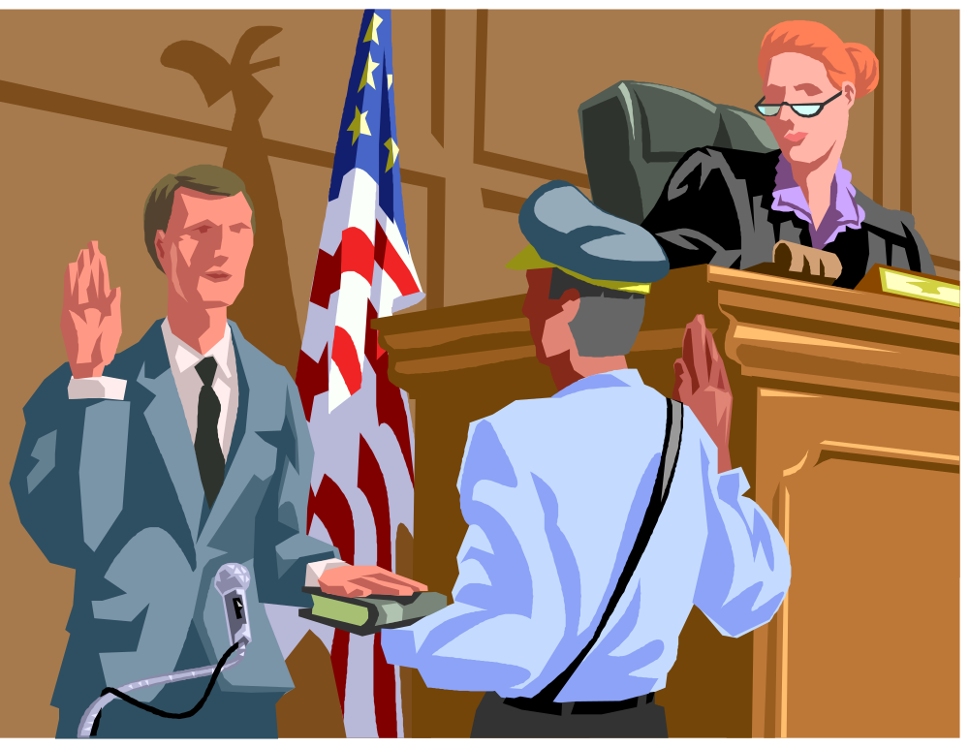
Why is eyewitness testimony important?
“I do solemnly, sincerely and truly declare and affirm that the evidence I shall give shall be the truth, the whole truth and nothing but the truth”
Eyewitness Testimony has been found to be only 60% reliable
yet is still admissible as evidence in a court of law.

Slide 55
What do we want?
What do we want from a good police interview?
  Accuracy
  Detail
  Increasing amounts of both
  What ideas have you learnt from memory and forgetting that might help police improve their practice?
https://www.youtube.com/watch?v=OOy_oP3ESQY

Slide 56
Key Terms
Cognitive Interview
Standard Police Interview
Enhanced Cognitive Interview
Modified Cognitive Interview
Encoding Specificity Theory
Confabulation

Slide 57
Cognitive Interview
(Fisher & Geiselman 1992)
Change of narrative order
Change of perspective
Context reinstatement
Reporting Everything
Uses memory cues to improve recall.
What types of question could be asked for each component?

Slide 58
Research: Geiselman (1985) Cognitive Interview.
Cognitive Interview
Standard Interview
Hypnosis
CI produces more effective recall than other techniques especially when used soon after the incident.

Slide 59
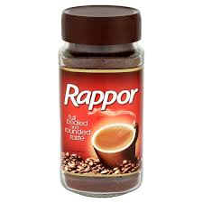
Enhanced Cognitive Interview
(Fisher & Geiselman 1987)
Importance of Rapport
No interruptions
Flow
Open-ended questions
Speak slowly
Do not guess
Reduce anxiety

Slide 60
Memom (2010) Meta-Analysis
Overview of 57 different studies on the effectiveness of CI.
CI produce more accurate detailed information than other methods.
Less confabulations.
More effective than SPI.

Slide 61
Exam Questions
Describe the key features of the enhanced cognitive interview. [6]
Describe research relevant to the enhanced cognitive interview. [6]

Slide 62
Just A Minute
In pairs you must prepare a speech on the research by Loftus and Palmer.
  One minute long (you will need to practise and time yourself)
  No repetition ( you cannot repeat any words)
  No hesitation (you must practice so you are fluent)
  No deviation (you must stay focused on the study)
Let’s see how well you do!

Slide 63
False Memories
How easy is it to get you to remember something that never happened?
Really easy?
A bit easy?
Quite difficult?
Impossible?

Slide 64
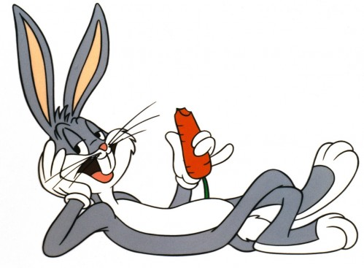
Loftus and Pickrell and Bugs Bunny
Read through the study.
Create 10 true/false statements.
Test your partner.
Swap your statements.

Slide 65
GRAVER
You have two GRAVER sheets.
Label one Loftus and Palmer and one Loftus and Pickrell (or car crash vs bugs bunny).
Complete one section e.g. ethics
Pass your sheet to the left.
Complete another section.
Repeat
Find your original sheet.
Read what others have written. If you disagree then write your view in a different colour.
Feedback.

Slide 66
Thinking
What did you learn today?
How are you going to remember what you learned today?
What did you learn that you didn’t know before?
What have you learned that could be useful elsewhere?

