Slide 1

3.3 Explanations of attachment
Learning Theory
Vs
Evolutionary Theory

Slide 2
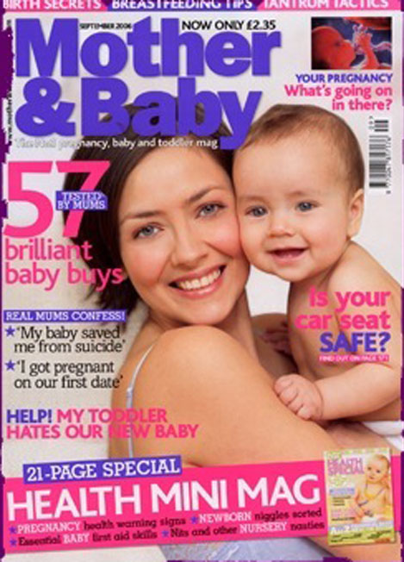
Maccoby (1980) identified four characteristics of attachment:

Slide 3
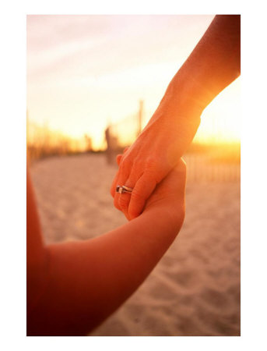
The infant seeks proximity, trying to stay near the caregiver

Slide 4
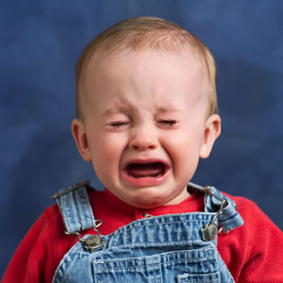
Both the infant and caregiver feel distressed when separated.

Slide 5

Both the infant and caregiver feel pleasure when reunited
http://www.youtube.com/watch?v=wDZUfGBUSeY

Slide 6
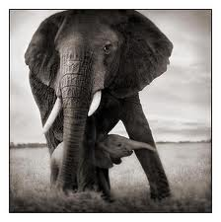
The infant is generally always aware of the caregiver and makes frequent contact.

Slide 7
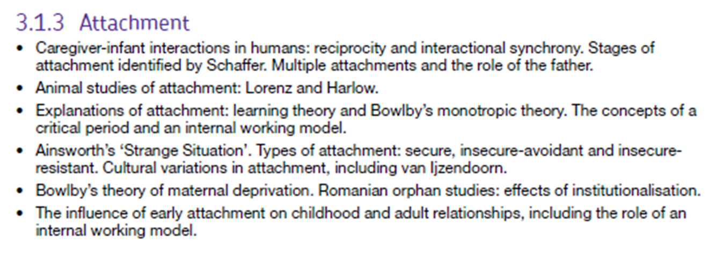
The Specification!

Slide 8
Starter review – How do Babies Attach?
If this is the answer – what was the question?
Shaffer’s Stages of Attachment
Imprinting
Critical Period
Sensitive Period
Cloth Comfort

Slide 9
Recap: The Role of Fathers
True or False Activity

Slide 10
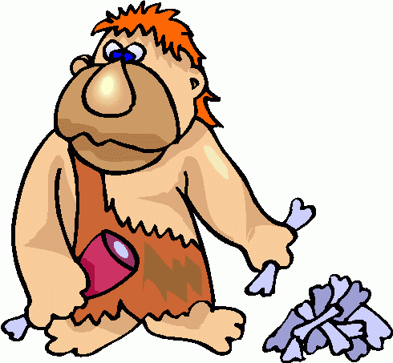

Attachment
Evolutionary perspective
Learning Theory Perspective
The tendency to form attachments is
INNATE!
Tendency is present in both infants
and mothers
Infants have no INNATE tendency to
form attachments
They learn attachments because of food

Slide 11
Learning Theory: Basic Assumptions
All behaviour is learnt through experience via the process of association.
Attachment – infant learns to associate caregiver with food.
Cupboard Love Theory

Slide 12
Classical Conditioning – Key Concepts
Conditioning
UCS
UCR
CS
CR

Slide 13
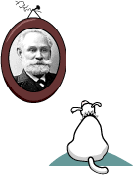
Ivan Pavlov1849-1936
http://www.simplypsychology.pwp.blueyonder.co.uk/pavlov.html

Slide 14
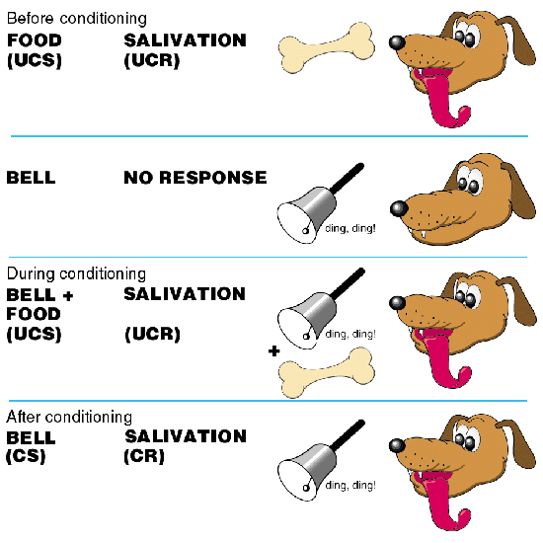
Pavlov’s Dogs
Activity:
Create your own version of this that would explain attachment in babies

Slide 15
Key Terms:
Unconditioned stimulus (UCS)
The stimulus that produces a reflex response.
Unconditioned response (UCR)
The reflex response to a UCR
Conditioned Stimulus (CS)
Conditioned Response (CR)
Dog Food
Salivation
a new stimulus presented with the UCS
Bell
the response which is learnt
Drooling at bell.

Slide 16
“You don’t have to be at home to be an attachment parent”
Learning Theory: the belief that attachments develop through conditioning processes.
Classical conditioning: when a response produced naturally by a certain stimulus, becomes associated with another stimulus that is not normally associated with that particular response

Slide 17
Key Words
Learning Theory: the belief that attachments develop through conditioning processes.
Classical conditioning: when a response produced naturally by a certain stimulus, becomes associated with another stimulus that is not normally associated with that particular response.
Operant Conditioning: learning occurring via reinforcement of behaviour, thus increasing the chances of the behaviour occurring again.
Cupboard Love Theory: the belief that attachments are formed with people who feed infants.

Slide 18

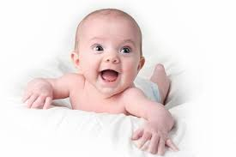



Classical Conditioning

Slide 19

Result

Slide 20
Operant Conditioning – Key Concepts
Positive Reinforcement
Negative Reinforcement
Punishment
Law of effect

Slide 21
Thorndike (1898) Cat Puzzle Box
A: To investigate the effect of consequences on learned behaviour.
M: He created a puzzle box for a cat. He observed what happened.
R: He noticed that a hungry cat would learn how to open the box and get to the food (reward)
C: The cat had learnt to associate opening the box and getting a pleasant

Slide 22
Thorndike’s – Law of Effect
Behaviours that are followed by rewards are usually repeated.
“If a certain response has pleasant consequences, it is more likely than other responses to occur”

Slide 23
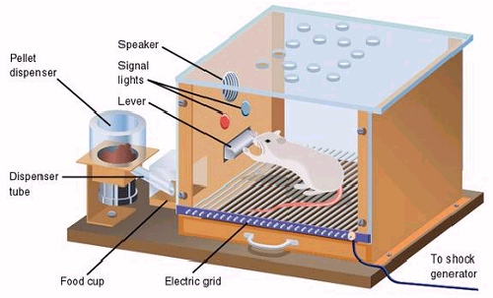
Skinner’s Box

Slide 24
Skinner’s Key Concepts
Punishment
Weakens behaviour because it is unpleasant and we try to avoid it.
Reinforcement
A consequence of behaviour that encourages or strengthens a behaviour.
Positive Reinforcement
A reward or pleasant consequence that increases the likelihood that a behaviour will be repeated
Negative Reinforcement
When an unpleasant experience is removed after a behaviour has been performed. This makes it more likely that the behaviour will be repeated.

Slide 25
Burrhus F. Skinner Operant Conditioning
Humans are not passive, they do not wait around for stimuli - they engage with their environments.
Behaviour is determined by the consequences of past behaviour.
consequence | What it involves | Behaviour
Positive Reinforcement (REWARD) | Something it likes (food) | strengthened
Punishment | Something it does not like (electric shock to paw) | weakened
Negative Reinforcement | Something it does not like (electrify the floor) | strengthened

Slide 26
Activity : Operant Conditioning
Create a flow diagram to explain how the following could be used to strengthen the attachment bond.
Being Fed
Hugs when crying
Being Ignored

Slide 27
Evaluation of Learning Theory
Learning theory is reductionist. Attachment is a complex behaviour with an emotional and cognitive component.
Babies attach to adults who do not necessarily feed them.
Babies do not live to eat but eat to live – they actively seek stimulation not passively receive nutrition.
Babies need constant emotional security not food.

Slide 28
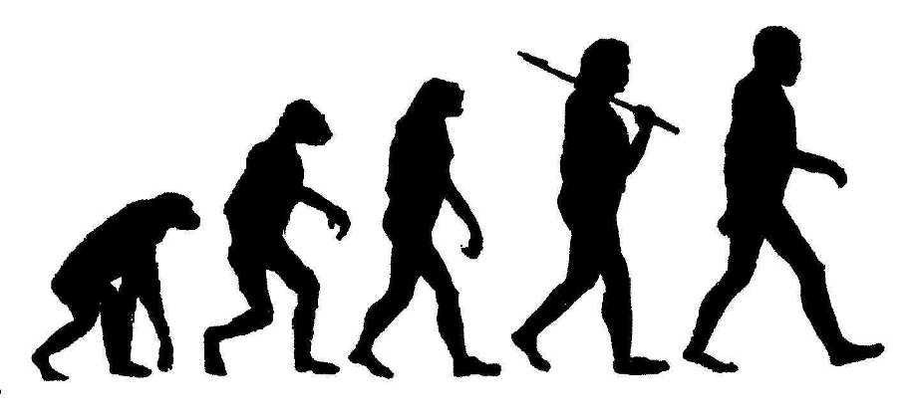
Today we are going to look at….
Evolution

Slide 29
What is evolution?

Slide 30

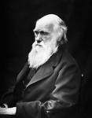

Darwin’s Dangerous Idea
Darwin (1859) publishes "On the Origin of Species by Means of Natural Selection".

Slide 31
Evolution is…
Evolution is a process whereby useful features are introduced in the species.
Features are useful if they help the animal survive long enough to reproduce.
To survive and reproduce animals need to be well adapted to their environment
Useful features are therefore called ADAPTIVE

Slide 32
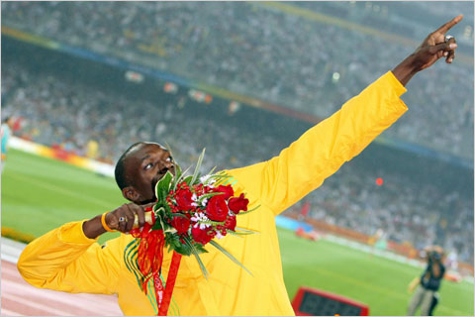
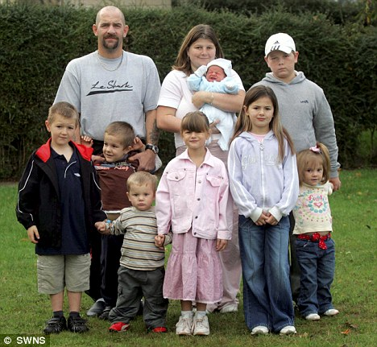

What does “SURVIVAL of the
FITTEST” mean?

Slide 33
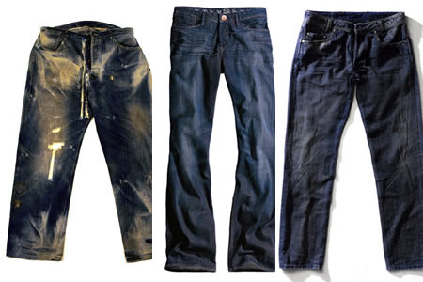
FUTURE
GENERATIONS

Slide 34

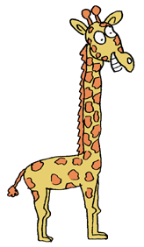
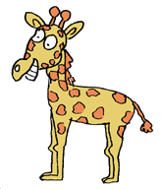
Fitness

Slide 35

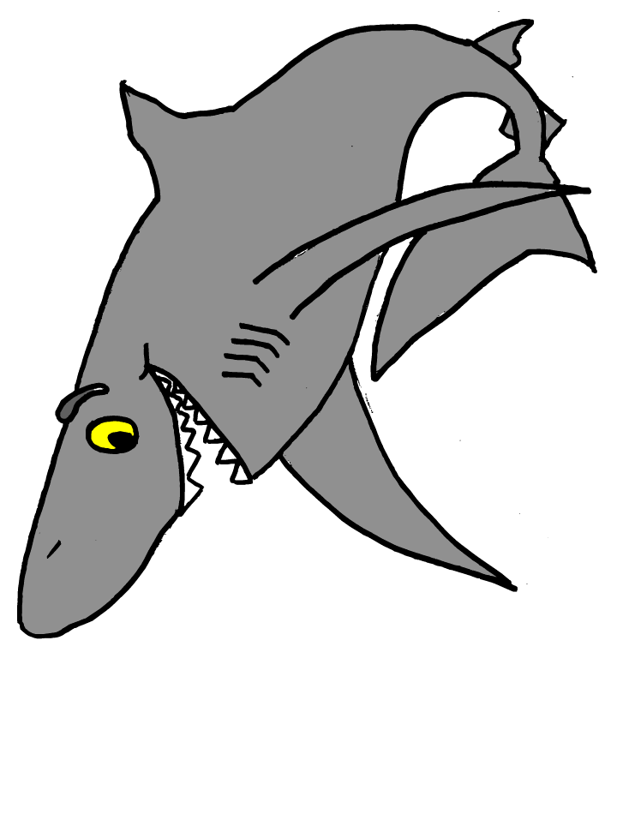
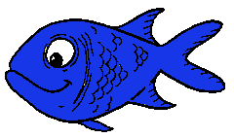
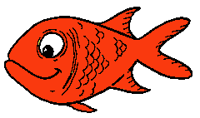
Fitness
Yummy!

Slide 36

Fitness: Which ones will survive
Arse.
Arse.
Damn.

Slide 37
Evolution & Psychology Activity
  Use evolutionary psychology to explain the following behaviour:
  Rooting Reflex
  Friendships - our need to be social beings
  Fight or Flight
  Sporting Prowess
  Altruism (helpfulness)
  Musical ability
  Fashion sense
  Humour

Slide 38
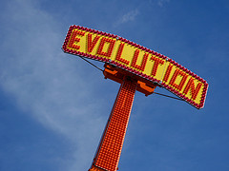
What has evolution got to do with attachment?

Slide 39
Evolution theory basically sees attachment as an animals instinct
What is the instinct?

Slide 40
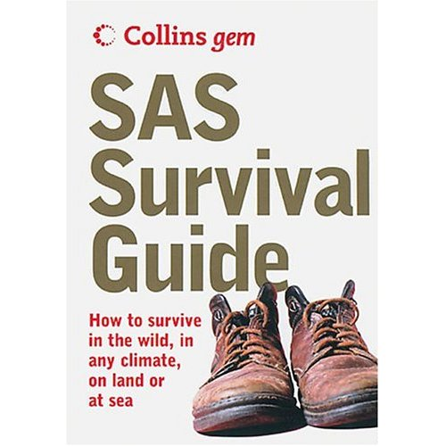
Bowlby (1969) suggested that attachment was important for survival!!!

Slide 41
How would attachment help with
an infants survival?
Discuss…

Slide 42
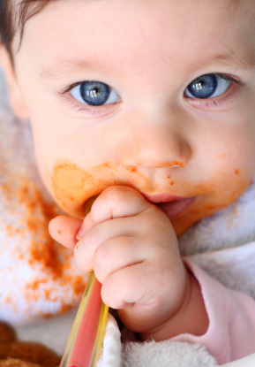
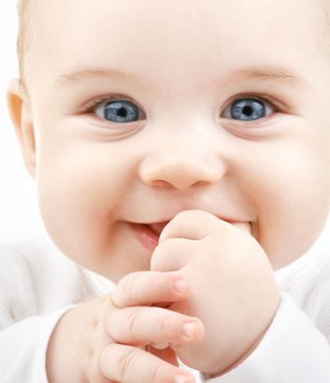
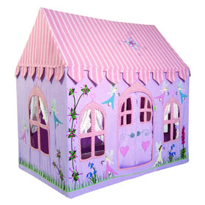
Forming an attachment may give a newborn an advantage over a newborn
that does not form an attachment, by ensuring a good source of food and
protection from harm

Slide 43
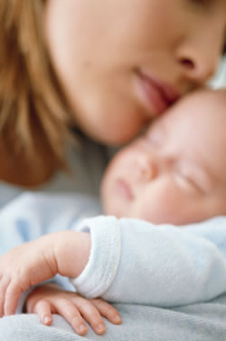
Why would biological parents have an instinct
to form an attachment with their young?
Discuss…
(Think about previous slides)

Slide 44

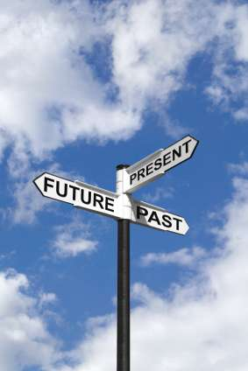
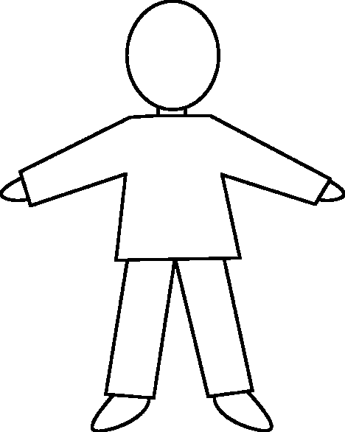
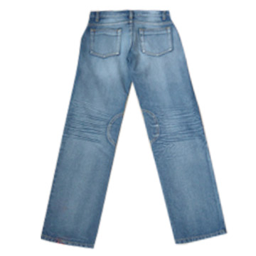
Biological Parents
It is their instincts to form an attachment too. If
this happens, then the child (who carries the
parents genes) will hopefully reproduce and
pass on their genes to the next generation.

Slide 45
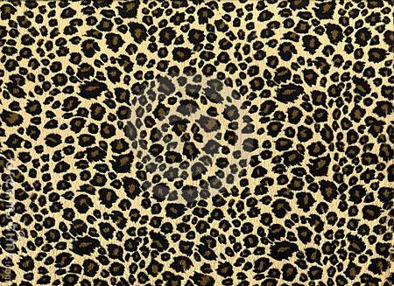
Animal Research
Attachment

Slide 46



Imprinting

Slide 47
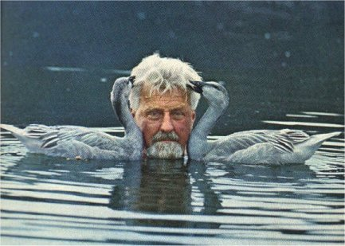
Lorenz (1935)

Slide 48
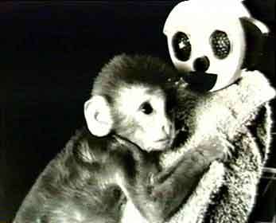
Harlow’s Monkeys

Slide 49
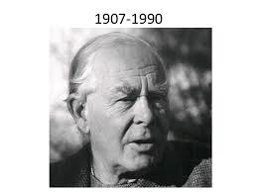
Attachment is a form of human imprinting

Slide 50
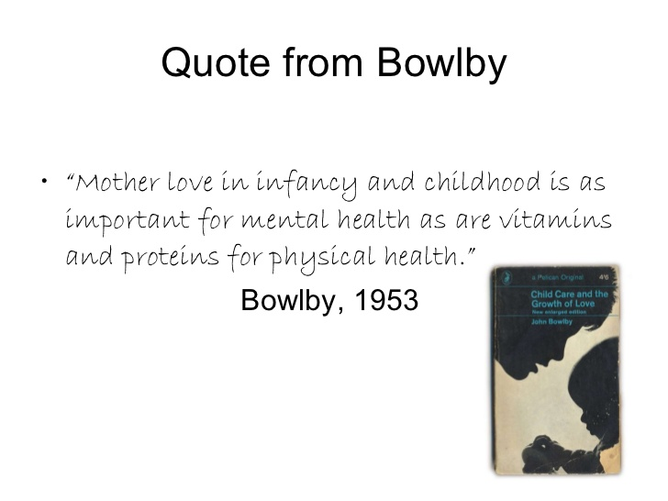

Slide 51
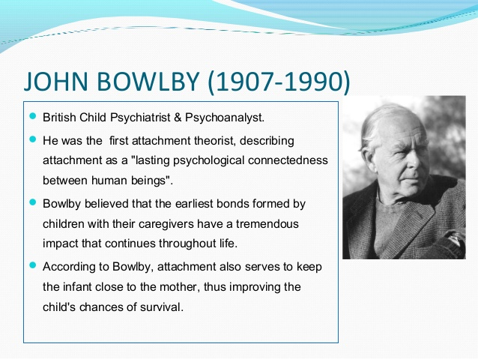

Slide 52
Bowlby’s Monotropic Theory
Evolutionary explanation of attachment.
Influenced by classic animal studies of Lorenz and Harlow.
Monotropic theory – infants have an innate tendency to make an attachment with one attachment figure, usually the mother.

Slide 53
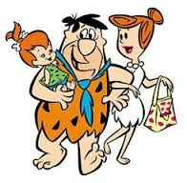
Emotional bonds have evolutionary functions.
Emerged in stone-age
Evolved through natural selection so offspring would stay close to their caregivers.
Genetically programmed behaviour to ensure species survival.

Slide 54
Bowlby’s Monotropic Theory
Social releasers
Critical time period
Internal working model

Slide 55
Social Releasers
Infants and carers have innate programming to become attached, these characteristics are called social releasers.
Crying
Smiling
Clinging
So, social releasers elicit caregiving in other people, it is adaptive for babies to display these behaviours because it ensures their own survival.
Hearing a baby cry makes us uncomfortable so we are driven to care for the baby so that it will stop crying. We like seeing a baby smile and we automatically smile back. Humans are innately programmed to respond to such behaviours because it is adaptive, it ensures the survival of the baby and therefore our own genes.

Slide 56
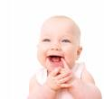

How do you respond to a baby laughing?
https://www.youtube.com/watch?v=bk0erH6bQqI

Slide 57

Babies crying
https://www.youtube.com/watch?v=7hS08XsI6Vg

Slide 58
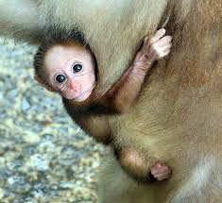
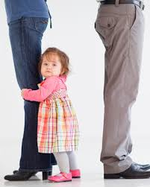
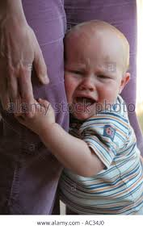
Babies following and clinging

Slide 59

Critical period
Stemmed from the work of ethologists e.g. Lorenz – imprinting.
A period in development during which an individual is especially impressionable
(a window of opportunity)
Bowlby believed an att. must form within the first 3 years of a child’s life.

Slide 60
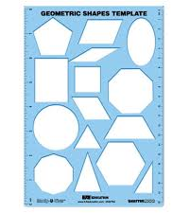
Internal working model
“Love in infancy is as important for mental health as vitamins and proteins for physical health”

Slide 61
Internal Working Model
The monotropic attachment is unique; it is the first to develop and the strongest bond of all.
Forms a model / template / blueprint for all future relationships.
Continuity hypothesis – there is consistency between early emotional experiences and later relationships.

Slide 62
Evaluation
Research evidence– Lorenz – Shaffer & Emerson (one primary attachment).
Used by New Right to keep women in the home.
Animals are different to humans – animals born mobile to maybe imprinting more important.
Attachment requires more than mere exposure to primary attachment – sensitive response.
Fathers seen as secondary or minor attachment figures – Fathers can be attachment figures in their own right.

Slide 63
Exam Questions:
Explain what is meant by internal working model. (3 marks)
Explain what is meant by monotropic theory of attachment. (2 marks)
Outline Bowlby’s theory of attachment, include reference to the critical period and internal working models. (6 marks)
Outline two criticisms of learning theory as an explanation of attachment. (4 marks)
Outline and evaluate learning theory as an explanation of attachment. (12 marks)
Describe and evaluate Bowlby’s monotropic theory of attachment. (12 marks).

Slide 64
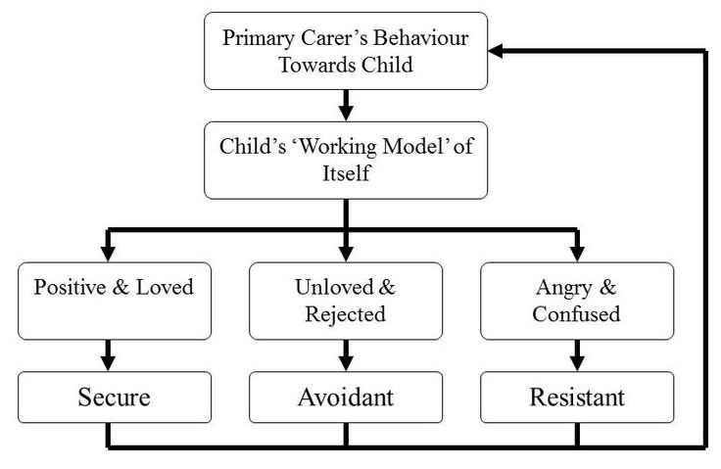
Next Week …

Slide 65
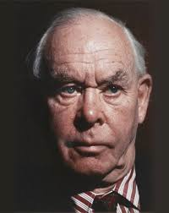
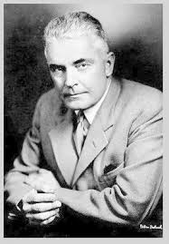

Bowlby Vs Learning
Theory
In the red corner . . . .
In the blue corner . . . .

Slide 66
Round 1
Who uses argues attachment is due to cupboard love’?

Slide 67
Round 2
Who suggests attachment is a human form of imprinting?

Slide 68
Round 3
Whose theory ignores the emotional part of attachment?

Slide 69
Round 4
Who was inspired by Lorenz and Harlow?

Slide 70
Round 5
Who said …“If a certain response has pleasant consequences, it is more likely than other responses to occur”

Slide 71
Round 6
Who was inspired by Lorenz and Harlow?

Slide 72
Round 7
Explain what is meant by social releasers?

