Slide 1
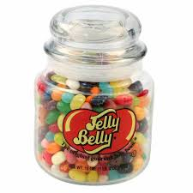
How many Jelly Beans in my Jar.
Starter
Procedure:
Make a private estimate – write it down do not show anyone else?
In small groups – discuss your estimate and establish a group estimate. Share with whole class.
Make a second private estimate

Slide 2
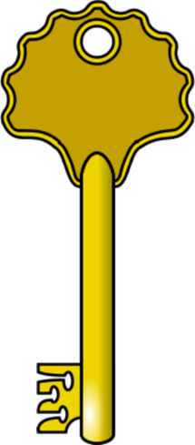

Conformity- Types and Explanations Lesson 1
Key words:
Conformity
Compliance
Identification
Internalisation
Informational Social Influence
Normative Social Influence
To understand the different types of conformity
To be able to explain conformity in terms of informational social influence and normative social influence.
To evaluate using research, explanations of conformity

Slide 3
Specification
1.1 | Types of conformity | internalisation, identification and compliance.
1.2 | Explanations for conformity | informational social influence and normative social influence, and variables affecting conformity including group size, unanimity and task difficulty as investigated by Asch.
 | Conformity to social roles | investigated by Zimbardo
 | Explanations for obedience | agentic state and legitimacy of authority, and situational variables affecting obedience including proximity, location and uniform, as investigated by Milgram.
 | Dispositional explanations for obedience | the Authoritarian Personality
 | Explanations of resistance to social influence | including social support and locus of control
 | Minority influence | including reference to consistency, commitment and flexibility
 | The role of social influence processes in social change | application of the above research to examples of social change e.g. suffragettes, Rosenstrasse Protest, racial equality, abolition of slave trade etc

Slide 4
Key Questions
1. What is conformity?
2. Why do people conform?
3. What different types are there?
4. Give examples of everyday life that can be seen as conformity.
5. Is conformity a good or bad thing? Make an argument either way? Justify your answer.
1.1 Conformity
Group Activity
Watch the following clip
https://www.youtube.com/watch?v=BgRoiTWkBHU

Slide 5
What does conformity look like?
1.1 Conformity

Slide 6
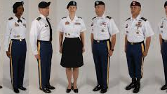

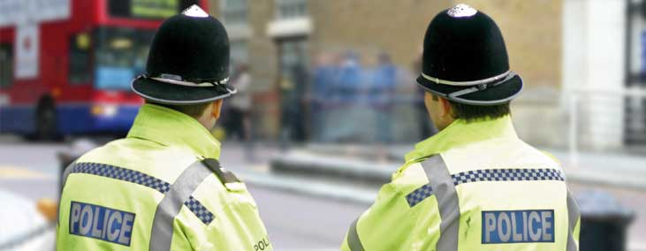
Uniform

Slide 7
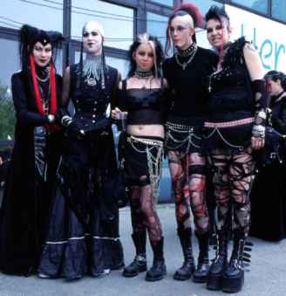


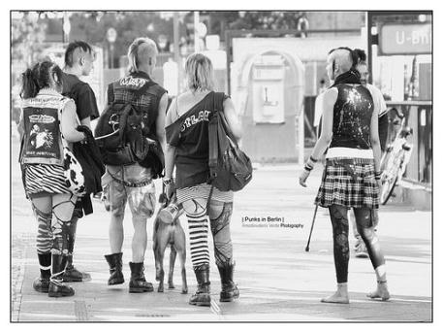
Fashion

Slide 8
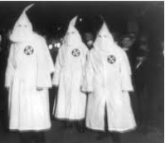
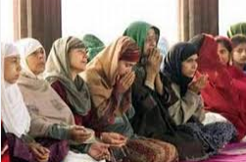
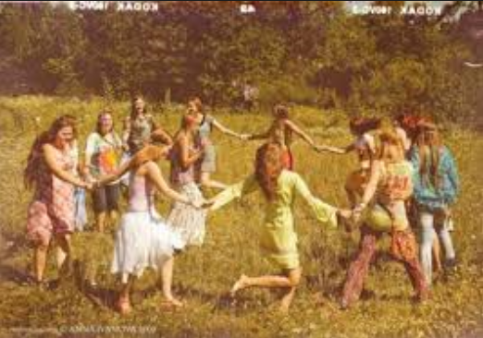

Belief

Slide 9
Social Influence

Slide 10
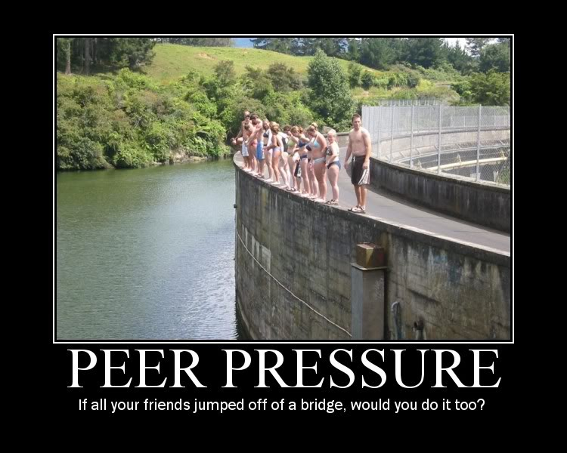

Slide 11
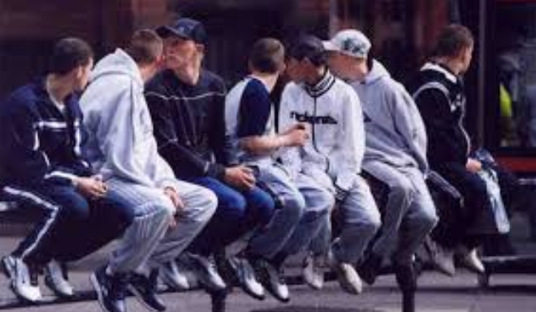
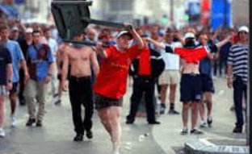

Behaviour

Slide 12

Conformity (Majority Influence)
1.1 Conformity
“Yielding to group pressure”
A change in a persons behaviour or opinions as a result of real or imagined pressure from a person or group of people.

Slide 13
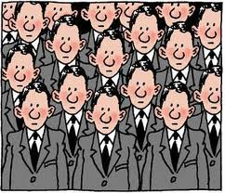
Kelman (1958)
There are different
types of conformity:
Compliance
Identification
Internalisation
Shallow Level
Deep Level

Slide 14

Compliance
1.1 conformity
Compliance is when you just go along with what others are doing.
The behaviour is simply to fit in with a group and once away from the group, behaviour and opinions will be back to ‘normal’.
Real life example: Laughing at a joke you don’t find funny.

Slide 15
Identification
1.1 conformity
Sometimes a person conforms to the behaviours of a group because membership of the group is desirable.
Public and private acceptance of majority influence in order to gain group acceptance.
You are publically part of a group but privately you may behave differently.
Real life example: Football team
School uniforms, work uniforms etc.

Slide 16
Internalisation
1.1 conformity
This is when a person genuinely believes and accepts a group norm. This would be publicly and privately as the views, behaviour and beliefs become part of the way they think.
The behaviour and beliefs are present even when not with the group.
Real life example: Religion, Vegetarianism

Slide 17
Internalisation, identification or compliance?
1.1 Conformity
Jamie always wears smart shoes but found out that at college most boys wear trainers. He decided to buy a pair of trainers and only wear them when he is in college.
Katie spoke to her local MP about Labour policies; she now is campaigning for Labour
James puts his coat in the cloakroom despite wanting to take it into the restaurant.
Identification
Internalisation
Compliance

Slide 18
Real-life application
1.1 Conformity
Schutz et al (2008) found they were able to change the behaviour of hotel guests by using printed messages encouraging them to save energy. The messages that suggested other guests were using fewer bath towels were most successful.
Question: Is this ISI or NSI?
Explain your answer

Slide 19
1.2 Explanations for Conformity
 | Types of conformity | internalisation, identification and compliance.
1.2 1.3 | Explanations for conformity | informational social influence and normative social influence, and variables affecting conformity including group size, unanimity and task difficulty as investigated by Asch.
 | Conformity to social roles | investigated by Zimbardo
 | Explanations for obedience | agentic state and legitimacy of authority, and situational variables affecting obedience including proximity, location and uniform, as investigated by Milgram.
 | Dispositional explanations for obedience | the Authoritarian Personality
 | Explanations of resistance to social influence | including social support and locus of control
 | Minority influence | including reference to consistency, commitment and flexibility
 | The role of social influence processes in social change | application of the above research to examples of social change e.g. suffragettes, Rosenstrasse Protest, racial equality, abolition of slave trade etc

Slide 20
Explanations of Conformity
1.2 conformity
The specification requires you to be able to describe and evaluate two explanations of conformity.
  Normative social influence
  Informational social influence
Explanations – Why do we conform?

Slide 21

Informational social influence
1.2 conformity
You want to be right! Right?
It’s a cognitive process and to do with thinking
This is based on the idea that you need information in order to be right. If everyone is doing a particular thing, this may be the right thing to do and therefore you conform.
ISI usually occurs when a person is new to a situation and wants to do the right thing, the situation is ambiguous and you look for what is right or in times of crisis.
You tend to look for an expert to see what they would do.

Slide 22
Examples of ISI
1.2 conformity
Your in class and are asked to write your answer on your whiteboard but you don’t know the answer. You look at other peoples boards for help. (ISI)
The road is shut due to fire. Everyone is running down a side street, including emergency services. You follow. Why?

Slide 23
Normative Social Influence
1.2 conformity
You want to be liked? Want to fit in?
NSI is concerned with emotion. Humans have a desire to be accepted and fear rejection.
Following social norms is a way of being accepted. Social norms are things society deem acceptable.
NSI usually occurs when you seek the approval of strangers. Perhaps in an interview or the first day at a new job.

Slide 24

Examples of NSI
1.2 conformity
In an interview waiting room, everyone is reading through their CVs, application forms etc. To fit in, you take out your documents.
Can you think of more?
https://www.youtube.com/watch?v=KAOmTMCtGkI

Slide 25
Research Evidence.
Informational Social Influence – Jenness (1932) Jelly Beans.
Majority Influence – Asch (1952)
Conformity – Mori & Arai (2010)

Slide 26
Exam Questions
1.1 & 1.2 conformity
In the context of conformity, explain what psychologists mean by the term identification. (2 marks)
One type of conformity is internalisation. Explain what psychologists mean by the term internalisation. (2 marks)
Outline normative social influence as an explanation for conformity (2 marks)
Internalisation, identification and compliance are all types of conformity. Outline one difference between any two of these. (2 marks)
Describe and evaluate informational social influence and normative social influence as explanations for conformity. Refer to evidence in your answer. (12 marks)

Slide 27
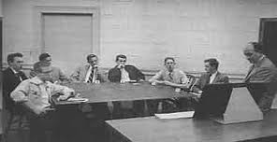
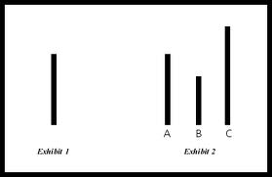
Study of Majority Influence
Asch (1955)
Make notes on:
procedure, findings,
conclusion, evaluation

Slide 28
Asch video clip
Asch (1955)
http://www.youtube.com/watch?v=iRh5qy09nNw
Shorter version
(~2 mins)
http://www.youtube.com/watch?v=TYIh4MkcfJA&feature=related
Longer version
(~4 mins)

Slide 29

AIM
Asch (1955)
To investigate the degree to which individuals would conform to a majority who gave obviously wrong answers.

Slide 30

Procedure
123 male American undergraduates recruited for a ‘vision test’
In each experiment all but one were confederates
In turn, participants and confederates were asked to state which of three lines was the same length as a stimulus line.
The real participant always answered last or second to last
Confederates would give the same incorrect answer for 12 out of 18 trials
Control group of 36 participants who were tested individually to see how accurate individual judgements were.

Slide 31
Findings
In a control trial, only 0.04% of responses given by participants were incorrect
For 12 critical trials 32% of responses given by participants were incorrect.
75% conformed to at least one wrong answer.
25% of participants never conformed.
5% conformed to all 12 wrong answers.

Slide 32
Why? Post Experiment Interviews
Findings
When asked why they conformed, participants often gave one of three answers:
Distortion of perception
  Participants actually started to perceive the line differently
Distortion of judgement
  Feelings of doubt about their judgement
Distortion of action
  Majority continued to trust their own perception and judgement but changed their behaviour to avoid disapproval

Slide 33
Conclusions
Most people were motivated by NORMATIVE SOCIAL INFLUENCE.
Individual judgement is influenced by majority opinions, even when the majority are obviously wrong.
This is known as the Asch Effect.

Slide 34
Evaluation
☺
Paradigm of conformity research. Established a scientific procedure.
☹
Child of its time – Perrin & Spencer (1980) UK students only 1 in 396 trials conformed.
Lacks generalisability?
Lacks ecological validity – artificial situation and task. Demand characteristics.
Unethical – participants are deceived – participants are psychologically stressed.
2/3 of participants do not conform.

Slide 35
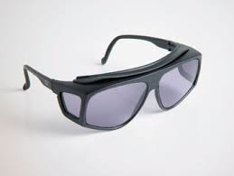
Contemporary research
Mori & Arai (2010)
Asch without the actors.
To combat the criticism of demand characteristics, this study uses real participants with overlapping filter glasses which change the participants view of the stimulus only.
Minority participants answered incorrectly 19.6% of the time compared with control of 8.2%.

Slide 36
Question: What impact would you expect the following to have on levels of conformity?
Variations
Group Size
Unanimity
Task Difficulty
Individual Differences

Slide 37
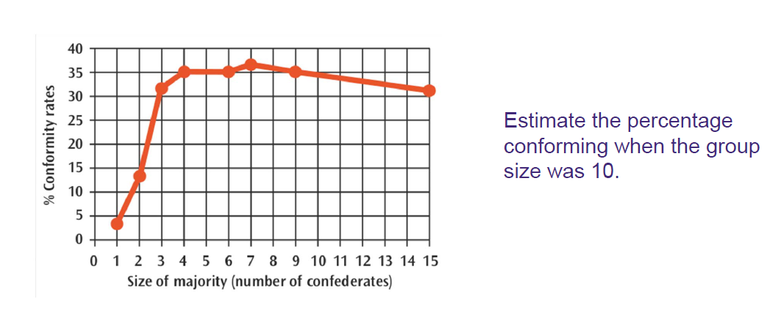
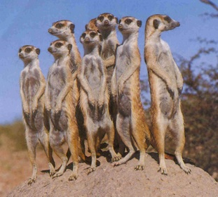
Variations – Size of the Majority
Group Size
Conformity low when majority consisted of one or two
With majority of three, conformity rose to 30%
Further increases did not substantially increase conformity

Slide 38

Variations – Unanimity of the Majority
Unanimity
When participant was joined by another real participant or disaffected confederate, conformity fell from 32% to 5.5%
If the dissenter gave a different wrong answer conformity fell to 9%
  Asch concluded: breaking the group’s consensus important to reduce conformity
    Abu Ghraib – Private Joe Darby

Slide 39
Task Difficulty
Q
A B C
Differences between the lines were made smaller
Conformity increased
When task is ambiguous we look to other people for guidance INFORMATIONAL SOCIAL INFLUENCE.
Lucas et al. (2006)
  Conformity is moderated by self-efficacy of the individual
  E.g. When exposed to maths problems, individuals confident in their abilities remained more independent
  Demonstrates both situational (task difficulty) and individual differences (self-efficacy) determine conformity

Slide 40
Individual Differences
Gender – Do women conform more than men?
Mood – Do anxious people conform more than calm people?
Culture – Do people from collectivist cultures conform more than those from individualist cultures?

Slide 41
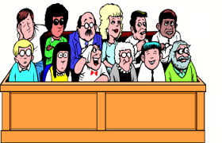
Real-World Applications
Conformity in juries
  Many jurors would not want to appear to have a different attitude to their fellow jurors
Tanford and Penrod, 1986
  1st vote of the jury determines the outcome 95% of the time
  Suggests conformity pressure is a real issue in juries
    How could this be reduced?

Slide 42
Quick quiz:
Plenary Questions
What are the three different types of conformity?
How many participants were there in Asch’s study? What gender?
What percentage of the responses were incorrect?
What percentage of the population never conformed?
Conformity increased when the line lengths were closer or farther apart?
The size of the majority must be more than what for individuals to conform?
Do men or women conform more?

Slide 43
1.3 Exam Questions
One variable that affects conformity is unanimity. Explain what is meant by unanimity in relation to conformity. (2 marks)
Apart from unanimity, identify TWO variables that have been shown to affect conformity. Briefly outline how each of these variables affects conformity. Refer to evidence in your answer. (6 marks)
Describe Asch’s study of conformity. (6 marks)
Describe and evaluate Asch’s research into conformity. (12 marks)

